Slide 1
Essential Questions
What are physical and chemical properties?
What are the differences and similarities of physical and chemical changes?
How does the law of conservation of mass apply to chemical changes?
Properties of Matter
Copyright © McGraw-Hill Education

Slide 2
Vocabulary
Review
boiling point
New
physical property
physical change
distillation
chemical property
chemical change
law of conservation of mass
Properties of Matter
Copyright © McGraw-Hill Education

Slide 3
Physical Properties
Any characteristic of a material that you can observe without changing the identity of the substances that make up the material is a physical property.
Examples of physical properties are color, shape, size, density, melting point, and boiling point.
Properties of Matter
Copyright © McGraw-Hill Education

Slide 4
Appearance
The appearance of substances is a physical property. How would you describe a basketball? You could begin by describing its shape, color, and state of matter. You can measure some physical properties such as measuring the diameter of the ball.
Properties of Matter
Copyright © McGraw-Hill Education

Slide 5
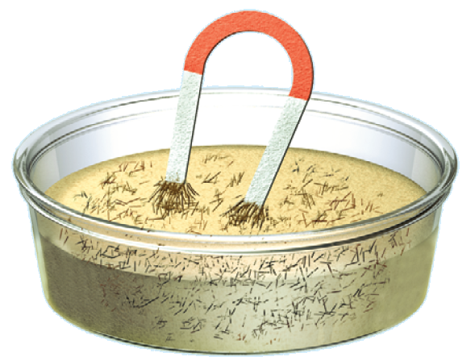
Behavior
Some physical properties describe the behavior of a material or a substance. Attraction to a magnet is a physical property of the substance iron. Every substance has a specific combination of physical properties that make it useful for certain tasks.
Properties of Matter
Copyright © McGraw-Hill Education

Slide 6
Using physical properties to separate mixtures
The best way to separate substances depends on their physical properties. Size is one physical property often used to separate substances.
Look at the mixture of iron filings and sand shown. You probably won’t be able to sift out the iron filings because they are similar in size to the sand particles. You can pass a magnet through the mixture. The magnet attracts only the iron filings and pulls them from the sand. This is an example of how a physical property, such as magnetic attraction, can be used to separate substances in a mixture.
Properties of Matter
Copyright © McGraw-Hill Education

Slide 7
Physical Change
The identity remains the same
A change in size, shape, or state of matter is called a physical change. These changes might involve energy changes, but the kind of substance—the identity of the element or compound—does not change.
Iron is a substance that can change states if it absorbs or releases enough energy—at high temperatures, it melts. Color changes can accompany a physical change, too. For example, when iron is heated it first glows red. Then, if it is heated to a higher temperature, it turns white.
Properties of Matter
Copyright © McGraw-Hill Education

Slide 8
Using physical changes
Many such areas that lie close to the sea obtain drinking water by using physical properties of water to separate it from the salt. One of these methods, which uses the property of boiling point, is a type of distillation.
Properties of Matter
Copyright © McGraw-Hill Education

Slide 9
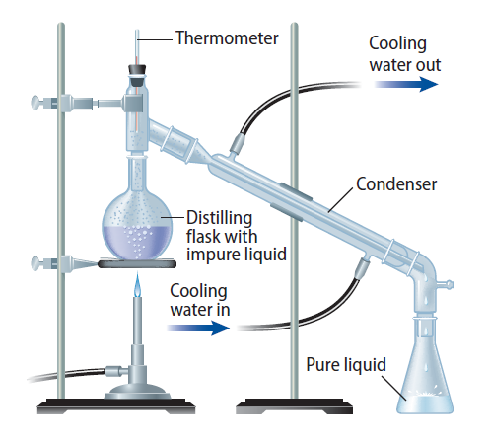
Distillation
The process for separating substances in a mixture by evaporating a liquid and recondensing its vapor is distillation. It usually is done in the laboratory using an apparatus similar to that shown.
Properties of Matter
Copyright © McGraw-Hill Education

Slide 10
Distillation
Two liquids having different boiling points can be separated in a similar way.
The mixture is heated slowly until it begins to boil.
Vapors of the liquid with the lowest boiling point form first and are condensed and collected.
Then, the temperature is increased until the second liquid boils, condenses, and is collected.
Properties of Matter
Copyright © McGraw-Hill Education

Slide 11
Chemical Properties and Chemical Changes
The tendency of a substance to burn, or its flammability, is an example of a chemical property because burning produces new substances during a chemical change. A chemical property is any characteristic of a material that you can observe that produces one or more new substances.
Properties of Matter
Copyright © McGraw-Hill Education

Slide 12
Detecting Chemical Change
If you leave a pan of chili cooking unattended on the stove for too long, your nose soon tells you that something is wrong. This burnt odor is a clue telling you that a new substance has formed.
A change of one substance to another is a chemical change. The foaming of an antacid tablet in a glass of water and the smell in the air after a thunderstorm are other signs of new substances being produced.
Properties of Matter
Copyright © McGraw-Hill Education

Slide 13
The Identity Changes
Clues such as heat, cooling, or the formation of bubbles or solids in a liquid are helpful indicators that a reaction is taking place. However, the only sure proof is that a new substance is produced. The only clue that iron has changed into a new substance is the presence of rust. Burning and rusting are chemical changes because new substances form.
Properties of Matter
Copyright © McGraw-Hill Education

Slide 14
Using chemical changes
One case where you might separate substances using a chemical change is in cleaning tarnished silver. Tarnish is a chemical reaction between silver metal and sulfur compounds in the air which results in silver sulfide. It can be changed back into silver using a chemical reaction.
You don’t usually separate substances using chemical changes in the home. In industry and chemical laboratories, however, this kind of separation is common. For example, many metals are separated from their ores and then purified using chemical changes.
Properties of Matter
Copyright © McGraw-Hill Education

Slide 15
Weathering
The forces of nature continuously shape Earth’s surface. Rocks split, deep canyons are carved out, sand dunes shift, and curious limestone formations decorate caves. Do you think these changes, often referred to as weathering, are physical or chemical? The answer is both.
Properties of Matter
Copyright © McGraw-Hill Education

Slide 16
Physical Weathering
Large rocks can split when water seeps into small cracks, freezes, and expands. However, the smaller pieces of newly exposed rock still have the same properties as the original sample. This is a physical change.
Chemical Weathering
Solid calcium carbonate, a compound found in limestone, does not dissolve easily in water. However, when the water is even slightly acidic, as it is when it contains some dissolved carbon dioxide, calcium carbonate reacts. It changes into a new substance, calcium hydrogen carbonate, which does dissolve in water.
Properties of Matter
Copyright © McGraw-Hill Education

Slide 17
The Conservation of Mass
According to the law of conservation of mass, the mass of all substances that are present before a chemical change, known as the reactants, equals the mass of all the substances that remain after the change, which are called the products.
Properties of Matter
Copyright © McGraw-Hill Education

Slide 18
CALCULATE TOTAL MASS OF PRODUCT
Use with Example Problem 1.
Problem
When hydrogen reacts with chlorine, the only product is hydrochloric acid. If 18 g of hydrogen react completely with 633 g of chlorine, how many grams of hydrochloric acid are formed?
SOLVE FOR THE UNKNOWN
Set Up the Problem
total mass of the product
= total mass of the reactants
mass of hydrochloric acid
= mass of hydrogen + mass of chlorine
Solve the Problem
mass of hydrochloric acid = 18 g + 633 g
The mass of hydrochloric acid is 651 g.
Response
ANALYZE THE PROBLEM
KNOWN
mass of hydrogen = 18 g
mass of chlorine = 633 g
UNKNOWN
mass of hydrochloric acid
EVALUATE THE ANSWER
The mass of reactants and products are equal because the equation was set up according to the law of conservation of mass.
Properties of Matter
Copyright © McGraw-Hill Education

Slide 19
Review
Essential Questions
What are physical and chemical properties?
What are the differences and similarities of physical and chemical changes?
How does the law of conservation of mass apply to chemical changes?
Vocabulary
physical property
physical change
distillation
chemical property
chemical change
law of conservation of mass
Properties of Matter
Copyright © McGraw-Hill Education

