Slide 1
Essential Questions
What are the differences between substances and mixtures?
How are elements and compounds identified?
How are suspensions, solutions, and colloids related?
Composition of Matter
Copyright © McGraw-Hill Education

Slide 2
Vocabulary
Review
property
New
substance
element
compound
heterogeneous mixture
suspension
colloid
Tyndall effect
homogeneous mixture
solution
Composition of Matter
Copyright © McGraw-Hill Education

Slide 3
Substances
Materials are made of a pure substance or a mixture of substances. A pure substance, or simply a substance, is a type of matter with a fixed composition. A substance can be either an element or a compound.
Composition of Matter
Copyright © McGraw-Hill Education

Slide 4
Elements
All substances are built from atoms.
If all the atoms in a substance have the same identity, that substance is an element.
About 90 elements are found on Earth. More than 20 others have been made in laboratories, but most of these are unstable and exist only for short periods of time.
Composition of Matter
Copyright © McGraw-Hill Education

Slide 5
Compounds
A compound is a substance in which the atoms of two or more elements are chemically combined in a fixed proportion.
Salt is an example of a compound.
Composition of Matter
Copyright © McGraw-Hill Education

Slide 6
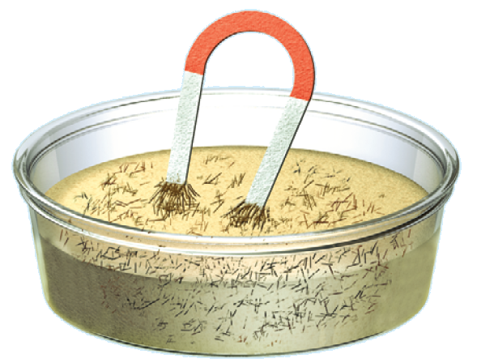
Mixtures
A mixture, such as the iron filings and sand, is a material made up of two or more substances that can be easily separated by physical means.
Composition of Matter
Copyright © McGraw-Hill Education

Slide 7
Heterogeneous mixtures
Unlike compounds, mixtures do not always contain the same proportions of the substances that make them up. A mixture in which different materials can be distinguished easily is called a heterogeneous mixture.
Most of the substances you come in contact with every day are heterogeneous mixtures. Some components are easy to see, like the ingredients in a salad, but others are not.
Composition of Matter
Copyright © McGraw-Hill Education

Slide 8
Suspensions
Pond water is a suspension, which is a heterogeneous mixture containing a liquid in which visible particles settle. One example is muddy pond water.
Composition of Matter
Copyright © McGraw-Hill Education

Slide 9
Colloids
Milk is an example of a specific kind of mixture called a colloid. A colloid is a type of mixture with particles that are larger than those in solutions but not heavy enough to settle out.
Composition of Matter
Copyright © McGraw-Hill Education

Slide 10
Identifying colloids
One way to distinguish a colloid from a solution is by its appearance. Fog appears white because its particles are large enough to scatter light. Sometimes it is not so obvious that a liquid is a colloid. You can tell for certain if a liquid is a colloid by passing a beam of light through it.
A light beam is invisible as it passes through a solution, but can be seen readily as it passes through a colloid. This occurs because the particles in the colloid are large enough to scatter light, but those in the solution are not.
This scattering of light by colloidal particles is called the Tyndall effect.
Composition of Matter
Copyright © McGraw-Hill Education

Slide 11
Homogenous mixtures
A homogeneous mixture contains two or more gaseous, liquid, or solid substances blended evenly throughout.
Another name for homogeneous mixtures is solution. A solution is a homogeneous mixture of particles so small that they cannot be seen with a microscope and will never settle to the bottom of their container. Solutions remain constantly and uniformly mixed.
Composition of Matter
Copyright © McGraw-Hill Education

Slide 12
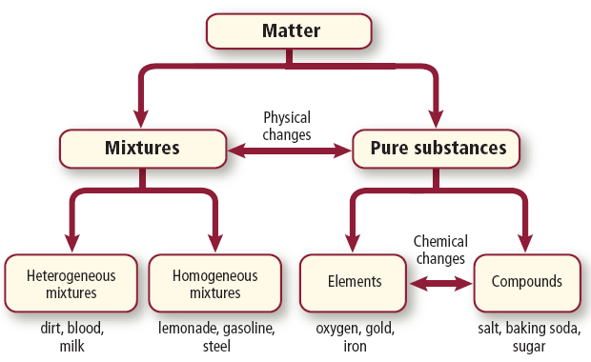
Comparing mixtures and substances
Composition of Matter
Copyright © McGraw-Hill Education

Slide 13
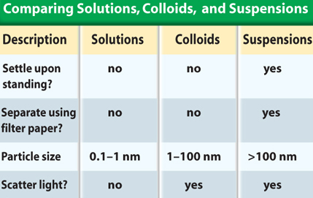
Types of Mixtures
The table summarizes the properties of different types of mixtures.
Composition of Matter
Copyright © McGraw-Hill Education

Slide 14
Review
Essential Questions
What are the differences between substances and mixtures?
How are elements and compounds identified?
How are suspensions, solutions, and colloids related?
Vocabulary
substance
element
compound
heterogeneous mixture
suspension
colloid
Tyndall effect
homogeneous mixture
solution
Composition of Matter
Copyright © McGraw-Hill Education

