Slide 1
Table of Contents
Motion
Section 1 • Describing Motion
Section 2 • Velocity and Momentum
Section 3 • Acceleration

Slide 2
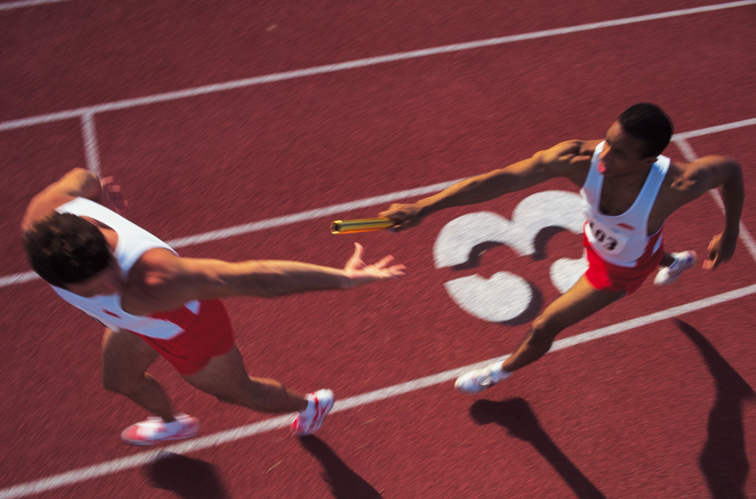
Motion
Are distance and time important in describing running events at the track-and-field meets in the Olympics?
Comstock/JupiterImages

Slide 3
Motion
Distance and time are important. In order to win a race, you must cover the distance in the shortest amount of time.
How would you describe the motion of the runners in the race?
Comstock/JupiterImages

Slide 4
Motion and Position
You don't always need to see something move to know that motion has taken place.
A reference point is needed to determine the position of an object.
Motion occurs when an object changes its position relative to a reference point.
The motion of an object depends on the reference point that is chosen.

Slide 5
Distance
An important part of describing the motion of an object is to describe how far it has moved, which is distance.
The SI unit of length or distance is the meter (m). Longer distances are measured in kilometers (km).

Slide 6
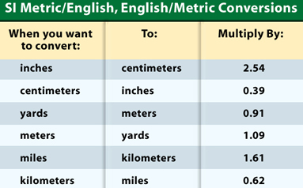
Distance
Shorter distances are measured in centimeters (cm).

Slide 7
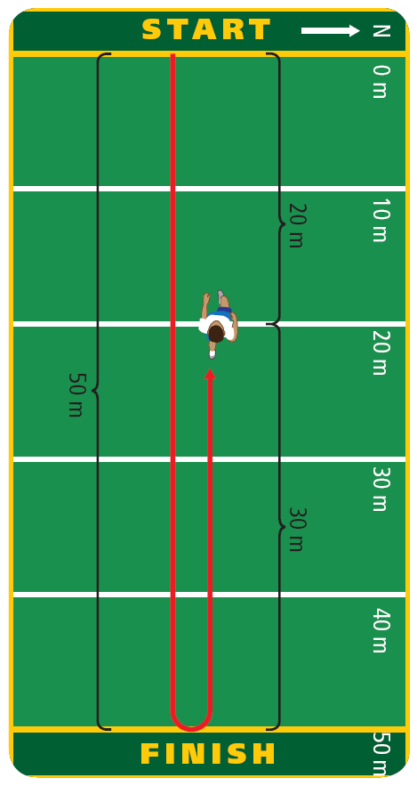
Displacement
Suppose a runner jogs to the 50-m mark and then turns around and runs back to the 20-m mark.
The runner travels 50 m in the original direction (north) plus 30 m in the opposite direction (south), so the total distance she ran is 80 m.

Slide 8
Displacement
Sometimes you may want to know not only your distance but also your direction from a reference point, such as from the starting point.
Displacement is the distance and direction of an object's change in position from the starting point.

Slide 9
Displacement
The length of the runner's displacement and the distance traveled would be the same if the runner's motion was in a single direction.

Slide 10
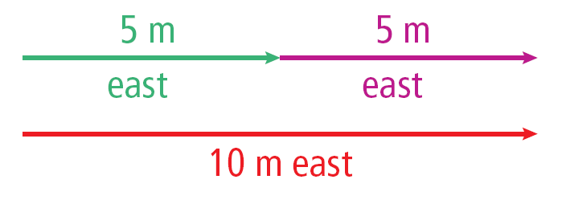
Adding Displacements
Displacements in the same direction can be added.
For example:

Slide 11
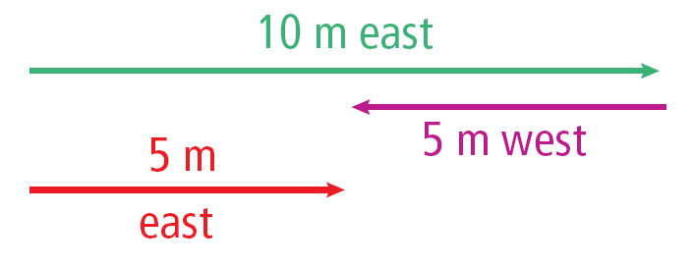
Adding Displacements
Displacements in opposite directions can be subtracted.
For example, if you walk 10 m east and then 5 m west, the size of your displacement is:

Slide 12
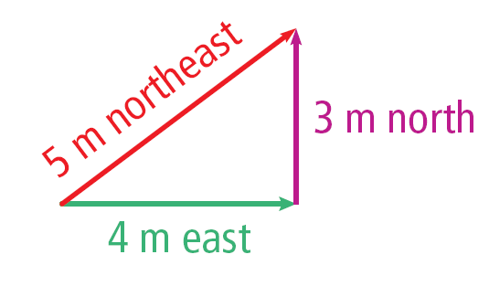
Adding Displacements
Displacements that are not in the same direction or in opposite directions cannot be directly added or subtracted.
For example, if you walk 4 m east and then 3 m north, your displacement is 5 m in a roughly northeast direction, but the total distance traveled is 7m.

Slide 13
Speed
You could describe movement by the distance traveled and by the displacement from the starting point.
You also might want to describe how fast it is moving.
Speed is the distance an object travels per unit of time.

Slide 14
Calculating Speed
Any change over time is called a rate.
If you think of distance as the change in position, then speed is the rate at which distance is traveled or the rate of change in position.

Slide 15
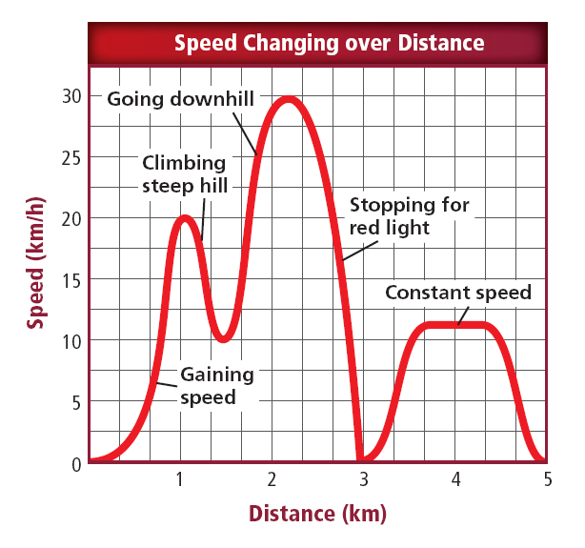
Changing Speed
Usually speed is not constant.
Think about riding a bicycle for a distance of 5 km, as shown.

Slide 16
Changing Speed
How would you express your speed on such a trip? Would you use your fastest speed, your slowest speed, or some speed between the two?

Slide 17
Average Speed
Average speed describes speed of motion when speed is changing.
Average speed is the total distance traveled divided by the total time of travel.
If the total distance traveled was 5 km and the total time was 1/4 h, or 0.25 h. The average speed was:

Slide 18
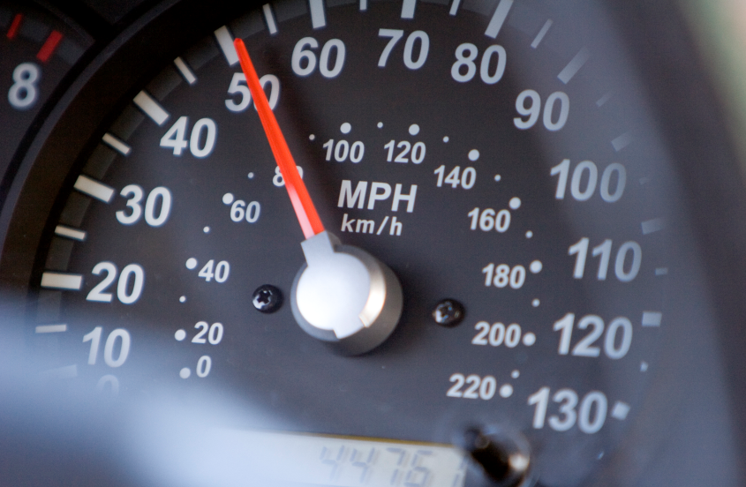
Instantaneous Speed
A speedometer shows how fast a car is going at one point in time or at one instant.
The speed shown on a speedometer is the instantaneous speed. Instantaneous speed is the speed at a given point in time.
Ryan McGinnis/Getty Images

Slide 19
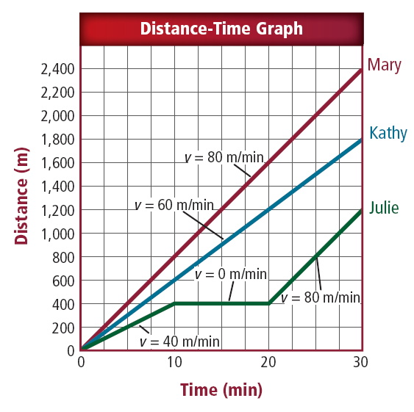
Plotting a Distance-Time Graph
On a distance-time graph, the distance is plotted on the vertical axis and the time on the horizontal axis.
Each axis must have a scale that covers the range of number to be plotted.

Slide 20
Velocity
Speed describes only how fast something is moving.
To determine direction you need to know the velocity.
Velocity includes the speed of an object and the direction of its motion.

Slide 21
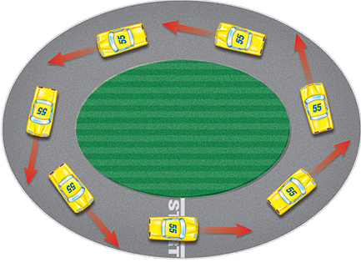
Velocity
Because velocity depends on direction as well as speed, the velocity of an object can change even if the speed of the object remains constant.
The speed of this car might be constant, but its velocity is not constant because the direction of motion is always changing.

Slide 22
Relative Motion
If you are sitting in a chair reading this sentence, you are moving.
You are not moving relative to your desk or your school building, but you are moving relative to the other planets in the solar system and the Sun.

Slide 23
Relative Motion
The choice of a reference point influences how you describe the motion of an object.
For example, consider a hurricane that is moving towards your house as you evacuate.

Slide 24
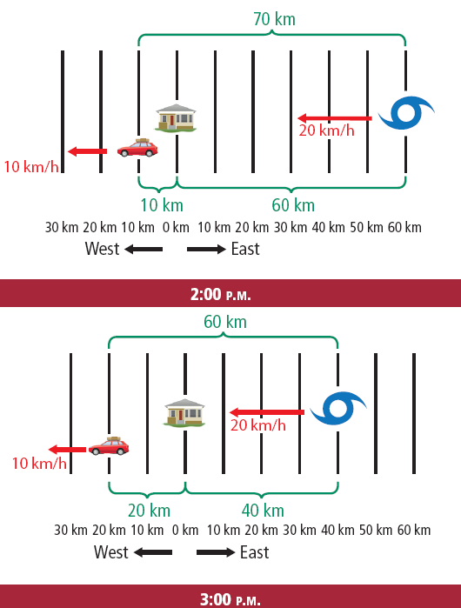
Relative Motion
If you choose your house as a reference point, the hurricane appears to be approaching at 20 km/h and the car appears to be moving away at 10 km/h.

Slide 25
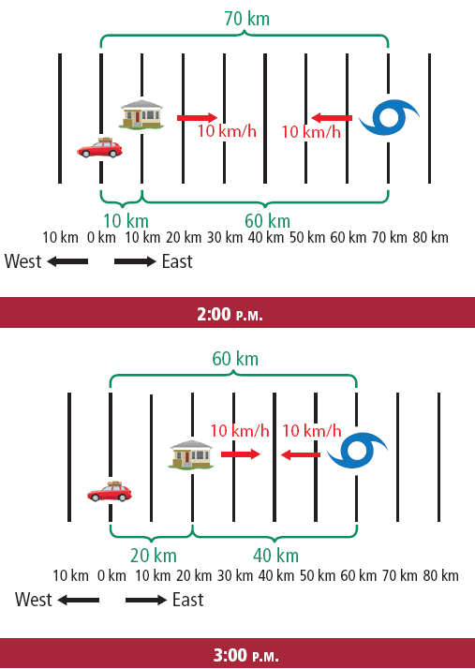
Relative Motion
If you choose your car as a reference point, the hurricane appears to be approaching at 10 km/h and the car appears to be moving away at 10 km/h.

Slide 26
Momentum
A moving object has a property called momentum that is related to how much force is needed to change its motion.
The momentum of an object is the product of its mass and velocity.

Slide 27
Momentum
Momentum is given the symbol p and can be calculated with the following equation:
The unit for momentum is kg · m/s. Notice that momentum has a direction because velocity has a direction.

Slide 28
Momentum
When two objects have the same velocity, the object with the larger mass has the larger momentum.
For example, a 1,500-kg car traveling at 30 m/s east has a momentum of 45,000 kg•m/s east.

Slide 29
Momentum
But a 30,000-kg truck traveling at 30 m/s east has a momentum of 900,000 kg•m/s.
Furthermore, when two objects have the same mass, the one with the larger velocity has a larger momentum.

Slide 31
Acceleration, Speed and Velocity
Acceleration is the rate of change of velocity. When the velocity of an object changes, the object is accelerating.
A change in velocity can be either a change in how fast something is moving, or a change in the direction it is moving.
Acceleration occurs when an object changes its speed, its direction, or both.

Slide 32
Speeding Up and Slowing Down
When you think of acceleration, you probably think of something speeding up. However, an object that is slowing down also is accelerating.
Acceleration also has direction, just as velocity does.
A change in velocity can be either a change in how fast something is moving or a change in the direction of movement.

Slide 33
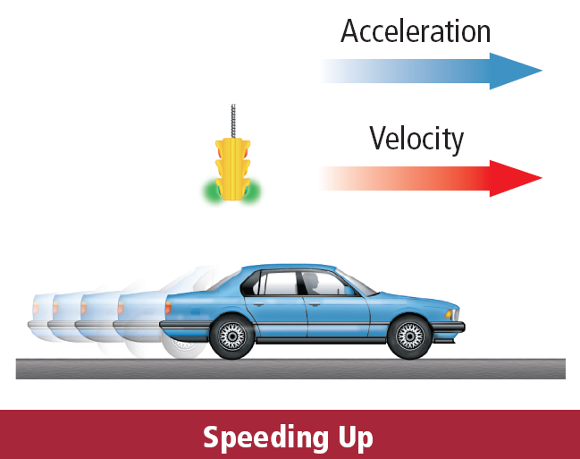
Speeding Up and Slowing Down
If the acceleration is in the same direction as the velocity, the speed increases.

Slide 34
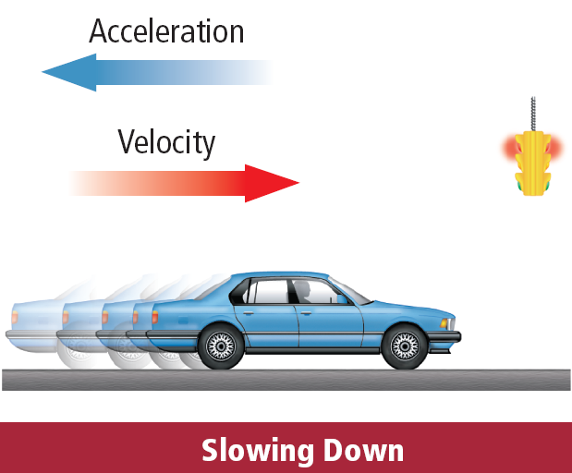
Speeding Up and Slowing Down
If the speed decreases, the acceleration is in the opposite direction from the velocity, and the acceleration is negative.

Slide 35
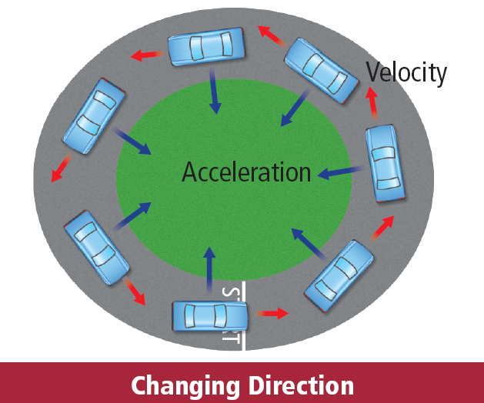
Changing Direction
Any time a moving object changes direction, its velocity changes and it is accelerating.

Slide 36
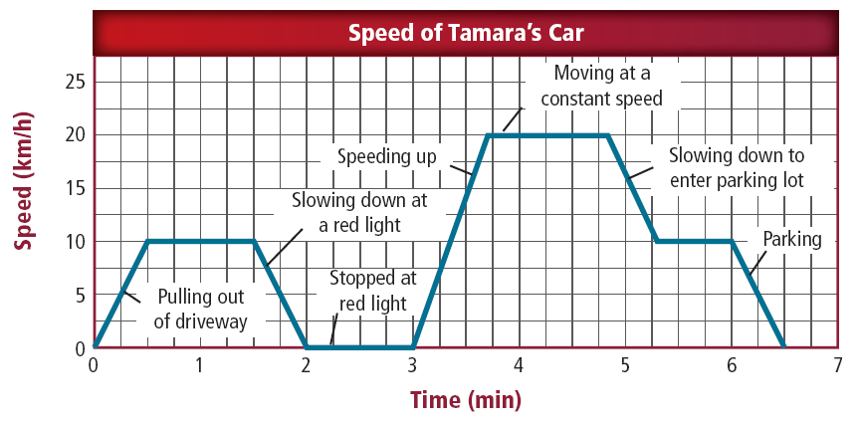
Speed-time Graphs
For objects traveling in a straight line, a speed-time graph can provide information about the object’s acceleration.
The slope of the line on a speed-time graph equals the object’s acceleration.

Slide 37
Calculating Acceleration
To calculate the acceleration of an object, the change in velocity is divided by the length of time interval over which the change occurred.
To calculate the change in velocity, subtract the initial velocity—the velocity at the beginning of the time interval—from the final velocity—the velocity at the end of the time interval.

Slide 38
Calculating Acceleration
Then the change in velocity is:

Slide 39
Calculating Acceleration
Using this expression for the change in velocity, the acceleration can be calculated from the following equation:

Slide 40
Calculating Acceleration
If the direction of motion doesn't change and the object moves in a straight line, the size of change in velocity is the same as the change in speed.
The size of change in velocity then is the final speed minus the initial speed.

Slide 41
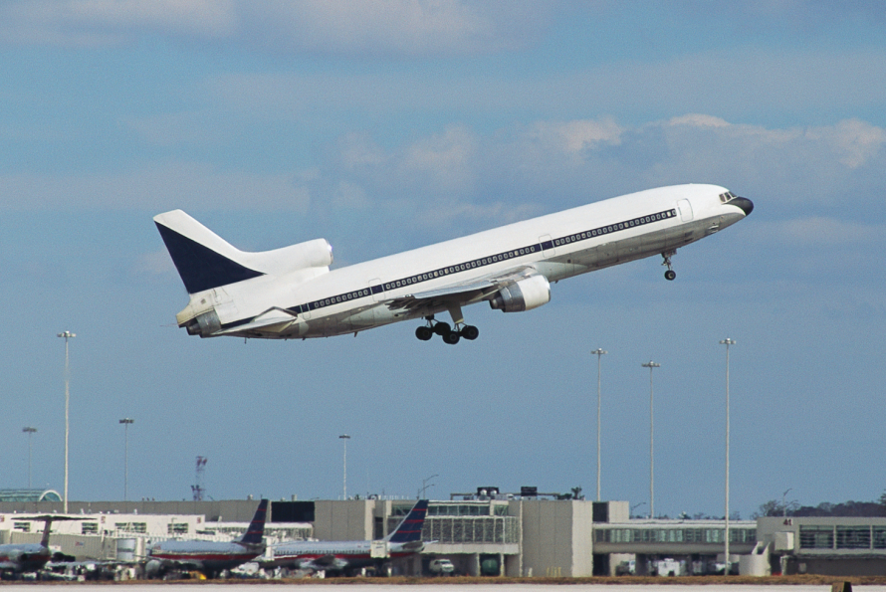
Speeding Up
Suppose a jet airliner starts at rest at the end of a runway and reaches a velocity of 80 m/s east in 20 s.
David Frazier/Corbis

Slide 42
Speeding Up
The airliner is traveling in a straight line down the runway, so its speed and velocity are the same size.
Because it started from rest, its initial speed was zero.

Slide 43
Speeding Up
Its acceleration can be calculated as follows:

Slide 44
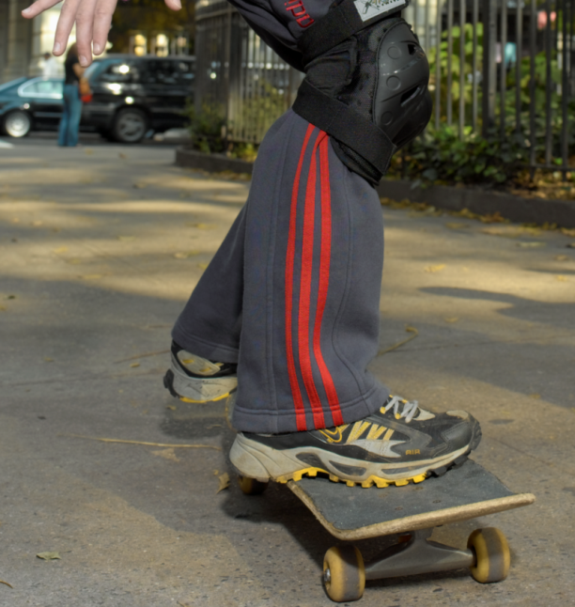
Slowing Down
Now imagine that a skateboarder is moving in a straight line with a velocity of 3 m/s and north comes to a stop in 2 s.
The final speed is zero and the initial speed was 3 m/s.
Ken Karp for MMH

Slide 45
Calculating Negative Acceleration
The skateboarder's acceleration is calculated as follows:
The acceleration is in the opposite direction of the skateboard’s velocity when the skateboarder is slowing down.

Slide 46
Motion in Two Dimensions
Most objects do not move in only in straight lines.
When an object changes direction, it is accelerating.
Like displacement and velocity, accelerations in the same direction can be added and accelerations in opposite directions can be subtracted.
Accelerations that are not in the same direction or in opposite directions cannot be directly added together.

Slide 47
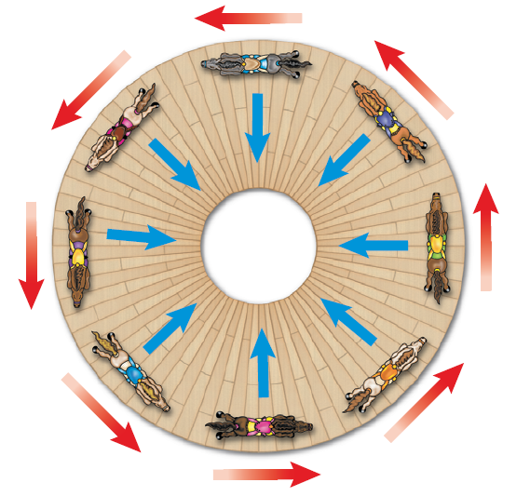
Changing Direction
The speed of the horses in this carousel is constant, but the horses are accelerating because their direction is changing constantly.

Slide 48
Circular Motion
When a ball enters a curve, even if its speed does not change, it is accelerating because its direction is changing.
When a ball goes around a curve, the change in the direction of the velocity is toward the center of the curve.

Slide 49
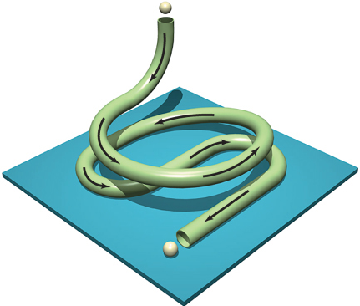
Circular Motion
Acceleration toward the center of a curved or circular path is called centripetal acceleration.

Slide 50
Projectile Motion
If you’ve tossed a ball to someone, you’ve probably noticed that thrown objects don’t always travel in straight lines. They curve downward.
Earth’s gravity causes projectiles to follow a curved path.

Slide 51
Horizontal and Vertical Motions
When you throw a ball, the force exerted by your hand pushes the ball forward.
This force gives the ball horizontal motion.
No force accelerates it forward, so its horizontal velocity is constant, if you ignore air resistance.
Donald Miralle/Getty Images

Slide 52
Horizontal and Vertical Motions
However, when you let go of the ball, gravity can pull it downward, giving it vertical motion.
The ball has constant horizontal velocity but increasing vertical velocity.

Slide 53
Horizontal and Vertical Motions
Gravity exerts an unbalanced force on the ball, changing the direction of its path from only forward to forward and downward.
The result of these two motions is that the ball appears to travel in a curve.

Slide 54
STOP NOTES

Slide 55
Horizontal and Vertical Distance
If you were to throw a ball as hard as you could from shoulder height in a perfectly horizontal direction, would it take longer to reach the ground than if you dropped a ball from the same height?
Click image to view movie

Slide 56
Horizontal and Vertical Distance
Surprisingly, it wouldn’t.
Both balls travel the same vertical distance in the same amount of time.

Slide 57
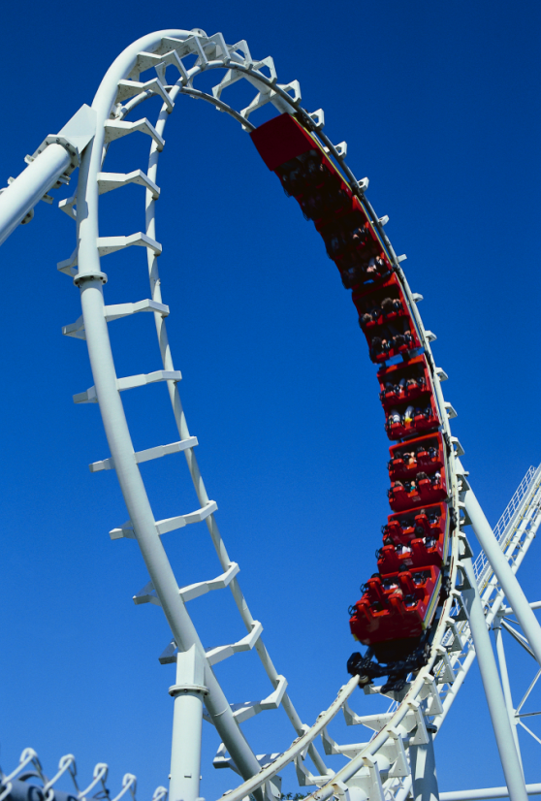
Amusement Park Acceleration
Engineers use the laws of physics to design amusement park rides that are thrilling, but harmless.
The highest speeds and accelerations usually are produced on steel roller coasters.
CORBIS

Slide 58
Amusement Park Acceleration
Steel roller coasters can offer multiple steep drops and inversion loops, which give the rider large accelerations.
As the rider moves down a steep hill or an inversion loop, he or she will accelerate toward the ground due to gravity.

Slide 59
Amusement Park Acceleration
When riders go around a sharp turn, they also are accelerated.
This acceleration makes them feel as if a force is pushing them toward the side of the car.

