Slide 1
Essential Questions
What are the names and symbols of common elements?
What is the structure of the atom?
How do scientists study quarks?
What is the electron cloud model of the atom?
Structure of the Atom
Copyright © McGraw-Hill Education

Slide 2
Vocabulary
Review
element
New
atom
nucleus
proton
neutron
electron
quark
electron cloud
Structure of the Atom
Copyright © McGraw-Hill Education

Slide 3
Scientific Shorthand
Scientists have developed their own shorthand for dealing with long, complicated names.
Chemical symbols consist of one capital letter or a capital letter plus one or two smaller letters.
For some elements, the symbol is the first letter of the element's name.
For other elements, the symbol is the first letter of the name plus another letter from its name.
Because scientists worldwide use this system, everyone understands what the symbols mean.
Structure of the Atom
Copyright © McGraw-Hill Education

Slide 4
Subatomic Particles
An element is matter that is composed of one type of atom, which is the smallest piece of matter that retains the element’s properties.
Atoms are composed of particles called:
protons
neutrons
electrons
Structure of the Atom
Copyright © McGraw-Hill Education

Slide 5
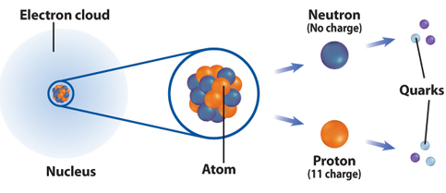
Subatomic Particles
Protons and neutrons are found in a small positively charged center of the atom called the nucleus that is surrounded by a cloud containing electrons.
Protons are particles with an electrical charge of 1+.
Electrons are particles with an electrical charge of 1–.
Neutrons are neutral particles that do not have an electrical charge.
Structure of the Atom
Copyright © McGraw-Hill Education

Slide 6
Quarks—even smaller particles
Protons and neutrons are made up of 3 smaller particles called quarks.
Structure of the Atom
Copyright © McGraw-Hill Education

Slide 7
The search for quarks using Hadron Collider.
To study quarks, scientists accelerate charge particles to tremendous speeds and then force them to collide with—or smash into—protons. This collision causes the proton to break apart.
The particles that result from the collision can be detected by various collection devices.
Structure of the Atom
Copyright © McGraw-Hill Education

Slide 9
The sixth quark
Scientists found five quarks and hypothesized that a sixth quark existed. However, it took a team of nearly 450 scientists from around the world several years to find the sixth quark.
The tracks of the sixth quark were hard to detect because only about one billionth of a percent of the proton collisions performed shows a presence of a sixth quark.
Structure of the Atom
Copyright © McGraw-Hill Education

Slide 10
Models—Tools for Scientists
Scientists and engineers use models to represent things that are difficult to visualize—or picture in your mind.
Scaled-down models allow you to see either something too large to see all at once, or something that has not been built yet.
Scaled-up models are often used to visualize things that are too small to see.
To study the atom, scientists have developed scaled-up models that they can use to visualize how the atom is constructed.
Structure of the Atom
Copyright © McGraw-Hill Education

Slide 11
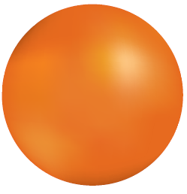
The atomic model
Around 400 B.C., Greek philosopher Democritus proposed that atoms are tiny particles that make up all matter.
Another famous Greek philosopher, Aristotle, disputed Democritus's theory and proposed that matter was uniform throughout and was not composed of smaller particles.
In the 1800s, John Dalton, an English scientist, was able to offer proof that atoms exist.
Dalton's model of the atom, a solid sphere was an early model of the atom.
Structure of the Atom
Copyright © McGraw-Hill Education

Slide 15
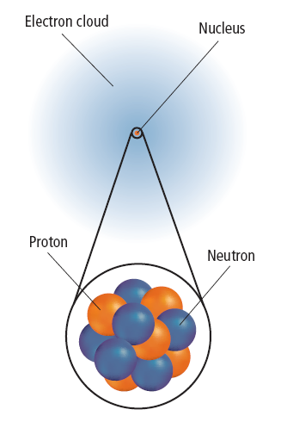
The electron cloud model (Erwin Schrödinger)
An electron cloud is the area around the nucleus of an atom where its electrons are most likely found.
By 1926, scientists had developed the electron cloud model of the atom that is in use today.
The electron cloud is 100,000 times larger than the diameter of the nucleus.
In contrast, each electron in the cloud is much smaller than a single proton.
Because an electron's mass is small and the electron is moving so quickly around the nucleus, it is impossible to describe its exact location in an atom.
Structure of the Atom
Copyright © McGraw-Hill Education

Slide 16
Review
Essential Questions
What are the names and symbols of common elements?
What is the structure of the atom?
How do scientists study quarks?
What is the electron cloud model of the atom?
Vocabulary
atom
nucleus
proton
neutron
electron
quark
electron cloud
Structure of the Atom
Copyright © McGraw-Hill Education

