Slide 1
Essential Questions
How does a gas exert pressure on its container?
How is a gas affected when pressure, temperature, or volume change?
Behavior of Gases
Copyright © McGraw-Hill Education

Slide 2
Vocabulary
Review
temperature
New
Boyle’s law
Charles’s law
Behavior of Gases
Copyright © McGraw-Hill Education

Slide 3
Boyle’s Law–Volume and Pressure
What happens to the gas pressure if you decrease the size of the container? If you squeeze gas into a smaller space, its particles will strike the walls more often—giving an increased pressure. The opposite is true, too. Robert Boyle (1627-1691), a British scientist, described this property of gases.
According to Boyle’s law, if you decrease the volume of a container of gas and hold the temperature constant, the pressure of the gas will increase. An increase in the volume of the container causes the pressure to drop, if the temperature remains constant.
Behavior of Gases
Copyright © McGraw-Hill Education

Slide 4
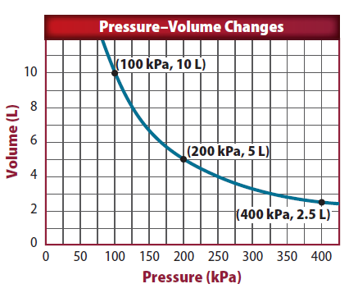
Volume and pressure
Boyle’s law states that as pressure is decreased the volume increases. The opposite also is true, as shown by the graph. As the pressure is increased, the volume will decrease.
Behavior of Gases
Copyright © McGraw-Hill Education

Slide 5
An equation for Boyle’s law
When Boyle’s law is applied to a real life situation, we find that the pressure multiplied by the volume is always equal to a constant if the temperature is constant.
You can use the equations P_{i}V_{i} =P_{i}V_{i} (Temperature remains Constant)
This shows us that the product of the initial pressure and volume—designated with the subscript i—is equal to the product of the final pressure and volume—designated with the subscript f.
Behavior of Gases
Copyright © McGraw-Hill Education

Slide 6
BOYLE’S LAW
SOLVE FOR THE UNKNOWN
Set Up the Problem
P_{i}V_{i} = P_{f}V_{f}
Solve the Problem
V_{f} = V_{i}$\left(\frac{\text{P}\text{i}}{\text{P}\text{f}}\right)$
V_{f} = 1$00\text{.0 }\text{L}\left(\frac{\text{101 }\text{kPa}}{\text{43.0 }\text{kPa}}\right)$
V_{f} = 235 L
Use with Example Problem 3.
Problem
A weather balloon has a volume of 100.0 L when it is released from sea level, where the pressure is 101 kPa. What will be the balloon’s volume when it reaches an altitude where the pressure is 43.0 kPa?
Response
ANALYZE THE PROBLEM
EVALUATE THE ANSWER
You can do a quick estimate to check your answer. The pressure was slightly more than halved. Therefore, the volume should
slightly more than double. The final volume of 235 L is slightly more than twice the initial volume of 100.0 L. Therefore, the
answer seems reasonable.
KNOWN
initial pressure: P_{i} = 101 kPa
initial volume: V_{i} = 100.0 L
final pressure: P_{f} = 43.0 kPa
UNKNOWN
final volume: V_{f}
Behavior of Gases
Copyright © McGraw-Hill Education

Slide 7
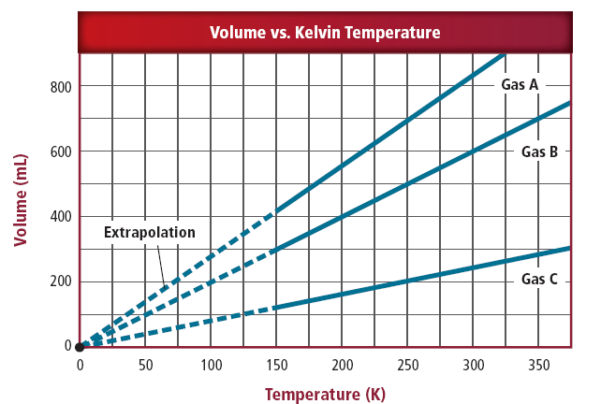
Charles’s Law–Temperature and Volume
Jacques Charles (1746-1823) was a French scientist who studied gases. According to Charles’s law, the volume of a gas increases with increasing temperature, as long as pressure does not change. As with Boyle’s law, the reverse is true, also.
Behavior of Gases
Copyright © McGraw-Hill Education

Slide 8
The kinetic theory and Charles’s law
Charles’s law can be explained using the kinetic theory of matter.
As a gas is heated, its particles move faster and faster and its temperature increases.
Because the gas particles move faster, they begin to strike the walls of their container more often and with more force.
Behavior of Gases
Copyright © McGraw-Hill Education

Slide 9
An equation for Charles’s law
The formula that relates the variables of temperature to volume shows a direct relationship when temperature is given in Kelvin.
When using Charles’s law, the pressure must be kept constant.
Behavior of Gases
Copyright © McGraw-Hill Education

Slide 10
USE CHARLES’S LAW
SOLVE FOR THE UNKNOWN
Set Up the Problem
$\frac{\text{V}\text{i}}{\text{T}\text{i}}$ = $\frac{\text{V}\text{f} }{\text{T}\text{f}}$
V_{f} = V_{i}$\left(\frac{\text{T}\text{f}}{\text{T}\text{i}}\right)$
Solve the Problem
V_{f} = 2.0 L $\left(\frac{\text{276} \text{K}}{\text{239 }\text{K}}\right)$
= 2.3 L
Use with Example Problem 4.
Problem
A 2.0-L balloon at room temperature (20.0°C) is placed in a refrigerator at 3.0°C. What is the volume of the balloon after it cools in the refrigerator?
Response
ANALYZE THE PROBLEM
KNOWN
initial volume: V_{i} = 2.0 L
initial temperature: T_{i} = 20°C = 20.0°C + 273 = 293 K
final temperature: T_{f} = 3.0°C = 3.0°C + 273 = 276 K
UNKNOWN
final volume: V_{f}
EVALUATE THE ANSWER
A good way to check your answer here is through experiment! If you place a balloon in a refrigerator, you will notice that the balloon shrinks, but not very much. This is consistent with our answer above.
Behavior of Gases
Copyright © McGraw-Hill Education

Slide 11
Gay-Lussac
Gas law states there is a direct relationship between pressure and temperature, while Volume remains constant.
The Equation is: P1/T1 = P2/T2.

Slide 12
Review
Essential Questions
How does a gas exert pressure on its container?
How is a gas affected when pressure, temperature, or volume change?
Vocabulary
Boyle’s law
Charles’s law
Behavior of Gases
Copyright © McGraw-Hill Education

