Slide 1
Essential Questions
What is Archimedes’ principle?
What is Pascal’s principle?
What is Bernoulli’s principle?
What are some applications of Archimedes’, Pascal’s, and Bernoulli’s principles?
Properties of Fluids
Copyright © McGraw-Hill Education

Slide 2
Vocabulary
Review
density
New
buoyancy
pressure
viscosity
Properties of Fluids
Copyright © McGraw-Hill Education

Slide 3
Archimedes’ Principle and Buoyancy
Despite their weight, ships are able to float. This is because a greater force pushing up on the ship opposes the weight—or force—of the ship pushing down.
Buoyancy is the ability of a fluid—a liquid or a gas—to exert an upward force on an object immersed in it.
Properties of Fluids
Copyright © McGraw-Hill Education

Slide 4
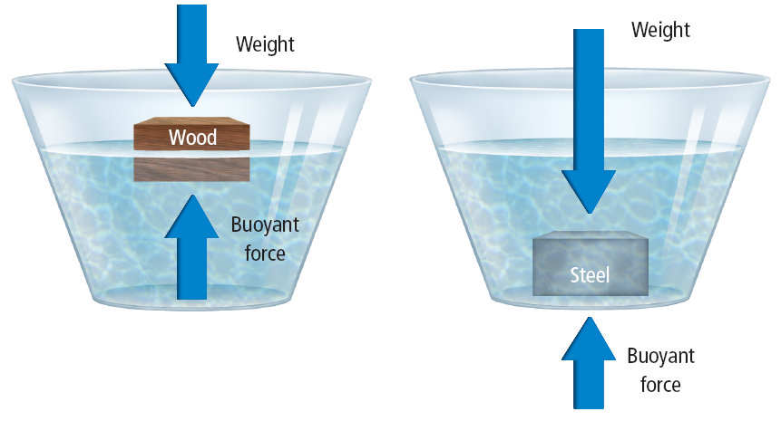
Archimedes’ principle
In the third century B.C., a Greek mathematician named Archimedes made a discovery about buoyancy. Archimedes found that the buoyant force on an object is equal to the weight of the fluid displaced by the object.
Properties of Fluids
Copyright © McGraw-Hill Education

Slide 5
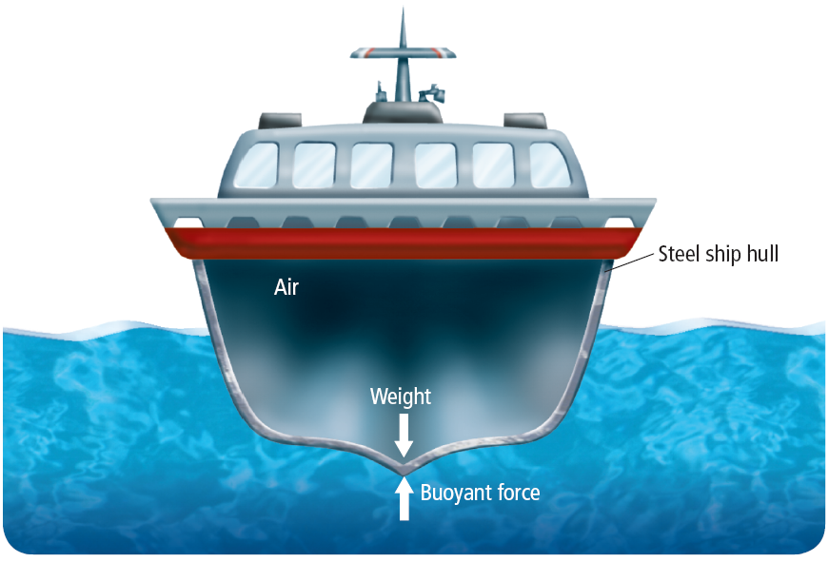
Density and buoyancy
Suppose you form a steel block into the shape of a hull filled with air. The steel has the same mass but takes up a larger volume. The overall density of the steel boat and air is less than the density of water. The boat will now float.
Properties of Fluids
Copyright © McGraw-Hill Education

Slide 6
Pascal’s Principle and Pressure
Pressure is force exerted per unit area. Blaise Pascal (1692-1662), a French scientist, discovered a useful property of fluids. According to Pascal’s principle, pressure applied to a fluid is transmitted throughout the fluid.
Properties of Fluids
Copyright © McGraw-Hill Education

Slide 7
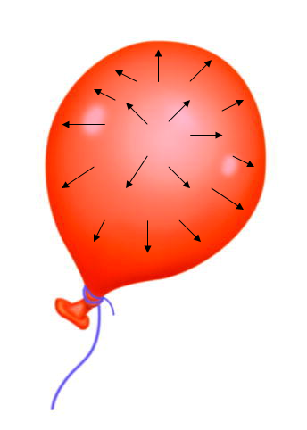
Pressure
Pressure is the amount of force exerted per unit of area, or P = F / A
A balloon and a bicycle tire are considered to be containers. They remain inflated because of collisions the air particles have with the walls of their container. This collection of forces, caused by the collisions of the particles, pushes the walls of the container outward. If more air is pumped into the balloon, the number of air particles is increased. This causes more collisions with the walls of the container, which causes it to expand.
Properties of Fluids
Copyright © McGraw-Hill Education

Slide 8
Pressure
Pressure is measured in a unit called Pascal (Pa), the SI unit of pressure.
Because pressure is the amount of force divided by area, one pascal of pressure is one Newton per square meter or 1 N/m².
At sea level, atmospheric pressure is 101.3 kPa. At Earth’s surface, the atmosphere exerts a force of about 101,300 N on every square meter—about the weight of a large truck.
Properties of Fluids
Copyright © McGraw-Hill Education

Slide 9
CALCULATE FORCE
SOLVE FOR THE UNKNOWN
Set Up the Problem
P = $\frac{\text{F}}{\text{A} }$
Solve the Problem
101,000 Pa = $\frac{\text{F}}{\text{1.80 }\text{m}\text{2 }}$
$\text{F}$ = 101,000 Pa $×\text{1.80 }\text{m}\text{2}$ = 182,000 Pa $∙$ m²
= 182,000 $\frac{\text{N}}{\text{m}\text{2} }∙\text{m}\text{2} \text{=}$ 182,000 N
Use with Example Problem 1.
Problem
Atmospheric pressure at sea level is about 101 kPa. With how much total force does Earth’s atmosphere push on an average human being at sea level? Assume that the surface area of an average human is 1.80 m².
Response
ANALYZE THE PROBLEM
KNOWN
pressure: P = 101 kPa = 101,000 Pa
area: A = 1.80 m²
UNKNOWN
force: F
EVALUATE THE ANSWER
You’ve set up your equation correctly if the units are the same on both sides: units of pressure = Pa = N/m² and (units of force) / (units of area) = N/m². The units on both sides of the equation match. Now, just double-check the calculation.
Properties of Fluids
Copyright © McGraw-Hill Education

Slide 10
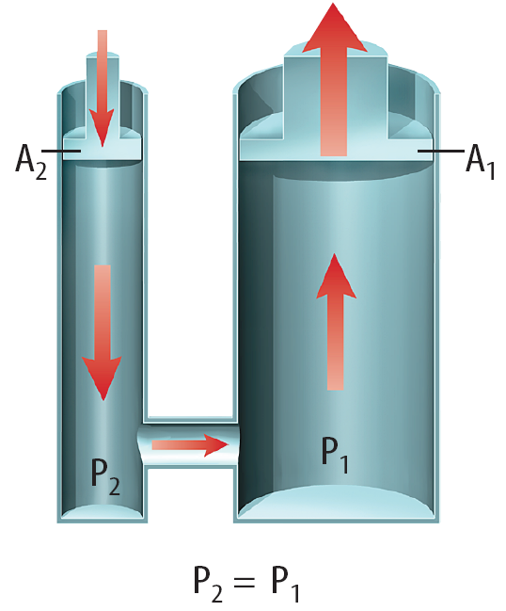
Pascal’s principle
Hydraulic machines are machines that move heavy loads in accordance with Pascal’s principle. Maybe you’ve seen a car raised using a hydraulic lift in an auto repair shop.
A pipe that is filled with fluid connects small and large cylinders.
Pressure applied to the small cylinder is transferred through the fluid to the large cylinder.
Properties of Fluids
Copyright © McGraw-Hill Education

Slide 11
Pascal’s principle
Because pressure remains constant throughout the fluid, according to Pascal’s principle, more force is available to lift a heavy load by increasing the surface area.
Pressure applied to the small cylinder is transferred through the fluid to the large cylinder.
Because pressure remains constant throughout the fluid, according to Pascal’s principle, more force is available to lift a heavy load by increasing the surface area.
Properties of Fluids
Copyright © McGraw-Hill Education

Slide 12
CALCULATE FORCES
Use with Example Problem 2.
Problem
A hydraulic lift is used to lift a heavy machine that is pushing down on a 2.8-m² platform with a force of 3,700 N. What force must be exerted on a 0.072-m² piston to lift the heavy machine?
SOLVE FOR THE UNKNOWN
Set Up the Problem
$\frac{\text{F}\text{in}}{\text{A}\text{in} }$ = $\frac{\text{F}\text{out}}{\text{A}\text{out}}$
Solve the Problem
F_{in} = $\left(\frac{\text{F}\text{out}}{\text{A}\text{out}} \right)$ A_{in} = $\left(\frac{\text{3700 }\text{N}}{\text{2.8 }\text{m}\text{2}}\right)$ 0.072 m² = 95 N
Response
ANALYZE THE PROBLEM
EVALUATE THE ANSWER
The ratio of the forces should be the same as the ratio of the areas. The area of the platform is about 40 times the area of the piston. Therefore, the force on the platform should be about 40 times the force on the piston. 3,700 N is about 40 times greater than 95 N, so the answer is reasonable.
KNOWN
force on platform: F_{out} = 3,700 N
area of platform: A_{out} = 2.8 m²
area of piston: A_{in} = 0.072 m²
UNKNOWN
force on piston: F_{in}
Properties of Fluids
Copyright © McGraw-Hill Education

Slide 13
Bernoulli’s Principle
According to Bernoulli’s principle, as the velocity of a fluid increases, the pressure exerted by the fluid decreases. One way to demonstrate Bernoulli’s principle is to blow across the top surface of a sheet of paper.
The paper will rise.
The velocity of the air you blew over the top surface of the paper is greater than that of the quiet air below it.
As a result, the air pressure pushing down on the top of the paper is lower than the air pressure pushing up on the paper.
The net force below the paper pushes the paper upward.
Another application of Bernoulli’s principle is the hose-end sprayer.
Properties of Fluids
Copyright © McGraw-Hill Education

Slide 14
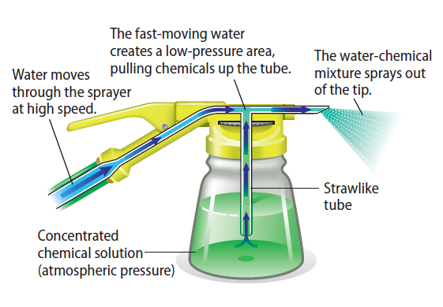
Bernoulli’s Principle
Pushing the trigger on the sprayer attachment allows the water in the hose to flow at a high rate of speed, creating a low pressure area above the straw-like tube. The concentrated chemical solution is sucked up through the straw and into the stream of water. The concentrated solution is mixed with water, reducing the concentration to the appropriate level and creating a spray that is easy to apply.
Properties of Fluids
Copyright © McGraw-Hill Education

Slide 15
Viscosity
Another property exhibited by fluid is its tendency to flow. The resistance to flow by a fluid is called viscosity.
When a container of liquid is tilted to allow flow to begin, the flowing particles will transfer energy to the particles that are stationary.
In effect, the flowing particles are pulling the other particles, causing them to flow, too.
If the flowing particles do not effectively pull the other particles into motion, then the liquid has a high viscosity, or a high resistance to flow.
If the flowing particles pull the other particles into motion easily, then the liquid has low viscosity, or a low resistance to flow.
Properties of Fluids
Copyright © McGraw-Hill Education

Slide 16
Review
Essential Questions
What is Archimedes’ principle?
What is Pascal’s principle?
What is Bernoulli’s principle?
What are some applications of Archimedes’, Pascal’s, and Bernoulli’s principles?
Vocabulary
buoyancy
pressure
viscosity
Properties of Fluids
Copyright © McGraw-Hill Education

