Slide 1
Essential Questions
What is the kinetic theory of matter?
How do particles move in the different states of matter?
How do particles behave at the boiling and melting points?
Matter and Thermal Energy
Copyright © McGraw-Hill Education

Slide 2
Kinetic Theory
The kinetic theory is an explanation of how particles in matter behave. The three assumptions of the kinetic theory are as follows:
All matter is composed of small particles (atoms, molecules, or ions).
These particles are in constant, random motion.
These particles are colliding with each other and the walls of their container.
Particles lose some energy during collisions with other particles. But the amount of energy lost is very small and can be neglected in most cases.
Matter and Thermal Energy
Copyright © McGraw-Hill Education

Slide 3
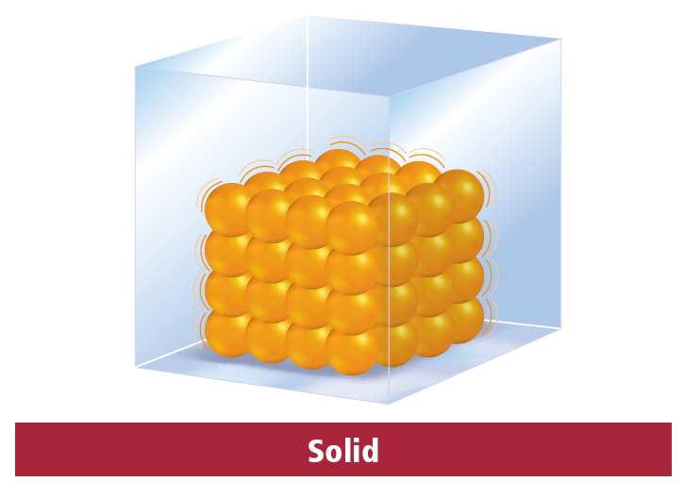
Solid State
The particles of a solid are closely packed together. Most solid materials have a specific type of geometric arrangement in which they form when cooled.
Matter and Thermal Energy
Copyright © McGraw-Hill Education

Slide 4
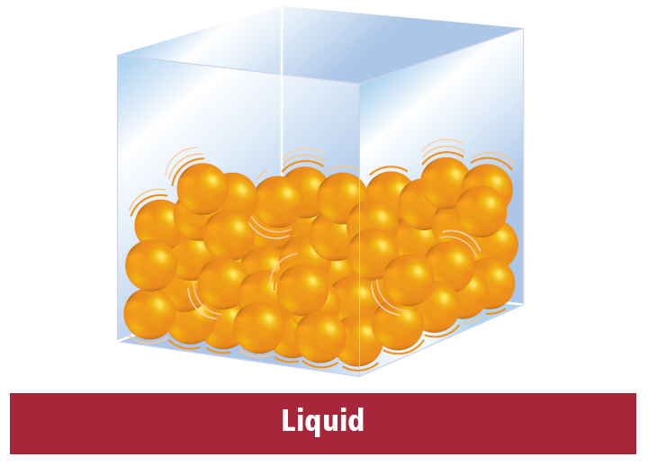
Liquid state
Particles in the liquid state have less kinetic energy than in the gas state. Thus, the particles in the liquid state are less able to overcome their attractions to each other. The particles cling together, giving liquids a definite volume. The particles can slide past each other, allowing liquids to flow and take the shape of their container.
Matter and Thermal Energy
Copyright © McGraw-Hill Education

Slide 5
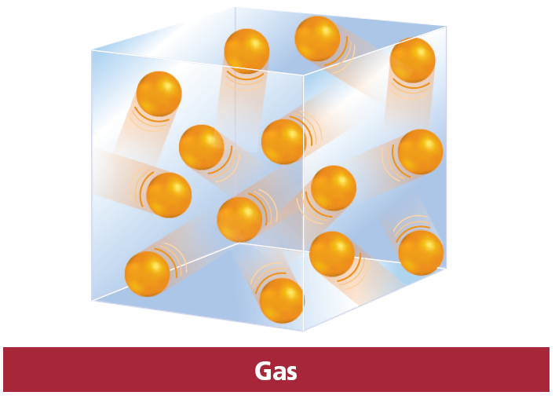
Gas State
Gases do not have a fixed volume or shape. Therefore, they can spread far apart or contract to fill the container that they are in.
Matter and Thermal Energy
Copyright © McGraw-Hill Education

Slide 6
Temperature
In science, temperature means the average kinetic energy of particles in the substance, or how fast the particles are moving. On average, molecules of frozen water at 0°C will move slower than molecules of water at 100°C.
Water molecules at 0°C have lower average kinetic energy than the molecules at 100°C. Molecules have kinetic energy at all temperatures, including absolute zero.
Matter and Thermal Energy
Copyright © McGraw-Hill Education

Slide 7
Changes of State
Melting and freezing
The particles gain enough kinetic energy to slip out of their ordered arrangement and the solid melts.
This is known as the melting point, or the temperature at which a solid begins to liquefy.
Energy is required for the particles to slip out of the ordered arrangement.
The amount of energy required to change a substance from the solid phase to the liquid phase at its melting point is known as the heat of fusion.
Matter and Thermal Energy
Copyright © McGraw-Hill Education

Slide 8
Vaporization and condensation
Vaporization can occur in two ways—evaporation and boiling.
Evaporation is vaporization that occurs at the surface of a liquid and can occur at nearly any temperature. To evaporate, particles must have enough kinetic energy to escape the attractive forces of the liquid.
The boiling point of a liquid is the temperature at which the pressure of the vapor in the liquid is equal to the external pressure acting on the surface of the liquid.
Heat of vaporization is the amount of energy required for the liquid at its boiling point to become a gas.
Sublimation is the process of a solid changing directly to a gas without forming a liquid. Example: Dry Ice (Solid CO2)
Matter and Thermal Energy
Copyright © McGraw-Hill Education

Slide 9
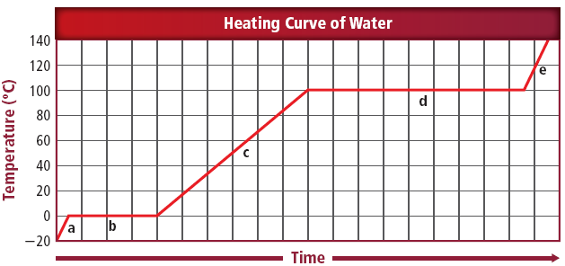
Heating curves
At 0°C, ice is melting. The temperature remains constant during melting. After the attractive forces are overcome, particles move more freely and their average kinetic energy, or temperature, increases.
At 100°C, water is boiling or vaporizing and the temperature remains constant again.
Matter and Thermal Energy
Copyright © McGraw-Hill Education

Slide 10
Plasma State
Plasma is matter that has enough energy to overcome not just the attractive forces between its particles but also the attractive forces within its atoms.
The forces produced from high-energy collisions are so great that electrons from the atom are stripped off.
All of the observed stars including the Sun consist of plasma. Plasma also is found in lightning bolts, neon and fluorescent tubes, and auroras.
* Research Bose-Einstein Condensate What is it????
Absolute zero = 0 Kelvin (-273C)
Matter and Thermal Energy
Copyright © McGraw-Hill Education

Slide 11
Thermal Expansion
Particles move faster and separate as the temperature rises. This separation of particles results in an expansion of the entire object, known as thermal expansion. Thermal expansion is an increase in the size of a substance when the temperature is increased.
The kinetic theory can be used to explain the contraction in objects, too. When the temperature of an object is lowered, particles slow down. The attraction between the particles increases and the particles move closer together. The movements of the particles closer together result in an overall shrinking of the object, known as thermal contraction.
Matter and Thermal Energy
Copyright © McGraw-Hill Education

Slide 12
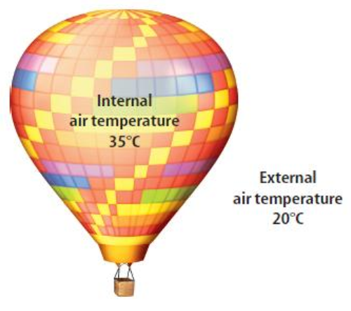
Hot-air balloons
This expansion results in a decreased density of the hot air. The density of the air in the hot-air balloon is lower than the density of the cooler air outside, which allows the balloon will rise.
Matter and Thermal Energy
Copyright © McGraw-Hill Education

Slide 13
Amorphous solids
Not all solids have a definite temperature at which they change from solid to liquid. Some solids merely soften and gradually turn into a liquid over a temperature range. These solids lack the highly ordered structure found in crystals. They are known as amorphous solids from the Greek word for “without form.”
Matter and Thermal Energy
Copyright © McGraw-Hill Education

Slide 14
Liquid Crystals
Liquid crystals are placed in classes depending upon the type of order they maintain when they liquefy. They are highly responsive to temperature changes and electric fields.
Scientists use the unique properties of liquid crystals to make liquid crystal displays (LCDs). LCD is common display technology for cell phones, televisions, calculators, and netbooks. LCD screens are composed of individual crystal picture elements (pixels)—varying the amount of electricity that passes through the pixel determines how the crystals are aligned and whether light is able to pass through them.
Matter and Thermal Energy
Copyright © McGraw-Hill Education

Slide 15
Review
Essential Questions
What is the kinetic theory of matter?
How do particles move in the different states of matter?
How do particles behave at the boiling and melting points?
Vocabulary
kinetic theory
melting point
heat of fusion
boiling point
heat of vaporization
sublimation
plasma
thermal expansion
Matter and Thermal Energy
Copyright © McGraw-Hill Education

