Slide 1
Essential Questions
How do moving electric charges and magnets interact?
What is the electromagnetic force?
How do an electromagnet’s properties affect its magnetic field strength?
How does an electric motor operate?
Electricity and Magnetism
Copyright © McGraw-Hill Education

Slide 2
Electric Current and Magnetism
In 1820, Han Christian Oersted, a Danish physics teacher, found that electricity and magnetism are related.
Oersted hypothesized that the electric current must produce a magnetic field around the wire, and the direction of the field changes with the direction of the current.
Electricity and Magnetism
Copyright © McGraw-Hill Education

Slide 3
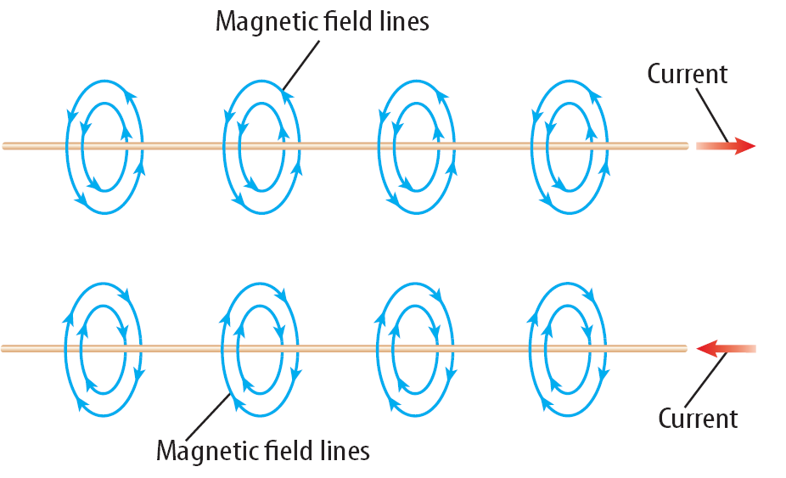
Moving Charges and Magnetic Fields
It is now known that moving charges, like those in an electric current, produce magnetic fields.
Around a current-carrying wire the magnetic field lines form circles.
The direction of the magnetic field around the wire reverses when the direction of the current in the wire reverses.
As the current in the wire increases the strength of the magnetic field increases.
Electricity and Magnetism
Copyright © McGraw-Hill Education

Slide 4
Electromagnetism
The electromagnetic force is the attractive or repulsive force between electric charges and magnets.
The interaction between electric charges and magnets is called electromagnetism.
Electricity and Magnetism
Copyright © McGraw-Hill Education

Slide 5
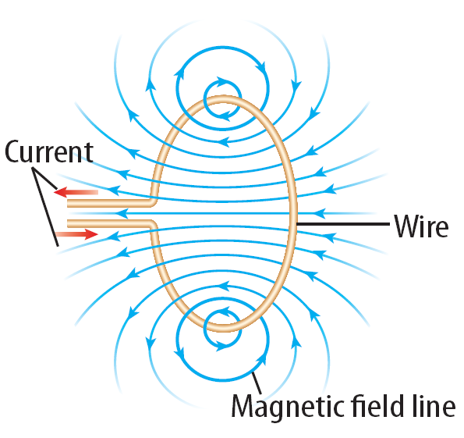
Electromagnets
When a current flows through a wire loop, the magnetic field inside the loop is stronger than the field around a straight wire.
Electricity and Magnetism
Copyright © McGraw-Hill Education

Slide 6
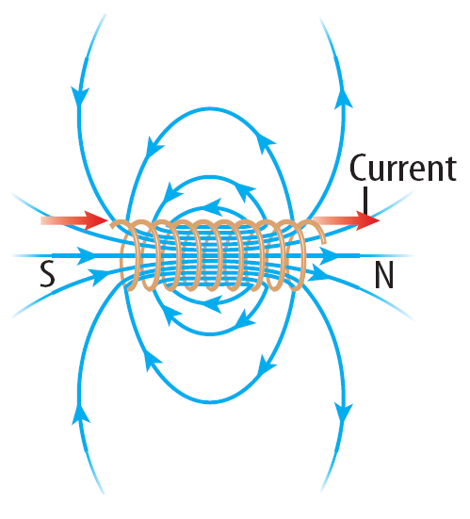
Electromagnets
A single wire wrapped into a cylindrical wire coil is called a solenoid.
The magnetic field inside a solenoid is stronger than the field in a single loop.
Electricity and Magnetism
Copyright © McGraw-Hill Education

Slide 7
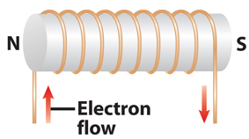
Electromagnets
An electromagnet is a temporary magnet made by wrapping a wire coil carrying a current around an iron core.
If the solenoid is wrapped around an iron core, an electromagnet is formed.
The solenoid’s magnetic field magnetizes the iron core. As a result, the field inside the solenoid with the iron core can be more than 1,000 times greater than the field inside the solenoid without the iron core.
Electricity and Magnetism
Copyright © McGraw-Hill Education

Slide 8
Properties of Electromagnets
Electromagnets are temporary magnets because the magnetic field is present only when current is flowing in the solenoid.
The strength of the magnetic field can be increased by adding more turns of wire to the solenoid or by increasing the current in the wire.
Electricity and Magnetism
Copyright © McGraw-Hill Education

Slide 9
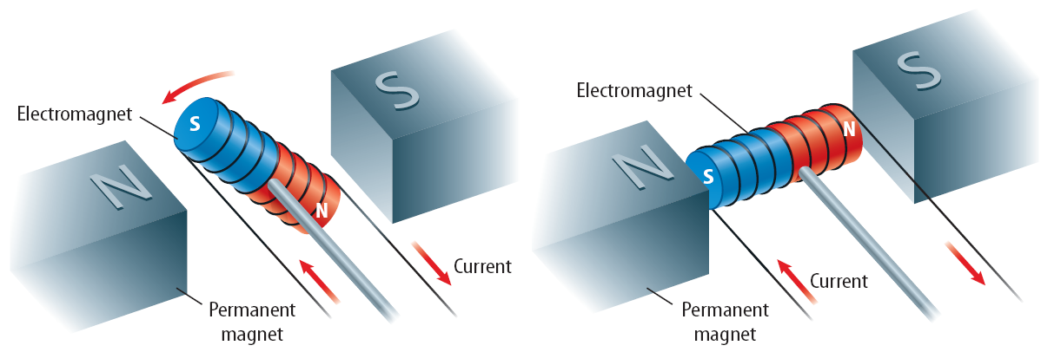
Making an Electromagnet Rotate
The forces exerted on an electromagnet by another magnet can be used to make the electromagnet rotate.
One way to change the forces that make the electromagnet rotate is to change the current in the electromagnet.
Increasing the current increases the strength of the forces between the two magnets.
Electricity and Magnetism
Copyright © McGraw-Hill Education

Slide 10
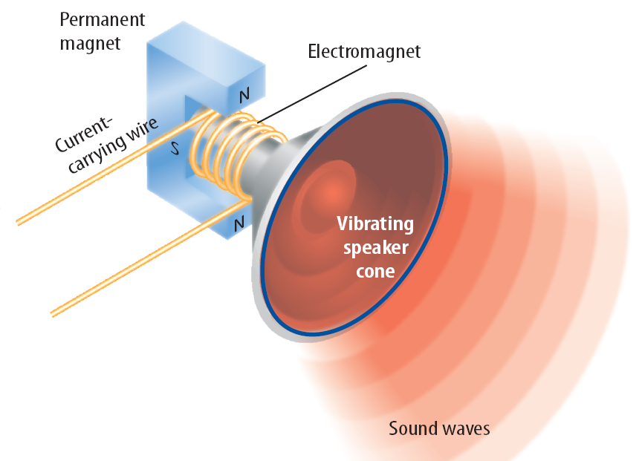
Using Electromagnets to Make Sound
How does musical information stored on a CD become sound you can hear?
The sound is produced by a loudspeaker that contains an electromagnet connected to a flexible speaker cone that is usually made from paper, plastic, or metal.
The electromagnet changes electrical energy to mechanical energy that vibrates the speaker cone to produce sound.
Electricity and Magnetism
Copyright © McGraw-Hill Education

Slide 11
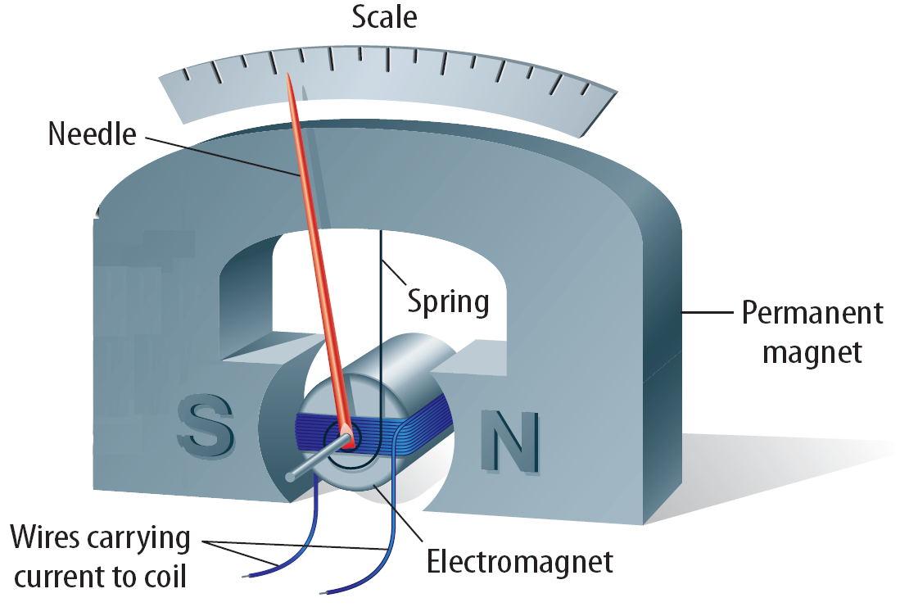
Galvanometers
How does a change in the amount of gasoline in a tank or the water temperature in the engine make a needle move in a gauge on the dashboard?
These gauges are galvanometers, which are devices that use an electromagnet to measure electric current.
In a galvanometer, the electromagnet is connected to a small spring.
Then the electromagnet rotates until the force exerted by the spring is balanced by the magnetic forces on the electromagnet.
Changing the current in the electromagnet causes the needle to rotate to different positions on the scale.
Electricity and Magnetism
Copyright © McGraw-Hill Education

Slide 12
Electric Motors
A fan uses an electric motor, which is a device that changes electrical energy into mechanical energy.
The motor in a fan turns the fan blades, moving air past your skin to make you feel cooler.
Almost every appliance in which something moves contains an electric motor.
Electricity and Magnetism
Copyright © McGraw-Hill Education

Slide 13
A Simple Electric Motor
The main parts of a simple electric motor include a wire coil, a permanent magnet, and a source of electric current, such as a battery.
The battery produces the current that makes the coil an electromagnet.
A simple electric motor also includes components called brushes and a commutator.
The brushes are conducting pads connected to the battery.
The brushes make contact with the commutator, which is a conducting metal ring that is split.
The brushes and the commutator form a closed electric circuit between the battery and the coil.
Electricity and Magnetism
Copyright © McGraw-Hill Education

Slide 14
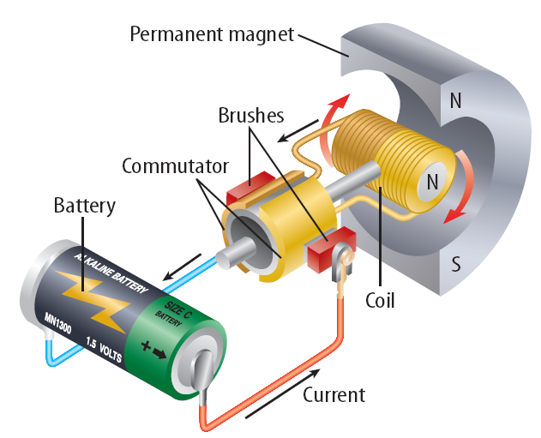
Making the Motor Spin
Step 1. When a current flows in the coil, the magnetic forces between the permanent magnet and the coil cause the coil to rotate.
Step 2. In this position, the brushes are not in contact with the commutator and no current flows in the coil. The inertia of the coil keeps it rotating.
Electricity and Magnetism
Copyright © McGraw-Hill Education

Slide 15
Making the Motor Spin
Step 3. The commutator reverses the direction of the current in the coil. This flips the north and south poles of the magnetic field around the coil.
Step 4. The coil rotates until its poles are opposite the poles of the permanent magnet. The commutator reverses the current, and the coil keeps rotating.
Electricity and Magnetism
Copyright © McGraw-Hill Education

Slide 16
Review
Essential Questions
How do moving electric charges and magnets interact?
What is the electromagnetic force?
How do an electromagnet’s properties affect its magnetic field strength?
How does an electric motor operate?
Vocabulary
electromagnetic force
electromagnetism
solenoid
electromagnet
galvanometer
electric motor
Electricity and Magnetism
Copyright © McGraw-Hill Education

