Slide 1
Essential Questions
When and how does a voltage difference produce an electric current?
How do batteries produce a voltage difference in a circuit?
How does Ohm’s law relate current, voltage difference, and resistance?
Electric Current
Copyright © McGraw-Hill Education

Slide 2
Vocabulary
Review
SI
New
electric current
voltage difference
electric circuit
resistance
Ohm’s law
Electric Current
Copyright © McGraw-Hill Education

Slide 3
Current and Voltage Difference
The net movement of electric charges in a single direction is an electric current.
In a metal wire, or any material, electrons are in constant motion in all directions. As a result, there is no net movement of electrons in one direction.
When an electric current flows in the wire, electrons continue their random movement, but they also drift in the direction that the current flows.
Electric current is measured in Amperes (A).
Electric Current
Copyright © McGraw-Hill Education

Slide 4
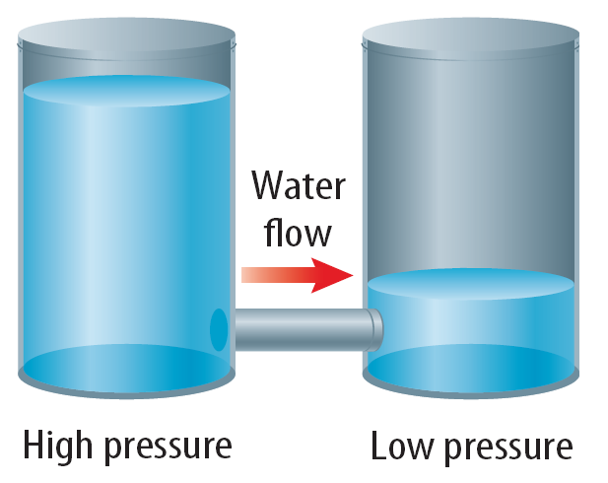
Voltage Difference
In some ways, the electric force that causes charges to flow is similar to the force acting on the water in a pipe.
Water flows from higher pressure to lower pressure.
Electric Current
Copyright © McGraw-Hill Education

Slide 5
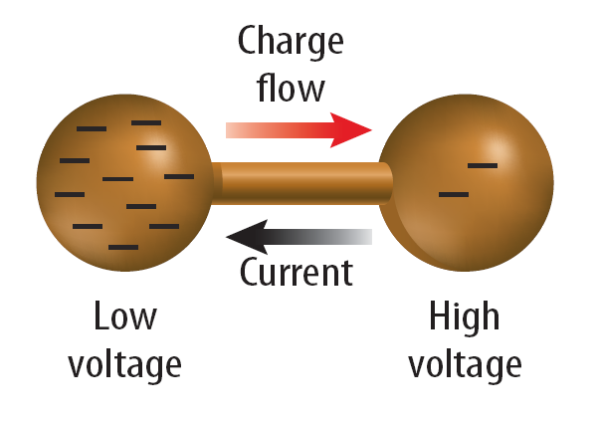
Voltage Difference
A voltage difference is related to the force that causes electric charges to flow. Voltage difference is measured in volts (v).
In a similar way, electric Current flows from higher voltage to lower voltage.
Electrons flow from low voltage to high voltage.
Electric Current
Copyright © McGraw-Hill Education

Slide 6
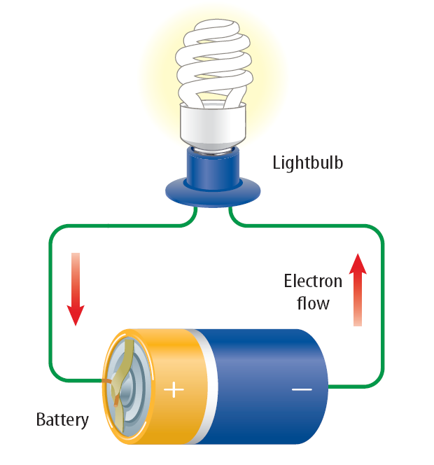
Electric Circuits
A closed path that electric current follows is a circuit.
This figure shows an electric current doing work by lighting a lightbulb.
If the circuit is broken by removing the battery, or the lightbulb, or one of the wires, current will not flow.
Electric Current
Copyright © McGraw-Hill Education

Slide 7
Batteries
A battery can provide the voltage difference that is needed to keep current flowing in a circuit.
To keep an electric current continually flowing in the electric circuit a voltage difference needs to be maintained in the circuit.
Current flows as long as there is a closed path that connects one battery terminal to the other battery terminal.
Electric Current
Copyright © McGraw-Hill Education

Slide 8
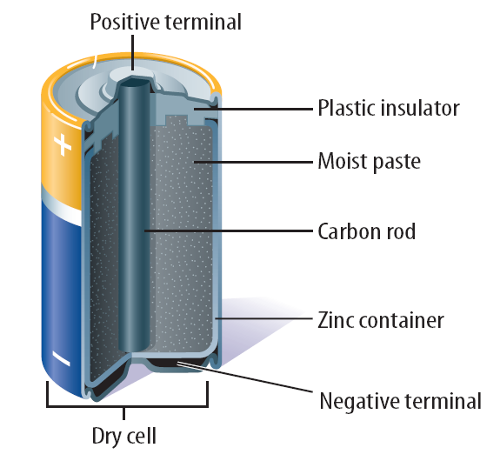
Dry-Cell Batteries
A cell consists of two electrodes surrounded by a material called an electrolyte.
The electrolyte enables charges to move from one electrode to the other.
One electrode is the carbon rod(+), and the other is the zinc
(-) container.
The electrolyte is a moist paste containing several chemicals.
The cell is called a dry cell because the electrolyte is a moist paste, and not a liquid solution.
Electric Current
Copyright © McGraw-Hill Education

Slide 9
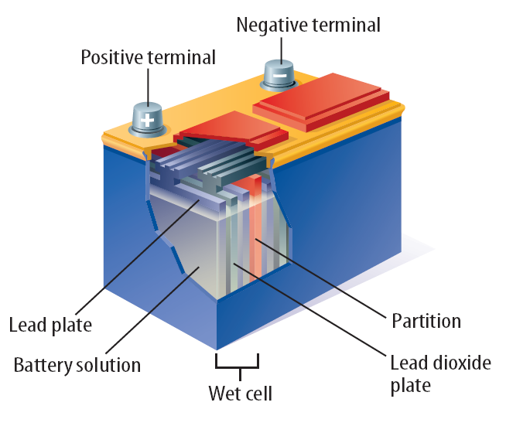
Wet-Cell Batteries
A wet cell contains two connected plates made of different metals or metallic compounds in a conducting solution.
A wet-cell battery contains several wet cells connected together.
Electric Current
Copyright © McGraw-Hill Education

Slide 10
Lead-Acid Batteries
A lead-acid battery contains a series of six wet cells made up of lead and lead dioxide plates in a sulfuric acid solution.
Most car batteries are lead-acid batteries.
The chemical reaction in each cell provides a voltage difference of about 2 V, giving a total voltage difference of 12 V.
Electric Current
Copyright © McGraw-Hill Education

Slide 11
Resistance
Resistance is the tendency for a material to oppose the flow of electrons, changing electrical energy into thermal energy and light.
With the exception of some substances that become superconductors at low temperatures, all materials have some electrical resistance.
Resistance is measured in ohms (Ω).
As the electrons flow through the filament in a light bulb, they bump into the metal atoms that make up the filament.
In these collisions, some of the electrical energy of the electrons is converted into thermal energy. Eventually, the metal filament becomes hot enough to glow, producing radiant energy that can light up a dark room.
Electric Current
Copyright © McGraw-Hill Education

Slide 12
Temperature, Length, and Thickness
The electric resistance of most materials usually increases as the temperature of the material increases.
The resistance of an object such as a wire also depends on the length and diameter of the wire.
The resistance of a wire, or any conductor, increases as the wire becomes longer.
The resistance also increases as the wire becomes thinner.
Electric Current
Copyright © McGraw-Hill Education

Slide 13
The Current in a Simple Circuit
A simple electric circuit contains a source of voltage difference, such as a battery, a device, such as a lightbulb, that has resistance, and conductors that connect the device to the battery terminals.
When the wires are connected to the battery terminals, current flows in the closed path.
The voltage difference, current, and resistance in a circuit are related.
If the voltage difference doesn't change, decreasing the resistance increases the current in the circuit.
If the resistance doesn't change, increasing the voltage difference increases the current.
Electric Current
Copyright © McGraw-Hill Education

Slide 14
Ohm’s Law
According to Ohm's law, the current in a circuit equals the voltage difference divided by the resistance.
Ohm's law provides a way to measure the resistance of objects and materials.
An object is connected to a source of voltage difference and the current flowing in the circuit is measured.
The object's resistance then equals the voltage difference divided by the measured current.
If I stands for the electric current, Ohm's law can be written as the following equation:
Electric Current
Copyright © McGraw-Hill Education

Slide 15
SOLVE FOR CURRENT
SOLVE FOR THE UNKNOWN
Set Up the Problem
I = $\frac{\text{V}}{\text{R} }$
Solve the Problem
I = $\frac{\text{6} \text{V}}{\text{1,200 }\text{Ω} }$
I = 0.005 $\frac{\text{V}}{\text{Ω}}$ = 0.005 A
The current through the batteries of the graphing calculator is 0.005 A.
Use with Example Problem 1.
Problem
The voltage difference in a graphing calculator is 6 V, and the resistance is 1,200 Ω. What is the current through the batteries of the graphing calculator?
Response
ANALYZE THE PROBLEM
KNOWN
voltage difference: V = 6 V
resistance: R = 1,200 Ω
UNKNOWN
current: I
EVALUATE THE ANSWER
The current in a graphing calculator is probably very small, and the answer for current is very small. Therefore, the answer is reasonable.
Electric Current
Copyright © McGraw-Hill Education

Slide 16
Alternating Current and Direct Current
An AC/DC adapter converts the alternating current from an electrical outlet into direct current.
In the U.S., electric power grids are built so that alternating current changes direction 120 times each second. Household appliances, such as toasters and hair dryers, are built to use alternating current.
Unlike alternating current, direct current never changes direction. Battery-powered devices, such as flashlights, use direct current.
Electric Current
Copyright © McGraw-Hill Education

Slide 17
Review
Essential Questions
When and how does a voltage difference produce an electric current?
How do batteries produce a voltage difference in a circuit?
How does Ohm’s law relate current, voltage difference, and resistance?
Vocabulary
electric current
voltage difference
electric circuit
resistance
Ohm’s law
Electric Current
Copyright © McGraw-Hill Education

