Slide 1
Essential Questions
How do geocentric and heliocentric models of the solar system differ?
What is each planet’s position in the solar system?
How are planets classified?
Planet Motion
Copyright © McGraw-Hill Education

Slide 2
Vocabulary
Review
ellipse
New
geocentric model
heliocentric model
extrasolar planet
Planet Motion
Copyright © McGraw-Hill Education

Slide 3
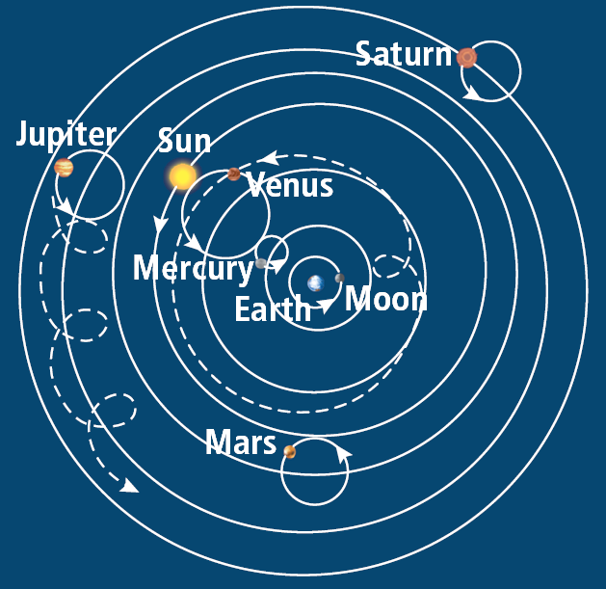
Models of the Solar System
Geocentric model
In the geocentric model of the solar system, Earth is considered the center and everything else revolves around it.
This model was developed by the Greek philosopher Ptolemy.
Planet Motion
Copyright © McGraw-Hill Education

Slide 4
Models of the Solar System
Heliocentric model
Earth-centered model held until 1543 when Polish astronomer Nicholas Copernicus proposed a different view.
Copernicus stated that the Moon revolves around Earth.
Earth and the other planets revolve around the Sun.
Planet Motion
Copyright © McGraw-Hill Education

Slide 5
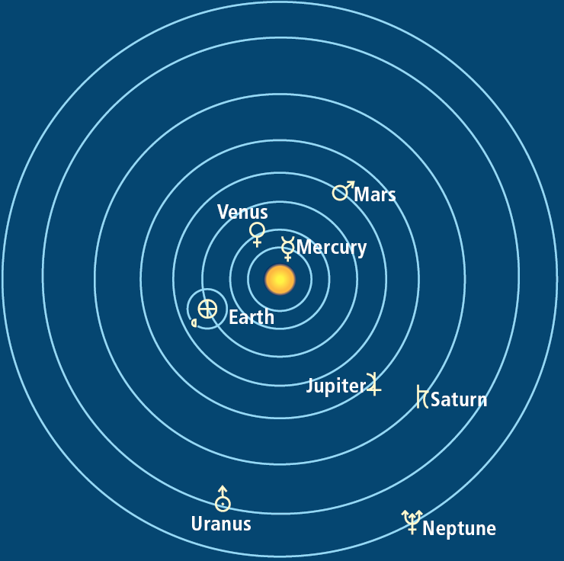
Models of the Solar System
Heliocentric model
The apparent motion of the planets, the stars, and the Sun is due to Earth’s rotation. This is the heliocentric model, or Sun-centered model of the solar system.
Planet Motion
Copyright © McGraw-Hill Education

Slide 6
Models of the Solar System
Heliocentric model
Using his telescope, Italian astronomer Galileo Galilei discovered evidence to support Copernicus’s model.
He observed that Venus went through phases like the Moon’s.
He also saw moons in orbit around Jupiter.
Planet Motion
Copyright © McGraw-Hill Education

Slide 7
Understanding the Solar System
In the early 1600’s, the German astronomer Johannes Kepler discovered the planets travel around the Sun in ellipses, not perfect spheres.
Planets travel at different speeds in their orbits.
The closer a planet is to the Sun, the faster it completes its orbit.
The astronomical unit (AU) equals the average distance from Earth to the Sun, about 150 million km.
Planet Motion
Copyright © McGraw-Hill Education

Slide 8
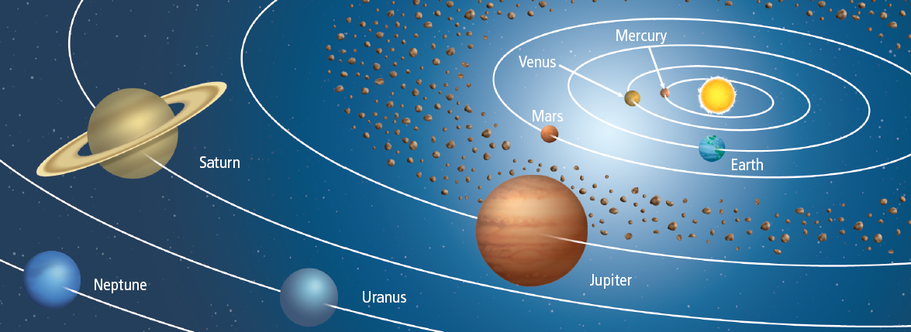
Understanding the Solar System
Classifying the planets
One system uses size, structure, and composition.
Those similar to Earth are called terrestrial planets. Giant planets are Jovian planets, “Gas Giants”
Two other systems classify planets by location.
Planet Motion
Copyright © McGraw-Hill Education

Slide 9
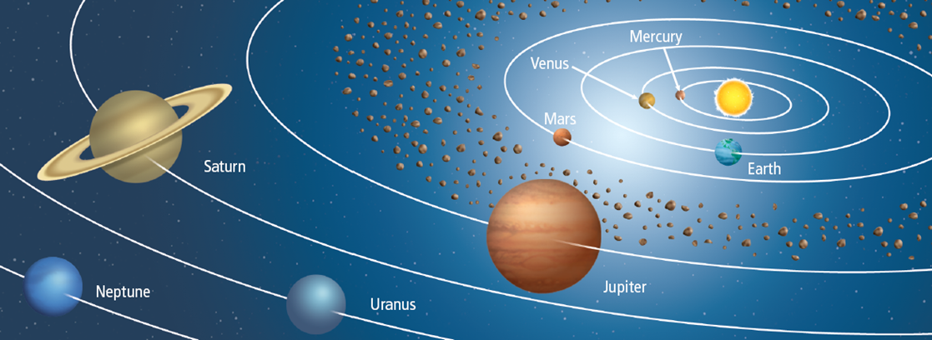
Understanding the Solar System
Classifying the planets based on orbit location:
Planets whose orbits are between the Sun and the asteroid belt are classified as inner planets and those beyond the asteroid belt are outer planets.
Another system classifies planets whose orbits are between Earth’s orbit and the Sun as inferior planets, and those whose orbits are beyond Earth’s orbit as superior planets.
Planet Motion
Copyright © McGraw-Hill Education

Slide 11
Other Solar Systems
Extrasolar planets—planets in orbit around other stars—are helping astronomers learn how planetary systems form.
As of 2013, astronomers have discovered more than 1,700 extrasolar planets in the universe.
Planet Motion
Copyright © McGraw-Hill Education

Slide 12
Review
Essential Questions
How do geocentric and heliocentric models of the solar system differ?
What is each planet’s position in the solar system?
How are planets classified?
Vocabulary
geocentric model
heliocentric model
extrasolar planet
Planet Motion
Copyright © McGraw-Hill Education

