Slide 1
Essential Questions
How is the periodic table organized?
What are the trends on the periodic table?
What are the properties of metals, nonmetals, and metalloids?
The Periodic Table
Copyright © McGraw-Hill Education

Slide 2
Vocabulary
Review
chemical property
New
periodic table
period
group
electron dot diagram
The Periodic Table
Copyright © McGraw-Hill Education

Slide 3
Organizing the Elements
In the periodic table, the elements are arranged by increasing atomic number and by changes in physical and chemical properties.
In the late 1800s, Dmitri Mendeleev, a Russian chemist, searched for a way to organize the elements.
When he arranged all the elements known at that time in order of increasing atomic masses, he discovered a pattern.
Because the pattern repeated, it was considered to be periodic. Today, this arrangement is called a periodic table of elements.
The Periodic Table
Copyright © McGraw-Hill Education

Slide 4
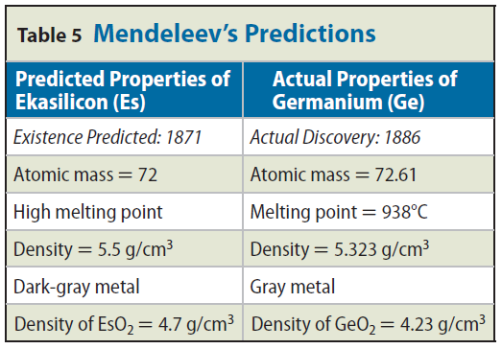
Mendeleev's predictions
Mendeleev had to leave blank spaces in his periodic table to keep the elements properly lined up according to their chemical properties.
From this information, he was able to predict the properties and the mass numbers of new elements that had not yet been discovered.
This table shows Mendeleev's predicted properties for germanium, which he called ekasilicon. His predictions proved to be accurate.
The Periodic Table
Copyright © McGraw-Hill Education

Slide 5
Changes in the periodic table
On Mendeleev's table, the atomic mass gradually increased from left to right. If you look at the modern periodic table, you will see several examples, such as cobalt and nickel, where the mass decreases from left to right.
In 1913, the work of Henry G.J. Moseley, a young English scientist, led to the arrangement of elements based on their increasing atomic numbers instead of an arrangement based on atomic masses.
The current periodic table uses Moseley's arrangement of the elements.
The Periodic Table
Copyright © McGraw-Hill Education

Slide 6
The Atom and the Periodic Table
The vertical columns in the periodic table are called groups, or families, and are numbered 1 through 18.
Elements in each group have similar properties.
The Periodic Table
Copyright © McGraw-Hill Education

Slide 7
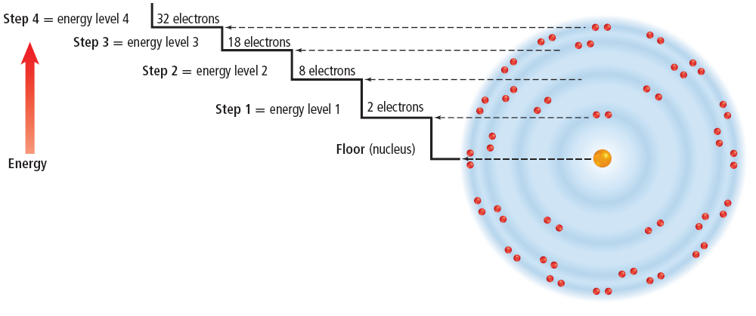
Electron cloud structure
In a neutral atom, the number of electrons is equal to the number of protons.
Scientists have found that electrons within the electron cloud have different amounts of energy.
The Periodic Table
Copyright © McGraw-Hill Education

Slide 8
Energy levels
Energy levels closer to the nucleus have less energy than those levels that are farther away.
Electrons fill these energy levels from the inner levels (closer to the nucleus) to the outer levels (farther from the nucleus).
Elements that are in the same group have the same number of electrons in their outer energy level.
It is the number of electrons in the outer energy level that determines the chemical properties of the element.
The Periodic Table
Copyright © McGraw-Hill Education

Slide 9
Energy levels
The maximum number of electrons that can be contained in each of the first four levels is shown.
A complete and stable outer energy level will contain eight electrons.
The Periodic Table
Copyright © McGraw-Hill Education

Slide 10
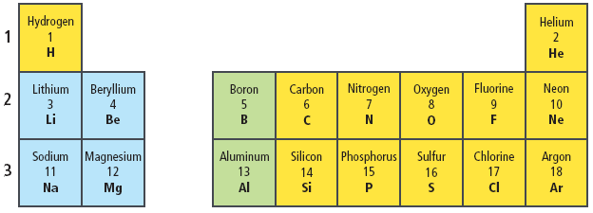
Rows on the periodic table
Remember that the atomic number found on the periodic table is equal to the number of electrons in an atom.
The first row has hydrogen with one electron and helium with two electrons both in energy level one.
Energy level one can hold only two electrons. Therefore, helium has a full or complete outer energy level.
The Periodic Table
Copyright © McGraw-Hill Education

Slide 11
Rows on the periodic table
The second row begins with lithium, which has three electrons—two in energy level one and one in energy level two.
Lithium is followed by beryllium with two outer electrons, boron with three, and so on until you reach neon with eight outer electrons.
The Periodic Table
Copyright © McGraw-Hill Education

Slide 12
Rows on the periodic table
Do you notice how the row in the periodic table ends when an outer level is filled?
In the third row of elements, the electrons begin filling energy level three.
The row ends with argon, which has a full outer energy level of eight electrons.
The Periodic Table
Copyright © McGraw-Hill Education

Slide 13
Electron dot diagrams
An electron dot diagram uses the symbol of the element and dots to represent the electrons in the outer energy level.
Elements that are in the same group have the same number of electrons in their outer energy level.
These electrons determine the chemical properties of an element.
Electron dot diagrams are used also to show how the electrons in the outer energy level are bonded when elements combine to form compounds.
The Periodic Table
Copyright © McGraw-Hill Education

Slide 14
Same group—similar properties
The elements in Group 17, the halogens, have electron dot diagrams similar to chlorine.
All halogens have seven electrons in their outer energy levels.
A common property of the halogens is the ability to form compounds readily with elements in Group 1.
The Group 1 element, sodium, reacts easily with the Group 17 element, chlorine.
The result is the compound sodium chloride, or NaCl—ordinary table salt.
The Periodic Table
Copyright © McGraw-Hill Education

Slide 15
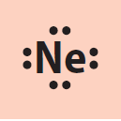
Same group—similar properties
Not all elements will combine readily with other elements.
The elements in Group 18 have complete outer energy levels.
This special configuration makes Group 18 elements relatively unreactive.
The Periodic Table
Copyright © McGraw-Hill Education

Slide 16
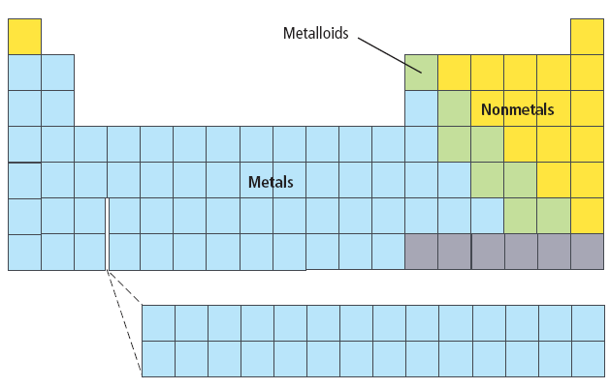
Regions of the Periodic Table
The horizontal rows of elements on the periodic table are called periods.
The vertical columns are called groups.
The elements increase by one proton and one electron as you go from left to right in a period. Elements within a group tend to have the same # of valence electrons.
All of the elements in the blue squares are metals.
The elements in yellow, are classified as nonmetals.
The elements in green are metalloids or semimetals.
The Periodic Table
Copyright © McGraw-Hill Education

Slide 17
Elements in the Universe
Using the technology that is available today, scientists are finding the same elements throughout the universe.
Many scientists believe that hydrogen and helium are the building blocks of other elements.
Exploding stars, or supernovas, give scientists evidence to support this theory.
Many scientists believe that supernovas have spread the elements that are found throughout the universe.
The Periodic Table
Copyright © McGraw-Hill Education

Slide 18
Review
Essential Questions
How is the periodic table organized?
What are the trends on the periodic table?
What are the properties of metals, nonmetals, and metalloids?
Vocabulary
periodic table
period
group
electron dot diagram
The Periodic Table
Copyright © McGraw-Hill Education

