Slide 1
Essential Questions
How do you determine the atomic mass and mass number of an atom?
What are isotopes?
How do you determine the average atomic mass of an element?
Masses of Atoms
Copyright © McGraw-Hill Education

Slide 2
Vocabulary
Review
mass
New
atomic number
mass number
isotope
average atomic mass
Masses of Atoms
Copyright © McGraw-Hill Education

Slide 3
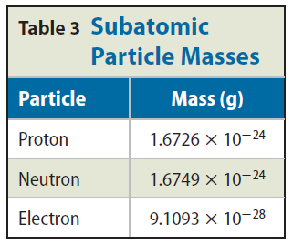
Atomic Mass
The nucleus contains most of the mass of the atom because protons and neutrons are far more massive than electrons.
The mass of a proton is about the same as that of a neutron. And the mass of each is about 1,800 times greater than the mass of the electron.
The unit of measurement used for atomic particles is the atomic mass unit (amu).
The mass of a proton or a neutron is almost equal to 1 amu.
Masses of Atoms
Copyright © McGraw-Hill Education

Slide 4
Atomic number
The number of protons in an atom is equal to its atomic number.
The number of protons tells you what type of atom you have and vice versa.
For example, every carbon atom has six protons. Also, all atoms with six protons are carbon atoms.
Masses of Atoms
Copyright © McGraw-Hill Education

Slide 5
Mass number
The mass number of an atom is the sum of the number of protons and the number of neutrons in the nucleus of an atom.
mass number = number of protons + number of neutrons
Masses of Atoms
Copyright © McGraw-Hill Education

Slide 6
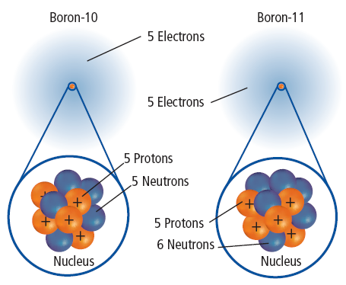
Isotopes
Atoms of the same element that have different numbers of neutrons are called isotopes.
Models of two isotopes of boron are shown. Because the numbers of neutrons in the isotopes are different, the mass numbers are also different.
You use the name of the element followed by the mass number of the isotope to identify each isotope: boron-10 and boron-11.
Masses of Atoms
Copyright © McGraw-Hill Education

Slide 7
Average atomic mass
The average atomic mass is the weighted-average mass of an element’s isotopes according to their natural abundance.
For example, four out of five atoms of boron are boron-11, and one out of five is boron-10.
To find the weighted-average or the average atomic mass of boron, you would solve the following equation:
Masses of Atoms
Copyright © McGraw-Hill Education

Slide 8
Review
Essential Questions
How do you determine the atomic mass and mass number of an atom?
What are isotopes?
How do you determine the average atomic mass of an element?
Vocabulary
atomic number
mass number
isotope
average atomic mass
Masses of Atoms
Copyright © McGraw-Hill Education

