Slide 1
Essential Questions
What is the law of reflection?
Why do waves change direction when they travel from one material to another?
How are refraction and diffraction similar? How are they different?
What happens when waves interfere with each other?
The Behavior of Waves
Copyright © McGraw-Hill Education

Slide 2
Reflection
Reflection occurs when a wave strikes an object and bounces off of it.
All types of waves—including sound, water and light waves—can be reflected.
How does the reflection of light allow you to see yourself in the mirror? It happens in two steps. First, light strikes your face and bounces off. Then, the light reflected off your face strikes the mirror and is reflected into your eyes.
The Behavior of Waves
Copyright © McGraw-Hill Education

Slide 3
Echoes
A similar thing happens to sound waves when your footsteps echo.
Sound waves form when your foot hits the floor and the waves travel through the air to both your ears and other objects.
Sometimes when the sound waves hit another object, they reflect off that object and come back to you.
Your ears hear the sound again, a few seconds after you first heard your footstep.
The Behavior of Waves
Copyright © McGraw-Hill Education

Slide 4
The Law of Reflection
According to the law of reflection, the angle of incidence is equal to the angle of refection. All reflected waves obey this law.
The beam striking the mirror is called the incident beam.
The beam that bounces off the mirror is called the reflected beam.
The line drawn perpendicular to the surface of the mirror is called the normal.
The angle formed by the incident beam and the normal is the angle of incidence.
The angle formed by the reflected beam and the normal is the angle of reflection.
The Behavior of Waves
Copyright © McGraw-Hill Education

Slide 5
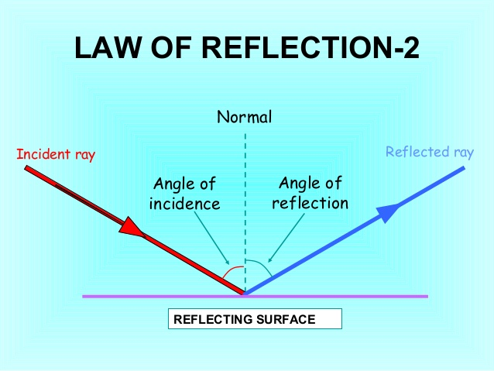

Slide 6
Refraction
Refraction is the bending of a wave caused by a change in its speed as it moves from one medium to another.
When a wave passes from one medium to another—such as when a light wave passes from air to water—it changes speed.
If the wave is traveling at an angle when it passes from one medium to another, it changes direction, or bends, as it changes speed.
The Behavior of Waves
Copyright © McGraw-Hill Education

Slide 7
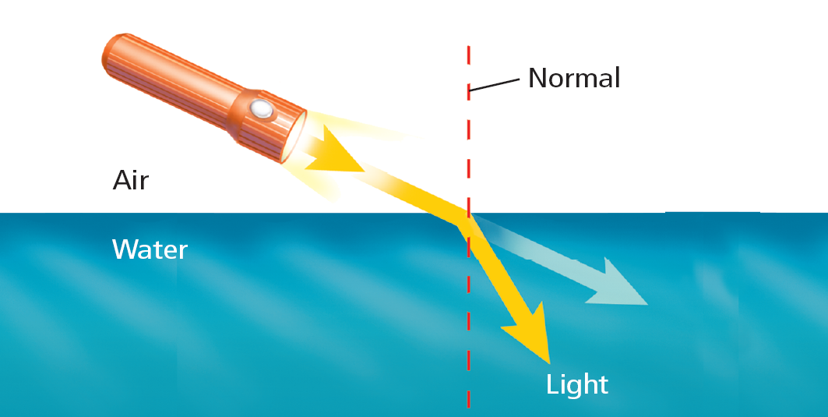
Refraction of Light in Water
Light waves travel slower in water than in air. This causes light waves to change direction when they move from water to air or air to water.
When light waves travel from air to water, they slow down and bend toward the normal.
The Behavior of Waves
Copyright © McGraw-Hill Education

Slide 8
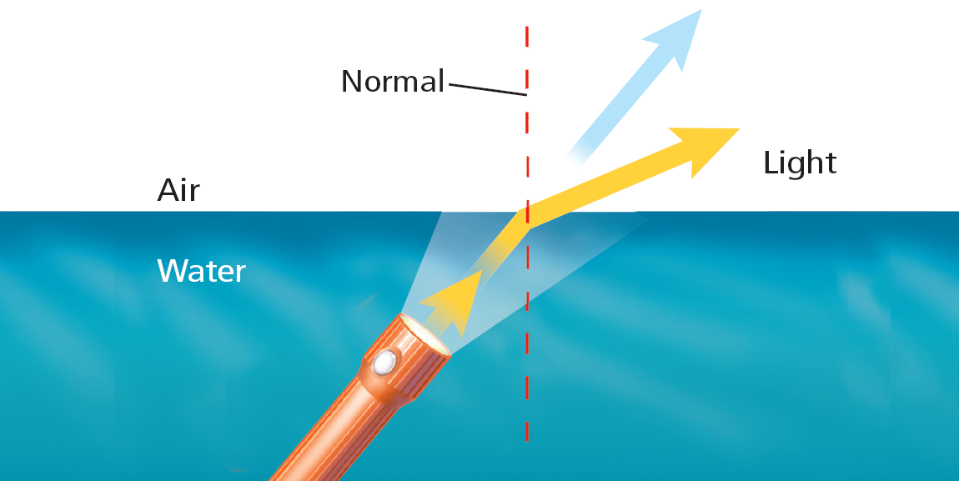
Refraction of Light in Water
When light waves travel from water to air, they speed up and bend away from the normal.
The Behavior of Waves
Copyright © McGraw-Hill Education

Slide 9
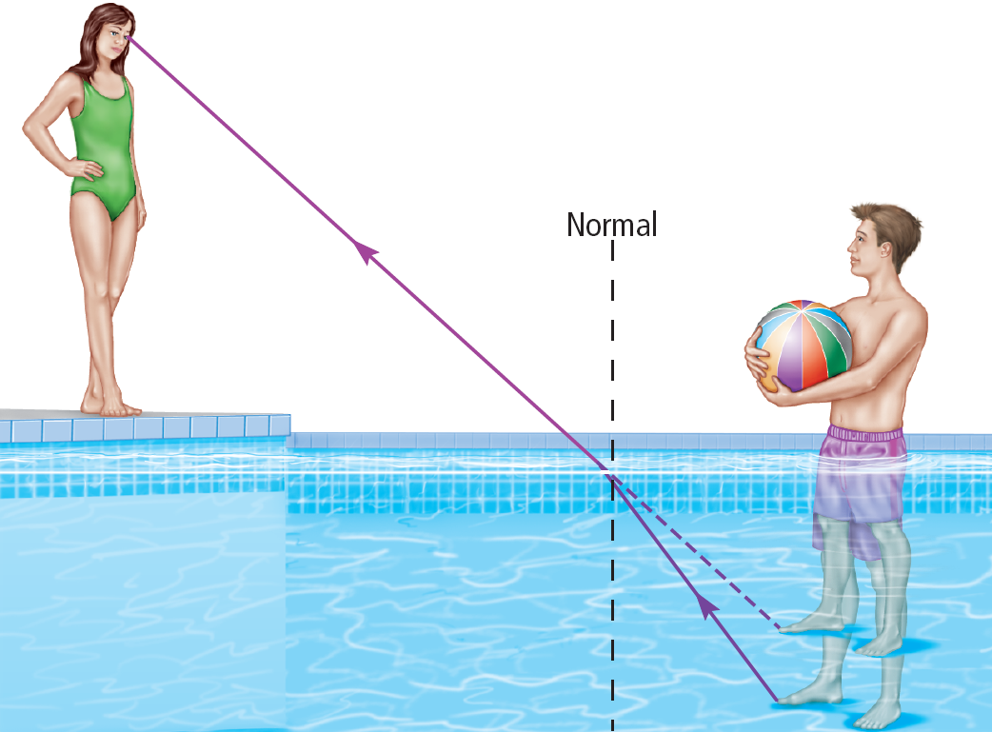
Refraction of Light in Water
You may have noticed that objects that are underwater seem closer to the surface than they really are.
In the figure, the light waves reflected from the swimmer’s foot are refracted away from the normal and enter your eyes.
However, your brain assumes that all light waves have traveled in a straight line.
The light waves that enter your eyes seem to have come from a foot that was higher in the water.
The Behavior of Waves
Copyright © McGraw-Hill Education

Slide 10
Diffraction
When waves strike an object, several things can happen.
The waves can bounce off, or be reflected.
If the object is transparent, light waves can be refracted as they pass through it.
Waves also can behave another way when they strike an object. The waves can bend around the object.
The Behavior of Waves
Copyright © McGraw-Hill Education

Slide 11
Diffraction
Diffraction occurs when an object causes a wave to change direction and bend around it.
Diffraction and refraction both cause waves to bend. The difference is that refraction occurs when waves pass through an object, while diffraction occurs when waves pass around an object.
Waves also can be diffracted when they pass through a narrow opening.
After they pass through the opening, the waves spread out.
The Behavior of Waves
Copyright © McGraw-Hill Education

Slide 12
Diffraction and Wavelength
The amount of diffraction that occurs depends on how big the obstacle or opening is compared to the wavelength.
When an obstacle is smaller than the wavelength, the waves bend around it.
If the obstacle is larger than the wavelength, the waves do not diffract as much. In fact, if the obstacle is much larger than the wavelength, almost no diffraction occurs.
The Behavior of Waves
Copyright © McGraw-Hill Education

Slide 14
Hearing Around Corners
You’re walking down the hallway and you can hear sounds coming from the lunchroom before you reach the open lunchroom door. Why can you hear the sound waves but not see the light waves while you’re still in the hallway?
The wavelengths of sound waves are similar in size to a door opening. Sound waves diffract around the door and spread out down the hallway.
Light waves have a much shorter wavelength. They are not observably diffracted by the door.
The Behavior of Waves
Copyright © McGraw-Hill Education

Slide 15
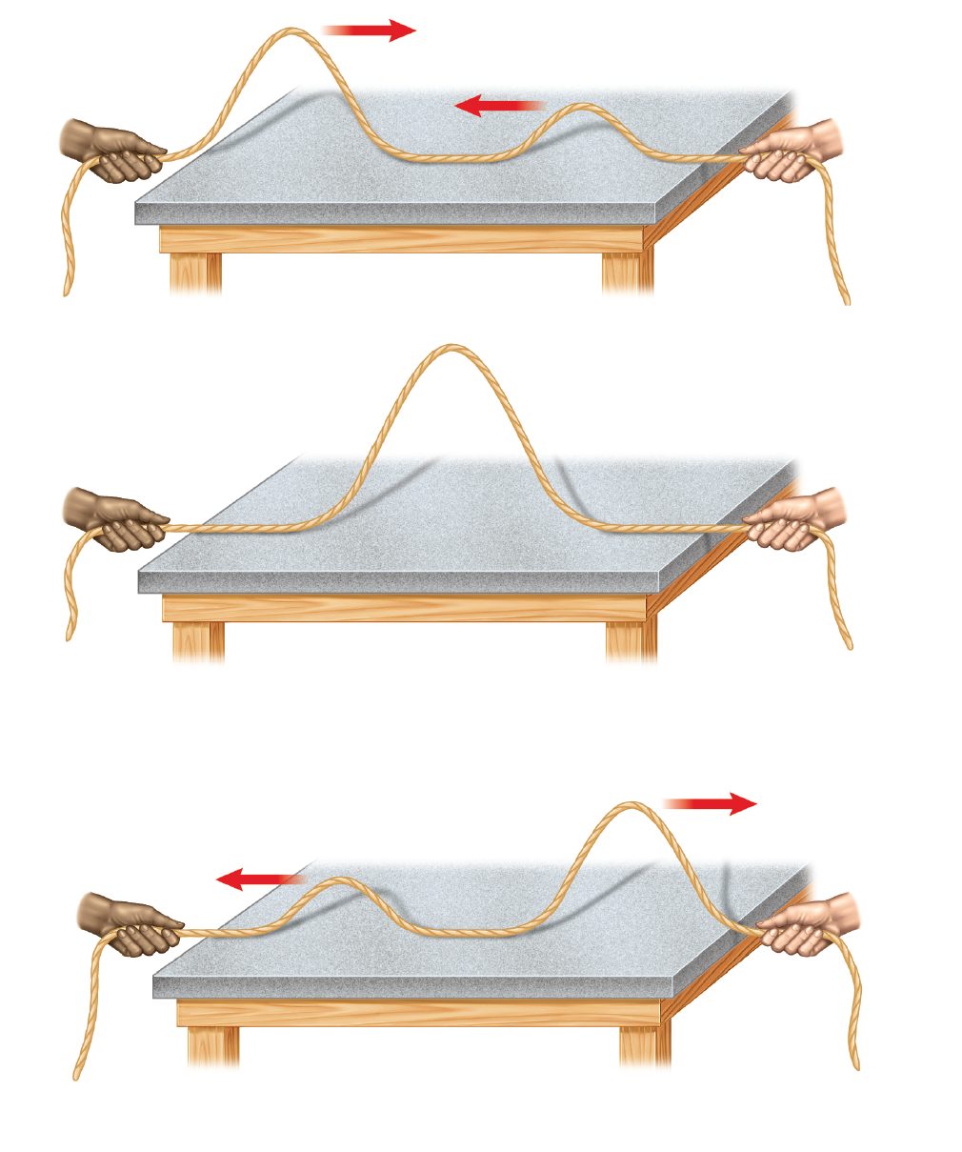
Interference
When two or more waves overlap and combine to form a new wave, the process is called interference. Interference occurs while two waves are overlapping.
The Behavior of Waves
Copyright © McGraw-Hill Education

Slide 16
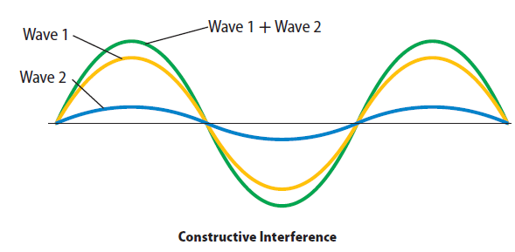
Constructive Interference
With constructive interference, the waves add together.
This happens when the crests of two or more transverse waves arrive at the same place at the same time and overlap.
The Behavior of Waves
Copyright © McGraw-Hill Education

Slide 17
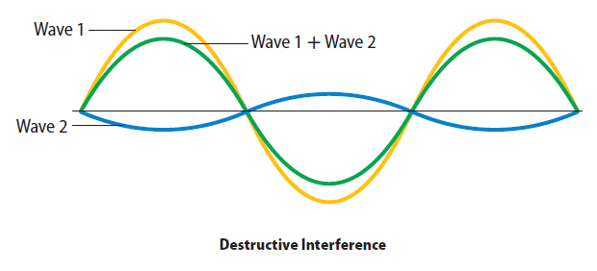
Constructive Interference
The amplitude of the new wave that forms is equal to the sum of the amplitudes of the original waves.
The Behavior of Waves
Copyright © McGraw-Hill Education

Slide 18
Destructive Interference
With destructive interference, the waves subtract from each other as they overlap.
This happens when the crests of one transverse wave meet the troughs of another transverse wave.
The Behavior of Waves
Copyright © McGraw-Hill Education

Slide 19
Destructive Interference
The amplitude of the new wave is the difference between the amplitudes of the waves that overlapped.
Waves undergoing destructive interference are said to be out of phase.
The Behavior of Waves
Copyright © McGraw-Hill Education

Slide 20
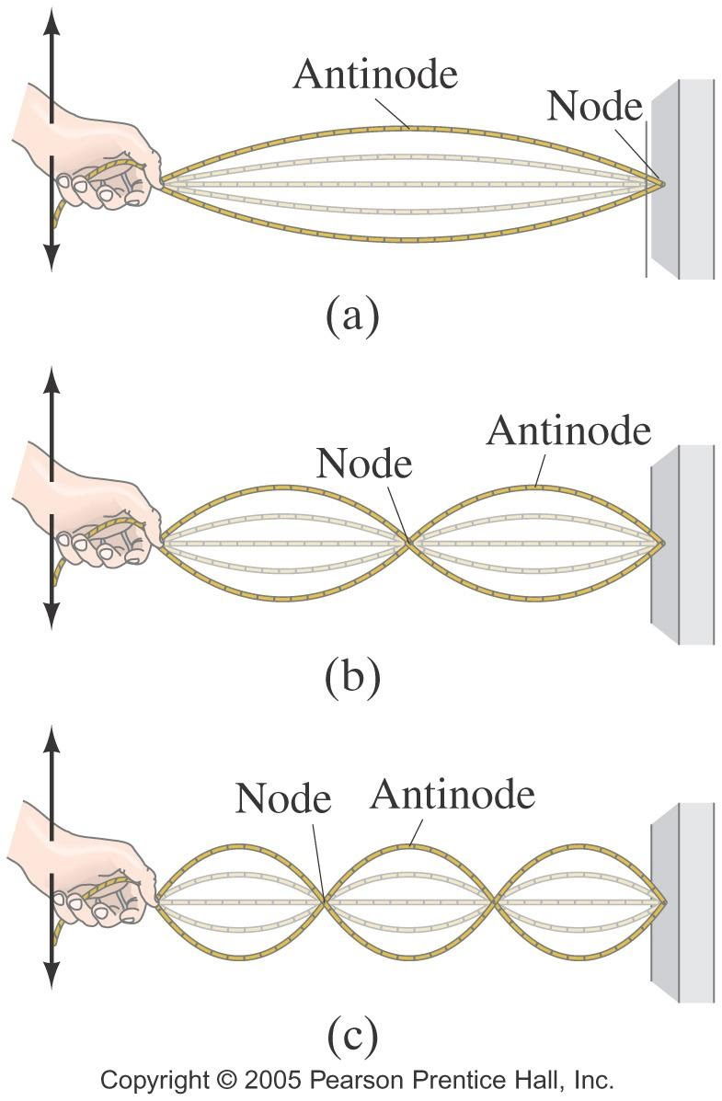
Standing Waves
A standing wave is a special type of wave pattern that forms when waves equal in wavelength and amplitude, but traveling in opposite directions, continuously interfere with each other.
The places where the two waves always cancel are called nodes.
The Behavior of Waves
Copyright © McGraw-Hill Education

Slide 21
Resonance
The process by which an object is made to vibrate at its natural frequencies is called resonance.
If enough energy is transferred to the object, the object can vibrate so strongly that it breaks apart.
The Behavior of Waves
Copyright © McGraw-Hill Education

Slide 22
Review
Essential Questions
What is the law of reflection?
Why do waves change direction from one material to another?
How are refraction and diffraction similar? How are they different?
What happens when waves interfere with each other?
Vocabulary
refraction
diffraction
interference
standing wave
node
resonance
The Behavior of Waves
Copyright © McGraw-Hill Education

