Slide 1

Section 2: Wave Properties
Wave properties depend on the vibrations of the wave source and the material in which the wave travels.
K What I Know | W What I Want to Find Out | L What I Learned

Slide 2
Essential Questions
How are wavelength and period related?
What is the relationship between frequency and wavelength?
How do you calculate the speed of a wave?
Wave Properties
Copyright © McGraw-Hill Education

Slide 3
Vocabulary
Review
vibration
New
crest
trough
compression
rarefaction
wavelength
frequency
period
amplitude
Wave Properties
Copyright © McGraw-Hill Education

Slide 4
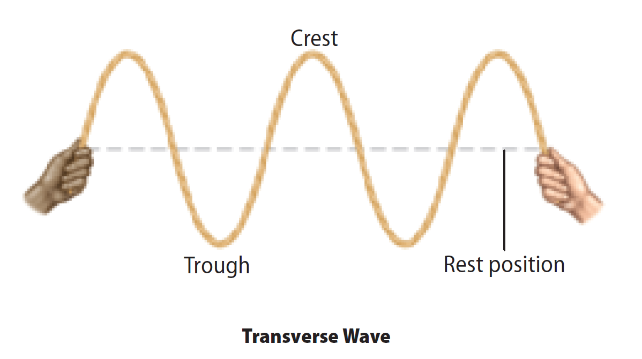
The Parts of a Wave
A transverse wave has alternating high points, called crests, and low points, called troughs.
Wave Properties
Copyright © McGraw-Hill Education

Slide 5
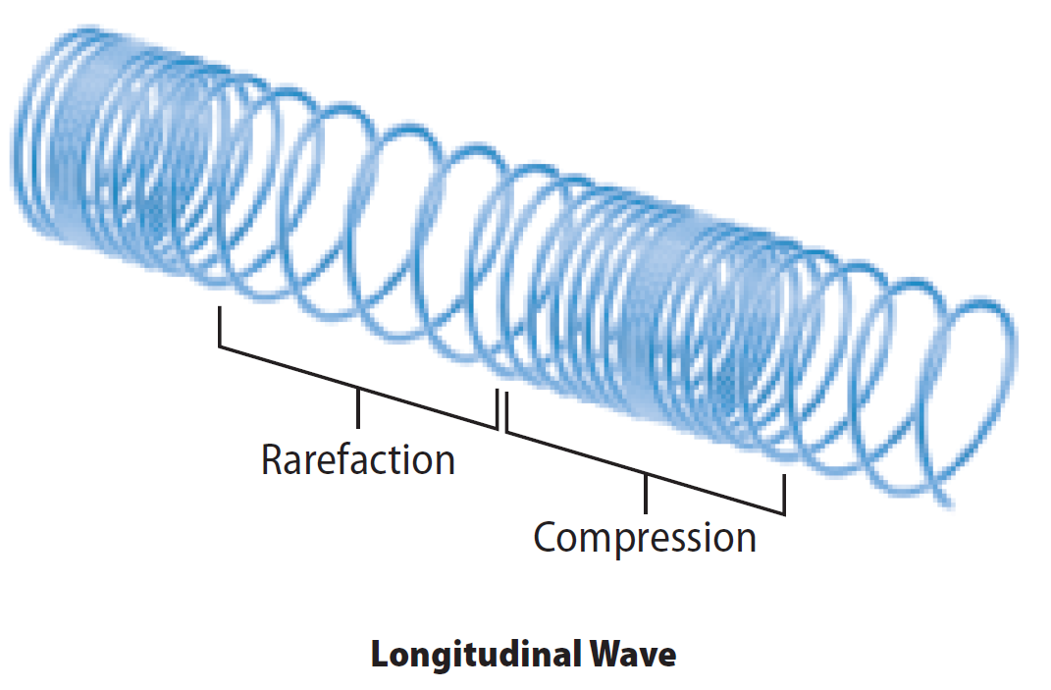
The Parts of a Wave
A longitudinal wave has no crests and troughs. When you make longitudinal waves with a coiled spring, a compression is a region where the coils are close together.
Wave Properties
Copyright © McGraw-Hill Education

Slide 6
The Parts of a Wave
The coils in the region next to a compression are spread apart, or less dense. This less-dense region of a longitudinal wave is called a rarefaction.
Wave Properties
Copyright © McGraw-Hill Education

Slide 7
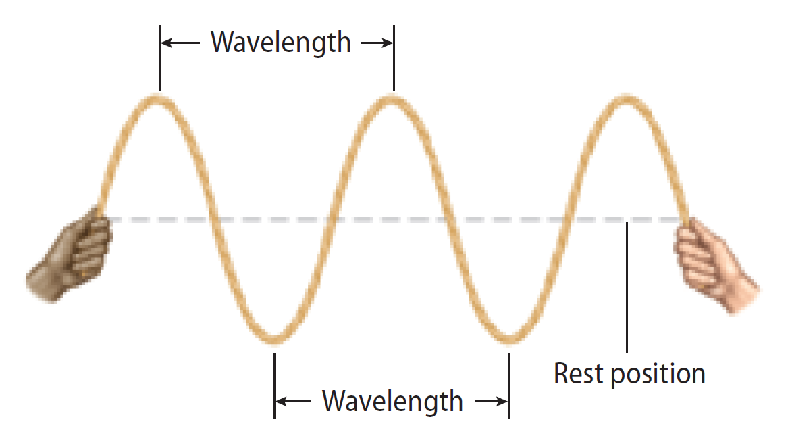
Wavelength
A wavelength is the distance between one point on a wave and the nearest point just like it.
For transverse waves the wavelength is the distance from crest to crest or trough to trough.
Wave Properties
Copyright © McGraw-Hill Education

Slide 8
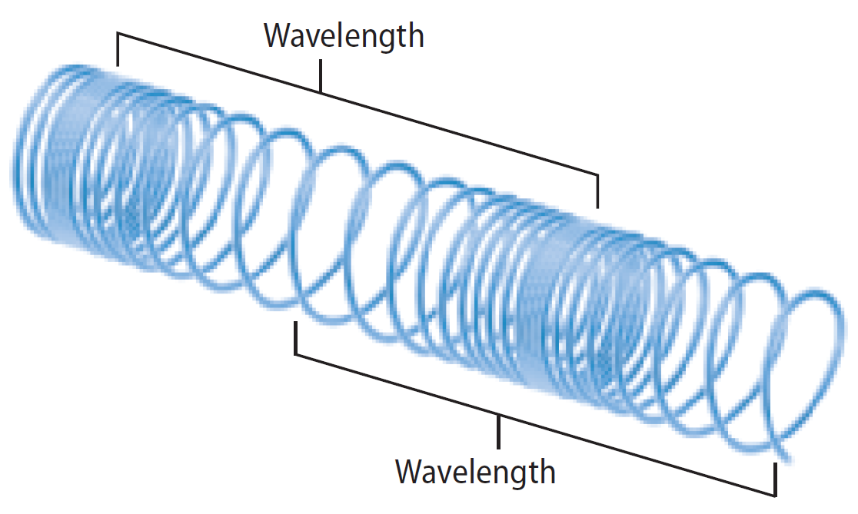
Wavelength
A wavelength in a longitudinal wave is the distance between two neighboring compressions or two neighboring rarefactions.
Wave Properties
Copyright © McGraw-Hill Education

Slide 9
Wavelength
The wavelengths of sound waves that you can hear range from a few centimeters for the highest-pitched sounds to about 15 m for the deepest sounds.
Wave Properties
Copyright © McGraw-Hill Education

Slide 10
Frequency and Period
The frequency of a wave is the number of wavelengths that pass a fixed point each second.
You can find the frequency of a transverse wave by counting the number of crests or troughs that pass by a point each second.
Frequency is expressed in hertz (Hz).
Wave Properties
Copyright © McGraw-Hill Education

Slide 11
Frequency and Period
The period of a wave is the amount of time it takes one wavelength to pass a point.
As the frequency of a wave increases, the period decreases.
Period has units of seconds.
Wave Properties
Copyright © McGraw-Hill Education

Slide 12
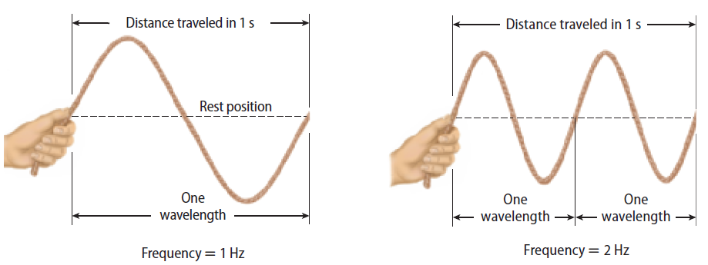
Wavelength is Related to Frequency
As frequency increases, wavelength decreases.
The frequency of a wave is always equal to the rate of vibration of the source that creates it.
If you move the rope down, up, and back down in 1 s, the frequency of the wave you generate is 1 Hz.
Wave Properties
Copyright © McGraw-Hill Education

Slide 13
Wavelength is Related to Frequency
The speed of a wave depends on the medium it is traveling through.
Sound waves usually travel faster through liquids and solids than they do through gases. However, light waves travel more slowly through liquids and solids than they do through gases or through a vacuum.
Sound waves usually travel faster through warmer materials than through cooler materials.
Wave Properties
Copyright © McGraw-Hill Education

Slide 14
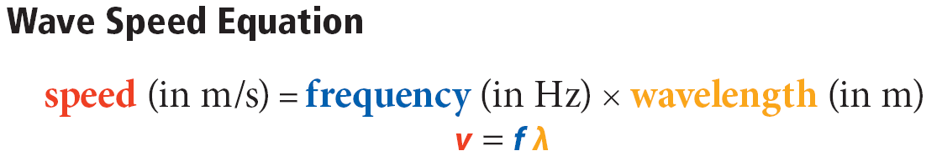
Calculating Wave Speed
You can calculate the speed of a wave represented by v by multiplying its frequency times its wavelength.
Wave Properties
Copyright © McGraw-Hill Education

Slide 15
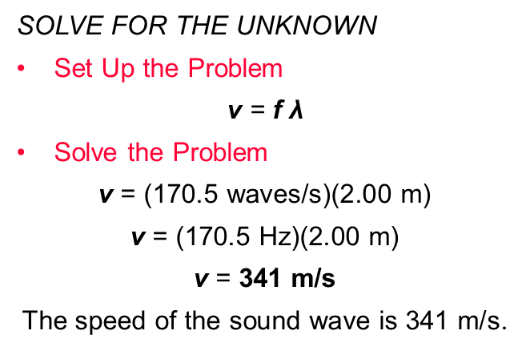
SOLVE FOR WAVE SPEED
SOLVE FOR THE UNKNOWN
Set Up the Problem
v = f λ
Solve the Problem
v $\text{= (170.5 }\text{waves}\text{/}\text{s}\text{)(2.00 }\text{m}\text{)}$
$\text{v} \text{=} \text{(170.5 }\text{Hz}\text{)(2.00 }\text{m}\text{)}$
v $\text{= }\text{341 }\text{m}\text{/}\text{s}$
$$\text{The} \text{speed} \text{of} \text{the} \text{sound} \text{wave} \text{is}\text{ 341 }\text{m}\text{/}\text{s}\text{.}$$
Use with Example Problem 1.
Problem
What is the speed of a sound wave that has a wavelength of 2.00 m and a frequency of 170.5 Hz?
Response
ANALYZE THE PROBLEM
KNOWN
wavelength: λ = 2.00 m
frequency: f = 170.5 Hz
UNKNOWN
wave speed: v
EVALUATE THE ANSWER
The speed of sound through air varies but is typically close to 340 m/s. Therefore, this answer seems reasonable.
Wave Properties
Copyright © McGraw-Hill Education

Slide 16
Amplitude and Energy
Amplitude is related to the amount of disturbance from a wave.
The greater the wave’s amplitude is, the greater the disturbance that the wave produces.
Amplitude is measured differently for longitudinal and transverse waves.
Wave Properties
Copyright © McGraw-Hill Education

Slide 17
Amplitude of Longitudinal waves
The amplitude of a longitudinal wave is related to how tightly the medium is pushed together at the compressions.
The denser the medium is at the compressions, the larger the wave’s amplitude is and the more disturbance the wave creates.
Wave Properties
Copyright © McGraw-Hill Education

Slide 18
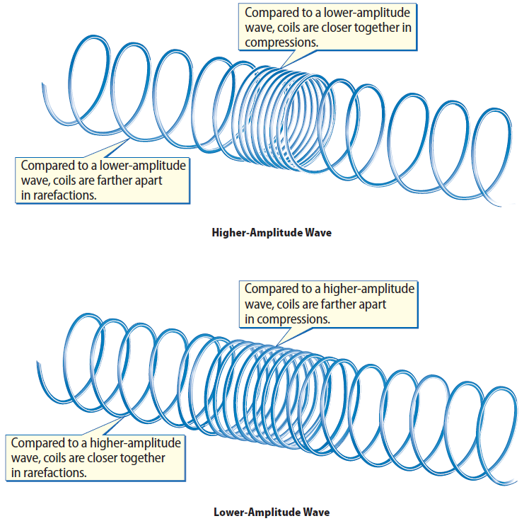
Amplitude of Longitudinal Waves
The closer the coils are in a compression, the farther apart they are in a rarefaction.
Wave Properties
Copyright © McGraw-Hill Education

Slide 19
Amplitude of Longitudinal Waves
The less dense the medium is at the rarefactions, the more energy the wave carries.
Wave Properties
Copyright © McGraw-Hill Education

Slide 20
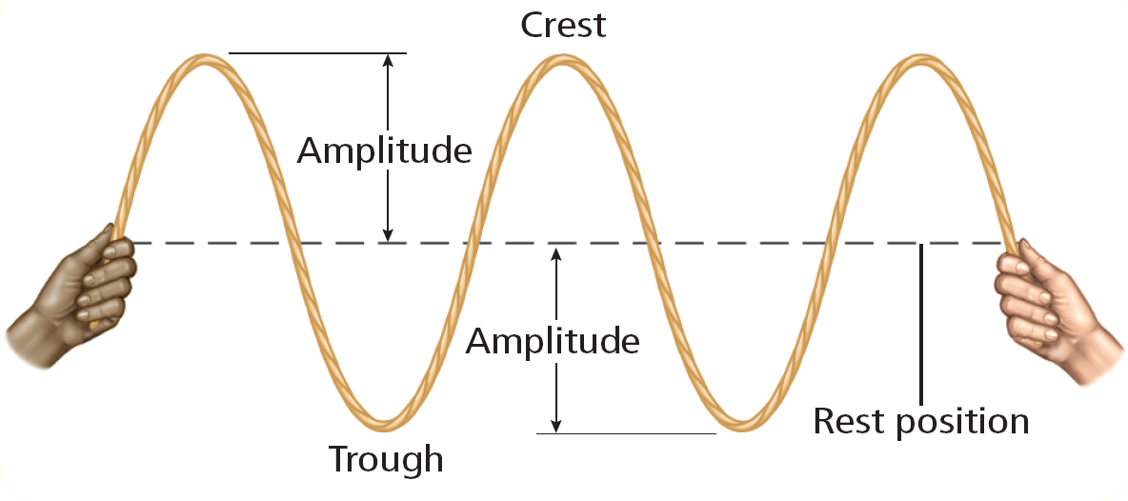
Amplitude of Transverse Waves
The amplitude of any transverse wave is the distance from the crest or trough of the wave to the rest position of the medium.
Wave Properties
Copyright © McGraw-Hill Education

Slide 21
Review
Essential Questions
How are wavelength and period related?
What is the relationship between frequency and wavelength?
How do you calculate the speed of a wave?
Vocabulary
crest
trough
compression
rarefaction
wavelength
frequency
period
amplitude
Wave Properties
Copyright © McGraw-Hill Education

