Slide 1
Essential Questions
How do waves transfer energy?
What are mechanical waves?
How do transverse waves differ from longitudinal waves?
The Nature of Waves
Copyright © McGraw-Hill Education

Slide 2
Vocabulary
Review
matter
New
wave
medium
mechanical wave
transverse wave
longitudinal wave
The Nature of Waves
Copyright © McGraw-Hill Education

Slide 3
Waves and Energy
A wave is a repeating disturbance or movement that transfers energy through matter or space.
For example, a pebble falls into a pool of water and ripples form.
Because it is moving, the falling pebble has energy.
As it splashes into the pool, the pebble transfers some of its energy to nearby water molecules, causing them to move.
What you see is energy traveling in the form of a wave on the surface of the water.
The Nature of Waves
Copyright © McGraw-Hill Education

Slide 5
Waves and Matter
All waves transfer energy without transferring matter from place to place.
Imagine you’re in a boat on a lake.
Approaching waves bump against your boat, but they don’t carry it along with them as they pass.
The waves don’t even carry the water along with them. Only the energy carried by the waves is transferred.
The Nature of Waves
Copyright © McGraw-Hill Education

Slide 7
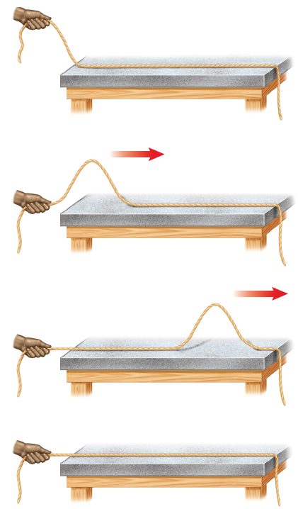
Making Waves
Suppose you are holding a rope at one end, and you give it a shake.
You would create a pulse that travels along the rope to the other end, and then the rope would be still again.
It is the up-and-down motion of your hand that creates the wave.
Anything that moves up and down or back and forth in a rhythmic way is vibrating.
The vibrating movement of your hand at the end of the rope created the wave. In fact, all waves are produced by something that vibrates.
The Nature of Waves
Copyright © McGraw-Hill Education

Slide 8
Mechanical Waves
The matter the waves travel through is called a medium. The medium can be a solid, a liquid, a gas, or a combination of these.
Not all waves need a medium.
Some waves, such as light and radio waves, can travel through space.
Waves that can travel only through matter are called mechanical waves.
The two types of mechanical waves are transverse waves and longitudinal waves.
The Nature of Waves
Copyright © McGraw-Hill Education

Slide 9
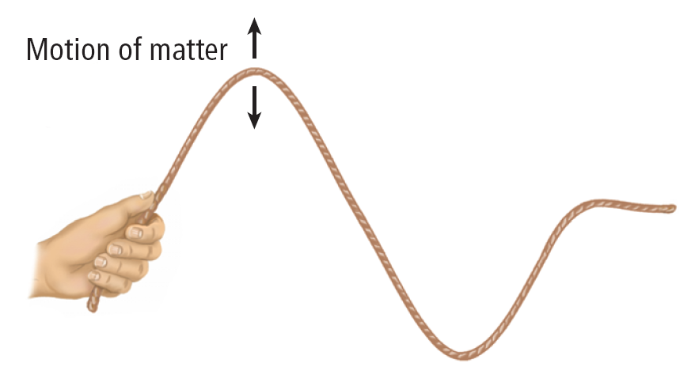
Transverse Waves
In a transverse wave, matter in the medium moves back and forth at right angles to the direction that the wave travels.
For example, a wave on a rope travels horizontally as the rope moves vertically up and down.
The Nature of Waves
Copyright © McGraw-Hill Education

Slide 10
Water Waves
Water waves are not purely transverse waves.
A water wave causes water to move back and forth, as well as up and down.
Water is pushed back and forth to form the crests and troughs.
The Nature of Waves
Copyright © McGraw-Hill Education

Slide 11
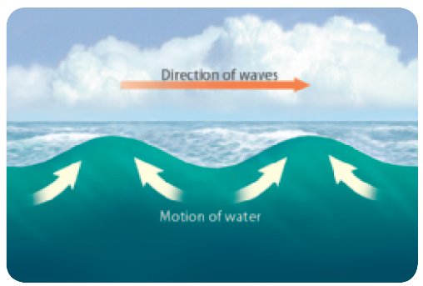
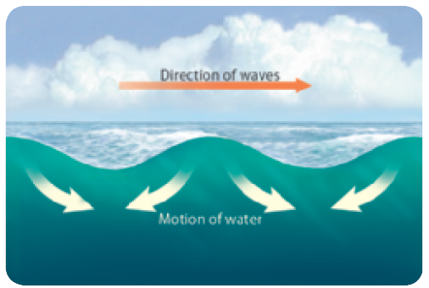
Water Waves
The low point of a water wave is formed when water is pushed aside and up to the high point of the wave.
The water that is pushed aside returns to its initial position.
The Nature of Waves
Copyright © McGraw-Hill Education

Slide 12
Water Waves
Ocean waves are formed most often by wind blowing across the ocean surface.
The size of the waves that are formed depend on the wind speed, the distance over which the wind blows, and how long the wind blows.
The Nature of Waves
Copyright © McGraw-Hill Education

Slide 13
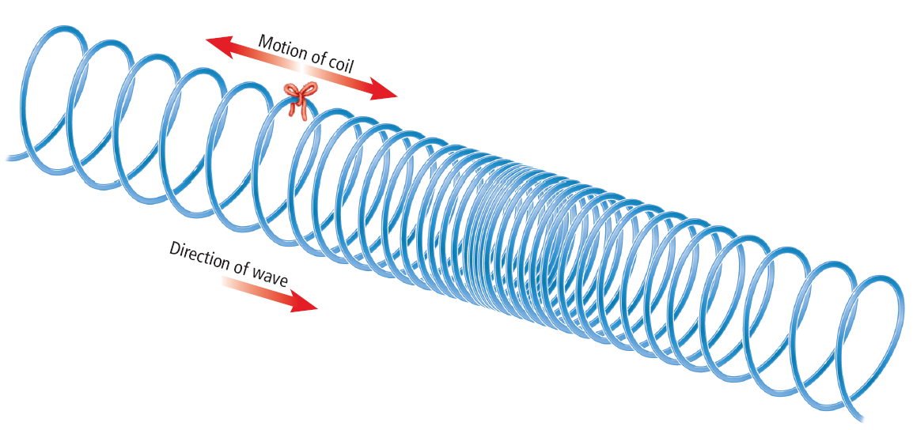
Longitudinal Waves
In a longitudinal wave, matter in the medium moves back and forth along the same direction that the wave travels.
You can model longitudinal waves with a coiled spring toy.
Squeeze several coils together at one end of the spring. Then let go of the coils.
The Nature of Waves
Copyright © McGraw-Hill Education

Slide 14
Longitudinal Waves
As the wave moves, it looks as if the whole spring is moving toward one end.
The wave carries energy, but not matter, forward along the spring.
Longitudinal waves also are called compressional waves.
The Nature of Waves
Copyright © McGraw-Hill Education

Slide 15
Sound Waves
Sound waves are longitudinal waves.
When a noise is made, such as when a locker door slams shut and vibrates, nearby air particles are pushed together by the vibrations.
The air particles are squeezed together like the coils in a coiled spring toy are when you make a longitudinal wave with it.
The compressions travel through the air to make a wave.
The Nature of Waves
Copyright © McGraw-Hill Education

Slide 16
Sound in Other Materials
Sound waves also can travel through other mediums, such as water and wood.
When a sound wave reaches your ear, it causes your eardrum to vibrate.
Your inner ear then sends signals to your brain, and your brain interprets the signals as sound.
The Nature of Waves
Copyright © McGraw-Hill Education

Slide 17
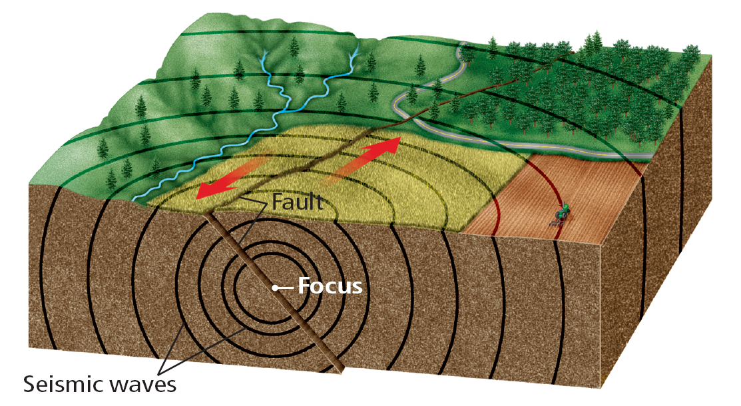
Seismic Waves
Forces in Earth’s crust can cause tectonic plates to suddenly slide past each other.
This sudden sliding between tectonic plates produces seismic (SIZE mihk) waves that carry energy outward.
The Nature of Waves
Copyright © McGraw-Hill Education

Slide 18
Seismic Waves
Seismic waves are a combination of longitudinal (p-waves) and transverse waves (s-waves). They can travel through Earth and along Earth’s surface.
The more the crust moves during an earthquake, the more energy is released.
The Nature of Waves
Copyright © McGraw-Hill Education

Slide 19
Review
Essential Questions
How do waves transfer energy?
What are mechanical waves?
How do transverse waves differ from longitudinal waves?
Vocabulary
wave
medium
mechanical wave
transverse wave
longitudinal wave
The Nature of Waves
Copyright © McGraw-Hill Education

