Slide 1
Essential Questions
What steps do scientists often use to solve problems?
Why do scientists use variables?
What is the difference between a scientific law and a scientific theory?
The Methods of Science
Copyright © McGraw-Hill Education

Slide 2
Vocabulary
Review
investigation
New
scientific methods
hypothesis
experiment
variable
dependent variable
independent variable
constant
control
bias
model
theory
scientific law
The Methods of Science
Copyright © McGraw-Hill Education

Slide 3
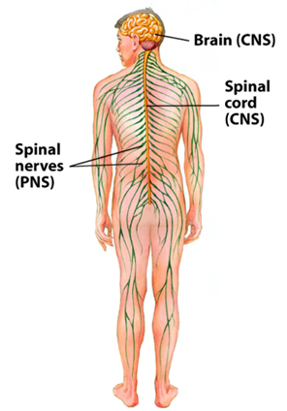
What is science?
Science is a method for studying the natural world. It is a process that uses observation and investigation to gain knowledge about events in nature.
Nature follows a set of rules.
Many rules, such as those concerning how the human body works, are complex.
Other rules, such as the fact that Earth rotates about once every 24 h, are much simpler.
Scientists ask questions to learn about the natural world.
The Methods of Science
Copyright © McGraw-Hill Education

Slide 4
Major Categories of Science
Science can be classified according to three main categories:
Life science deals with living things.
Earth science investigates Earth and space.
Physical science deals with matter and energy.
The Methods of Science
Copyright © McGraw-Hill Education

Slide 5
Science Changes
Scientific explanations help you understand the natural world. As more is learned about the natural world, some of the earlier explanations might be found to be incomplete or new technology might provide more accurate answers.
The Methods of Science
Copyright © McGraw-Hill Education

Slide 6
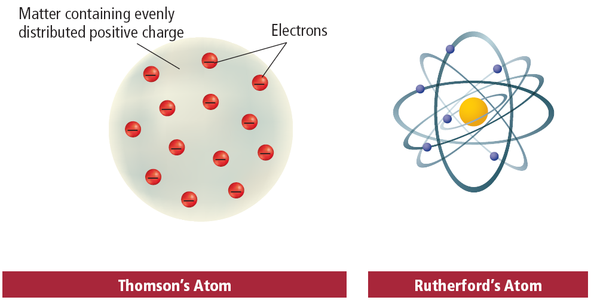
Science Changes
Scientists have studied the atom for more than two centuries.
Thompson and Rutherford both created models to help explain their understanding of an atom.
The Methods of Science
Copyright © McGraw-Hill Education

Slide 7
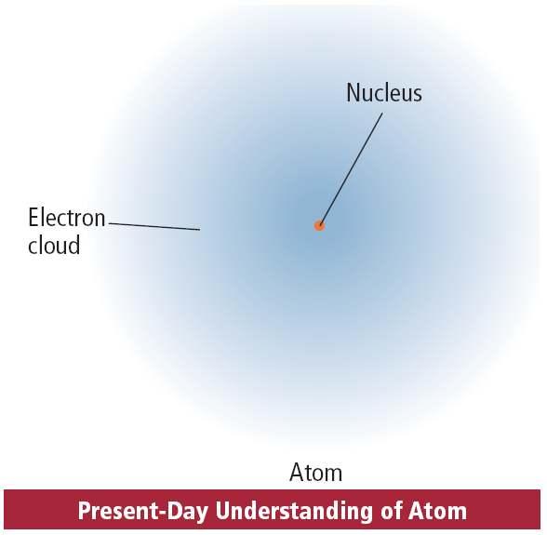
Science Changes
Today we use a different model called the electron cloud model.
This model is a result of many investigations and collaboration of many scientists.
Because it is the nature of science to be open to change, investigations into the model of the atom continue today.
The Methods of Science
Copyright © McGraw-Hill Education

Slide 8
Investigations
Scientists learn new information about the natural world by performing investigations, which can be done in many different ways.
Some investigations involve simply observing something that occurs and recording the observations.
Other investigations involve setting up experiments that test the effect of one thing on another.
Some investigations involve building a model that resembles something in the natural world and then testing the model to see how it acts.
The Methods of Science
Copyright © McGraw-Hill Education

Slide 9
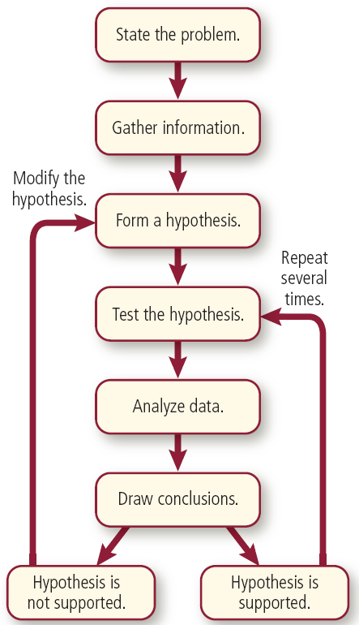
Scientific Methods
An organized set of investigation procedures is called a scientific method. Six common steps found in scientific methods are shown.
The Methods of Science
Copyright © McGraw-Hill Education

Slide 10
State the Problem
Many scientific investigations begin when someone observes an event in nature and wonders why or how it occurs.
Then the question of “why” or “how” is the problem.
Sometimes a statement of a problem arises from an activity that is not working.
The Methods of Science
Copyright © McGraw-Hill Education

Slide 11
Research and Gather Information
Before testing a hypothesis, it is useful to learn as much as possible about the background of the problem.
Have others found information that will help determine what tests to do and what tests will not be helpful?
The Methods of Science
Copyright © McGraw-Hill Education

Slide 12
Form a Hypothesis
A hypothesis is a possible explanation for a problem using what you know and what you observe.
For example, NASA scientists hypothesized that a ceramic material might withstand the heat and forces of reentry and could work on the space shuttle.
The Methods of Science
Copyright © McGraw-Hill Education

Slide 13
Test a Hypothesis
An experiment tests the effect of one thing on another using controlled conditions.
One common way to test a hypothesis is to perform an experiment.
Some hypotheses can be tested by making observations.
Others can be tested by building a model and relating it to real-life situations
The Methods of Science
Copyright © McGraw-Hill Education

Slide 14
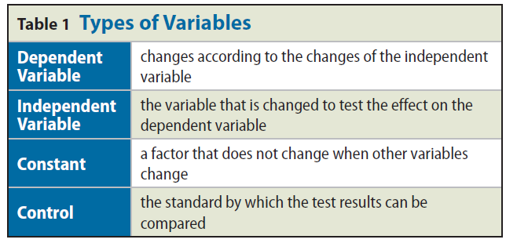
Variables
A variable is a quantity that can have more than a single value.
You might set up an experiment to determine which of three fertilizers helps plants to grow the biggest.
Possible factors include plant type, amount of sunlight, amount of water, room temperature, type of soil, and type of fertilizer.
The Methods of Science
Copyright © McGraw-Hill Education

Slide 15
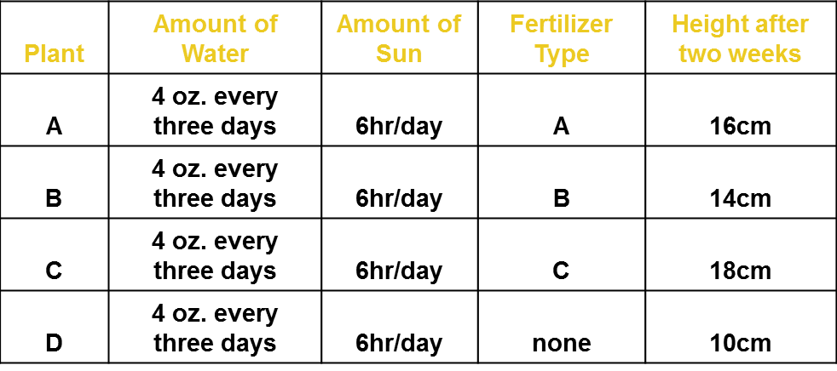
Variables
In this experiment, the amount of growth is the dependent variable because its value changes according to the changes in the other variables.
The Methods of Science
Copyright © McGraw-Hill Education

Slide 16
Variables
The variable you change to see how it will affect the dependent variable is called the independent variable.
The Methods of Science
Copyright © McGraw-Hill Education

Slide 17
Constants
A factor that does not change when other variables change is called a constant.
You might set up four trials, using the same soil and type of plant.
Each plant is given the same amount of sunlight and water and is kept at the same temperature. These are constants.
The Methods of Science
Copyright © McGraw-Hill Education

Slide 18
Controls
The fourth plant is not fertilized.
This plant is a control. A control is the standard by which the test results can be compared.
The Methods of Science
Copyright © McGraw-Hill Education

Slide 19
Controls
Suppose that after several days, the three fertilized plants grow between 2 and 3 cm.
If the unfertilized plant grows 1.5 cm, you might infer that the growth of the fertilized plants was due to the fertilizers.
The Methods of Science
Copyright © McGraw-Hill Education

Slide 20
Analyze the Data
An important part of every experiment includes recording observations and organizing the test data into easy-to-read tables and graphs.
Interpreting the data and analyzing the observations is an important step.
If the data are not organized in a logical manner, wrong conclusions can be drawn.
The Methods of Science
Copyright © McGraw-Hill Education

Slide 21
Draw Conclusions
Based on the analysis of your data, you decide whether or not your hypothesis is supported.
For the hypothesis to be considered valid and widely accepted, the experiment must result in the exact same data every time it is repeated.
The Methods of Science
Copyright © McGraw-Hill Education

Slide 22
Peer Review
Before science-based information is made public it is reviewed by scientists’ peers—scientists who are in the same field of study.
Peer review is a process by which the procedures and results of an experiment are evaluated by other scientists who are in the same field as those who are conducting similar research.
Reviewing other scientists’ work is a responsibility that many scientists have.
The Methods of Science
Copyright © McGraw-Hill Education

Slide 23
Being Objective
A bias occurs when what the scientist expects changes how the results are viewed.
This expectation might cause a scientist to select a result from one trial over those from other trials.
Scientists can lessen bias by running as many trials as possible and by keeping accurate notes of each observation made.
Valid experiments also must have data that are measurable.
For example, a scientist performing a global warming study must base his or her data on accurate measures of global temperature.
The Methods of Science
Copyright © McGraw-Hill Education

Slide 24
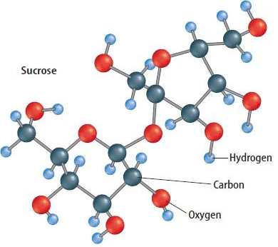
Visualizing with Models
A model represents an idea, event, or object to help people better understand it.
The Methods of Science
Copyright © McGraw-Hill Education

Slide 25
Models in History
Lord Kelvin, who lived in England in the 1800s, was famous for making models.
To model his idea of how light moves through space, he put balls into a bowl of jelly and encouraged people to move the balls around with their hands.
Kelvin’s work to explain the nature of temperature and heat still is used today.
The Methods of Science
Copyright © McGraw-Hill Education

Slide 26
High-tech Models
Today, many scientists use computers to build models.
NASA experiments involving space flight would not be practical without computers.
A computer simulation uses a computer to test a process or procedure and to collect data.
Computer software is designed to safely and conveniently mimic the processes under study.
The Methods of Science
Copyright © McGraw-Hill Education

Slide 27
Scientific Theories and Laws
A scientific theory is an explanation of things or events based on knowledge gained from many observations and investigations. It is not a guess.
Just because a scientific theory has data supporting it does not mean it will never change.
A theory can be used to explain a law, but theories do not become laws.
For example, many theories have been proposed to explain how the law of gravity works.
Even so, there are few theories in science and even fewer laws.
The Methods of Science
Copyright © McGraw-Hill Education

Slide 28
Scientific Theories and Laws
A scientific law is a statement about what happens in nature and that seems to be true all the time.
Laws tell you what will happen under certain conditions, but they don’t explain why or how something happens.
Gravity is an example of a scientific law.
The Methods of Science
Copyright © McGraw-Hill Education

Slide 29
The Limitations of Science
Science can help you explain many things about the world, but science cannot explain or solve everything.
Most questions about emotions and values are not scientific questions because they cannot be tested.
You might take a survey to get people’s opinions about such questions, but that would not prove that the opinions are true for everyone.
The Methods of Science
Copyright © McGraw-Hill Education

Slide 30
Review
Essential Questions
What steps do scientists often use to solve problems?
Why do scientists use variables?
What is the difference between a scientific law and a scientific theory?
Vocabulary
scientific methods
hypothesis
experiment
variable
dependent variable
independent variable
constant
control
bias
model
theory
scientific law
The Methods of Science
Copyright © McGraw-Hill Education

