Slide 1
Essential Questions
What is a standard of measurement?
What multiple of ten does each SI prefix represent?
What are the SI units and symbols for length, volume, mass, density, time, and temperature?
How can related SI units be converted?
Standards of Measurement
Copyright © McGraw-Hill Education

Slide 2
Vocabulary
Review
measurement
New
standard
SI
volume
matter
mass
density
Standards of Measurement
Copyright © McGraw-Hill Education

Slide 3
Units and Standards
A standard is an exact quantity that people agree to use to compare measurements.
Suppose you and a friend want to make some measurements to find out whether a desk will fit through a doorway.
You have no ruler, so you decide to use your hands as measuring tools.
Standards of Measurement
Copyright © McGraw-Hill Education

Slide 4
Units and Standards
Even though you both used hands to measure, you did not check to see whether your hands were the same width as your friend’s.
In other words, you did not use a measurement standard, so you can not compare the measurements.
Hands are a convenient measuring tool, but using them can lead to misunderstanding.
Standards of Measurement
Copyright © McGraw-Hill Education

Slide 5
Measurement Systems
Suppose the label on a ball of string indicates that the length of the string is 1. Is the length 1 feet, 1 m, or 1 cm?
For a measurement to make sense, it must include a number and a unit.
The English system of measurement is commonly used in the United States.
Most other nations use the metric system—a system of measurement based on multiples of ten.
Standards of Measurement
Copyright © McGraw-Hill Education

Slide 6
International System of Units
All SI standards are universally accepted and understood by scientists throughout the world.
This give the scientific community a consistent unit of measurement for any and all research that is shared.
This was known as the Metric system.
Standards of Measurement
Copyright © McGraw-Hill Education

Slide 7
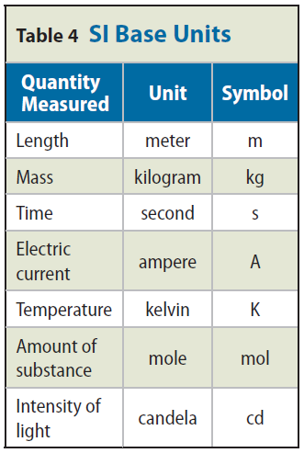
International System of Units
Each type of SI measurement has a base unit.
The meter is the base unit of length.
Every type of quantity measured in SI has a symbol for that unit.
All other SI units are obtained from these seven units.
Standards of Measurement
Copyright © McGraw-Hill Education

Slide 8
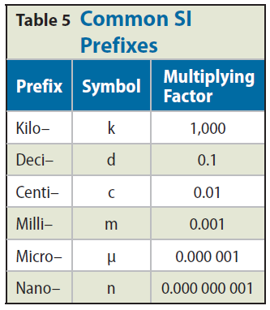
SI Prefixes
The SI system is easy to use because it is based on multiples of ten.
Prefixes are used with the names of the units to indicate what multiple of ten should be used with the units.
The most frequently used prefixes are shown.
Standards of Measurement
Copyright © McGraw-Hill Education

Slide 9
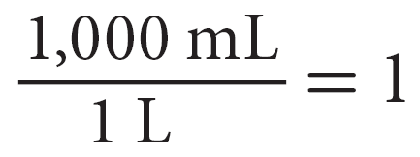
Converting Between SI Units
A conversion factor is a ratio that is equal to one and is used to change one unit to another.
For example, there are 1,000 mL in 1 L, so 1,000 mL = 1 L.
Standards of Measurement
Copyright © McGraw-Hill Education

Slide 10
Converting Between SI Units using Dimensional Analysis
To convert units, you multiply by the appropriate conversion factor.
For example, to convert 55 L to mL, multiply 55 L by a conversion factor.
Use the conversion factor with new units (mL) in the numerator and the old units (L) in the denominator.
Standards of Measurement
Copyright © McGraw-Hill Education

Slide 11
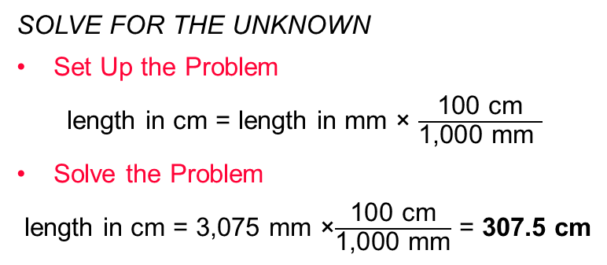
CONVERT UNITS
Use with Example Problem 1.
Problem
How long, in centimeters, is a 3,075-mm rope?
SOLVE FOR THE UNKNOWN
Set Up the Problem
length in cm = length in mm × $\frac{\text{100 }\text{cm}}{\text{1,000 }\text{mm} }$
Solve the Problem
length in cm = 3,075 mm ×$\frac{\text{100 }\text{cm}}{\text{1,000 }\text{mm}}$ = 307.5 cm
Response
ANALYZE THE PROBLEM
KNOWN
rope length in mm = 3,075 mm
1 m = 100 cm = 1,000 mm
UNKNOWN
rope length in cm
EVALUATE THE ANSWER
Millimeters are smaller than centimeters, so make sure your answer in mm is larger than the measurement in cm. Because SI is based on tens, the answer in mm should differ from the length in cm by a factor of ten.
Standards of Measurement
Copyright © McGraw-Hill Education

Slide 12
Measuring Length
In scientific measurement, length is the distance between two points.
The SI base unit of length is the meter, m.
Metric rulers and meter sticks are used to measure length.
Standards of Measurement
Copyright © McGraw-Hill Education

Slide 13
Measuring Volume
The amount of space occupied by an object is called its volume. If you want to know the volume of a solid rectangle, such as a brick, you measure its length, width, and height and multiply the three numbers and their units together (V = l × w × h).
For a brick, your measurements probably would be in centimeters.
The volume would then be expressed in cubic centimeters, cm³.
In measuring a liquid’s volume, you are indicating the capacity of the container that holds that amount of liquid.
The most common units for expressing liquid volumes are liters and milliliters.
Standards of Measurement
Copyright © McGraw-Hill Education

Slide 14
Measuring Liquid Volume
Sometimes, liquid volumes such as doses of medicine are expressed in cubic centimeters. Suppose you wanted to convert a measurement in liters to cubic centimeters.
You use conversion factors to convert L to mL and then mL to cm³.
1 mL = 1cubic centimeter.
Standards of Measurement
Copyright © McGraw-Hill Education

Slide 15
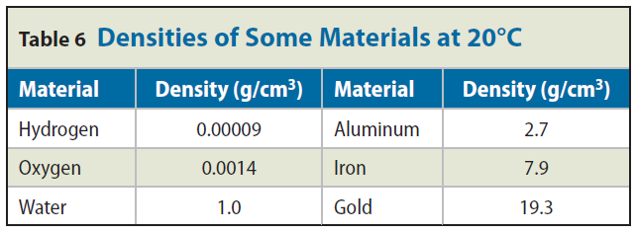
Measuring Mass and Density
Mass is a measurement of the quantity of matter in an object.
The mass and volume of an object can be used to find the density of the material the object is made of.
Density is the mass per unit volume of a material.
You find density by dividing an object’s mass by the object’s volume.
Standards of Measurement
Copyright © McGraw-Hill Education

Slide 16
Derived Units
The measurement unit for density, g/cm³, is a combination of SI units.
A unit obtained by combining different SI units is called a derived unit.
An SI unit multiplied by itself also is a derived unit.
Density = Mass (g) / Volume (cubic centimeters or mL)
Standards of Measurement
Copyright © McGraw-Hill Education

Slide 17
Measuring Time and Temperature
It is often necessary to keep track of how long it takes for something to happen or whether something heats up or cools down. These measurements involve time and temperature.
Time is the interval between two events.
The SI unit for time is the second.
Think of temperature as a measure of how hot or how cold something is.
Standards of Measurement
Copyright © McGraw-Hill Education

Slide 18
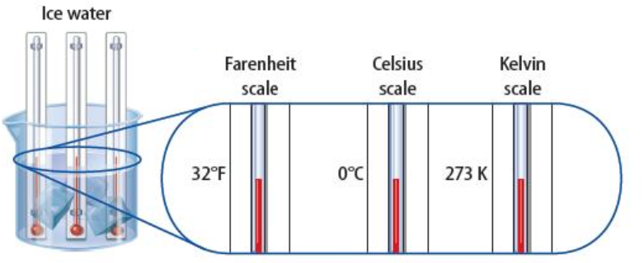
Celsius
For most scientific work, temperature is measured on the Celsius (C) scale.
On this scale, the freezing point of water is 0°C, and the boiling point of water is 100°C.
Between these points, the scale is divided into 100 equal divisions. Each one represents 1°C.
Standards of Measurement
Copyright © McGraw-Hill Education

Slide 19
Kelvin and Fahrenheit
The SI unit of temperature is the kelvin (K).
Zero on the Kelvin scale (0 K) is the coldest possible temperature, also known as absolute zero.
Absolute zero is equal to -273°C which is 273° below the freezing point of water.
Standards of Measurement
Copyright © McGraw-Hill Education

Slide 20
Kelvin and Fahrenheit
Kelvin temperature can be found by adding 273 to the Celsius reading. So, on the Kelvin scale, water freezes at 273 K and boils at 373 K.
The temperature measurement you are probably most familiar with is the Fahrenheit scale, which was based roughly on the temperature of the human body, 98.6°.
Standards of Measurement
Copyright © McGraw-Hill Education

Slide 21
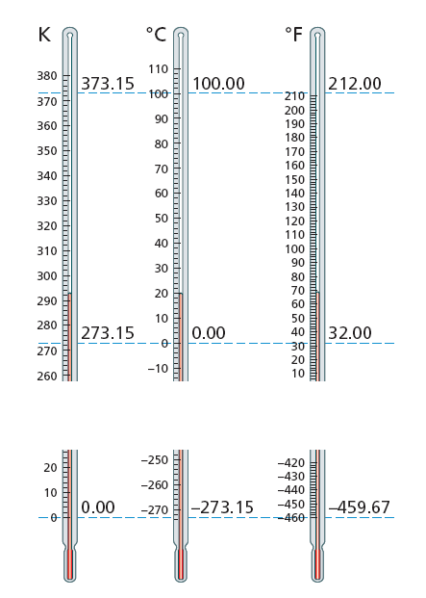
Kelvin and Fahrenheit
These three thermometers illustrate the scales of temperature between the freezing and boiling points of water.
Standards of Measurement
Copyright © McGraw-Hill Education

Slide 22
Review
Essential Questions
What is a standard of measurement?
What multiple of ten does each SI prefix represent?
What are the SI units and symbols for length, volume, mass, density, time, and temperature?
How can related SI units be converted?
Vocabulary
standard
SI
volume
matter
mass
density
Standards of Measurement
Copyright © McGraw-Hill Education

