Slide 1
Essential Questions
What are the three types of graphs, and how are they used?
How are dependent and independent variables expressed in a graph?
How can you analyze data using the various types of graphs?
Communicating with Graphs
Copyright © McGraw-Hill Education

Slide 2
Vocabulary
Review
data
New
graph
Communicating with Graphs
Copyright © McGraw-Hill Education

Slide 3
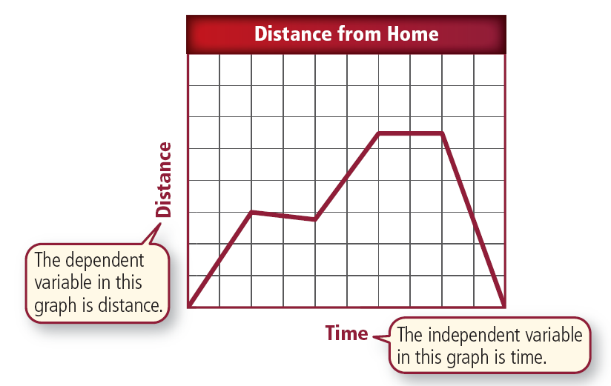
A Visual Display
A graph is a visual display of information or data.
This is a graph that shows the motion that takes place when a girl takes her dog for a walk.
Communicating with Graphs
Copyright © McGraw-Hill Education

Slide 4
A Visual Display
The horizontal axis, or the x-axis, measures time.
Time is the independent variable because as it changes, it affects the measure of another variable.
Communicating with Graphs
Copyright © McGraw-Hill Education

Slide 5
A Visual Display
The distance from home that the girl and the dog walk is the other variable.
It is the dependent variable and is measured on the vertical axis, or y-axis.
Communicating with Graphs
Copyright © McGraw-Hill Education

Slide 6
A Visual Display
Different kinds of graphs—line, bar, and circle—are appropriate for displaying different types of information.
Communicating with Graphs
Copyright © McGraw-Hill Education

Slide 7
A Visual Display
Graphs make it easier to understand complex patterns by displaying data in a visual manner.
Scientists often graph their data to detect patterns that would not have been evident in a table.
The conclusions drawn from graphs must be based on accurate information and reasonable scales.
Communicating with Graphs
Copyright © McGraw-Hill Education

Slide 8
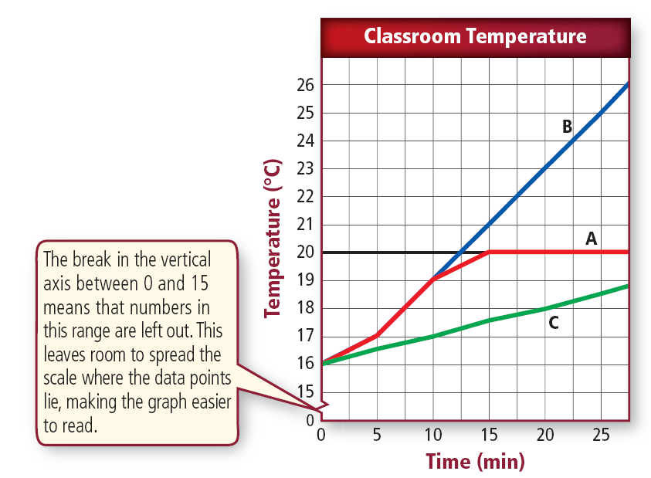
Line Graphs
A line graph can show any relationship where the dependent variable changes due to a change in the independent variable. Line graphs often show how a relationship between variables changes over time.
Communicating with Graphs
Copyright © McGraw-Hill Education

Slide 9
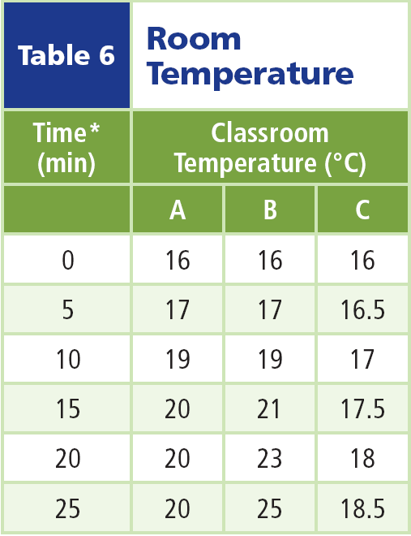
Display Data on Line Graphs
You can show more than one event on the same graph as long as the relationship between the variables is identical.
Suppose a builder had three choices of thermostats for a new school.
He wanted to test them to know which was the best brand to install throughout the building.
He installed a different thermostat in classrooms, A, B, and C.
He recorded his data in this table.
Communicating with Graphs
Copyright © McGraw-Hill Education

Slide 10
Display Data on Line Graphs
The builder then plotted the data on a graph.
He could see from the table that the data did not vary much for the three classrooms, so he chose small intervals for the y-axis and left part of the scale out (the part between 0° and 15 °).
This allowed him to spread out the area on the graph where the data points lie.
Communicating with Graphs
Copyright © McGraw-Hill Education

Slide 11
Display Data on Line Graphs
You can see easily the contrast in the colors of the three lines and their relationship to the black horizontal line. The black line represents the thermostat setting and is the control.
The most important factor in making a line graph is always using the x-axis for the independent variable.
The y-axis always is used for the dependent variable.
Communicating with Graphs
Copyright © McGraw-Hill Education

Slide 12
Constructing Line Graphs
Another factor in constructing a graph involves units of measurement.
You might use a Celsius thermometer for one part of your experiment and a Fahrenheit thermometer for another.
You must first convert your temperature readings to the same unit of measurement before you make your graph.
Scientists use a variety of tools, such as computers and graphing calculators to help them draw graphs.
Communicating with Graphs
Copyright © McGraw-Hill Education

Slide 13
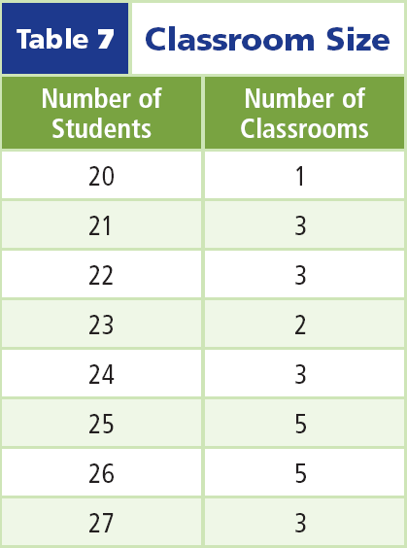
Bar Graphs
A bar graph is useful for comparing information collected by counting.
For example, suppose you counted the number of students in every classroom in your school on a particular day and organized your data in a table.
Communicating with Graphs
Copyright © McGraw-Hill Education

Slide 14
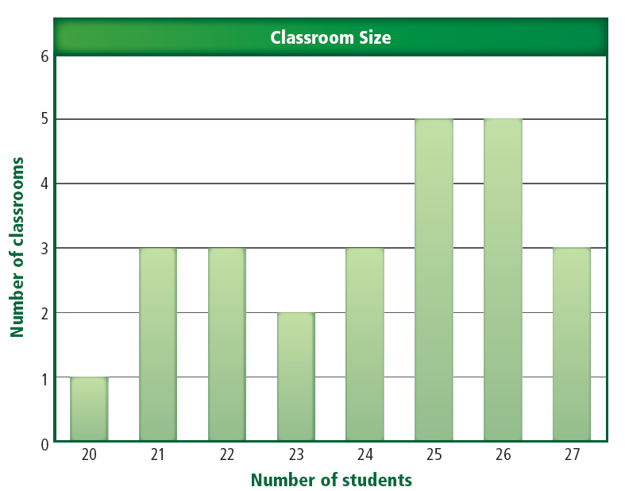
Bar Graphs
You could show these data in a bar graph like the one shown.
As on a line graph, the independent variable is plotted on the x-axis and the dependent variable is plotted on the y-axis.
You might need to place a break in the scale of the graph to better illustrate your results.
Communicating with Graphs
Copyright © McGraw-Hill Education

Slide 15
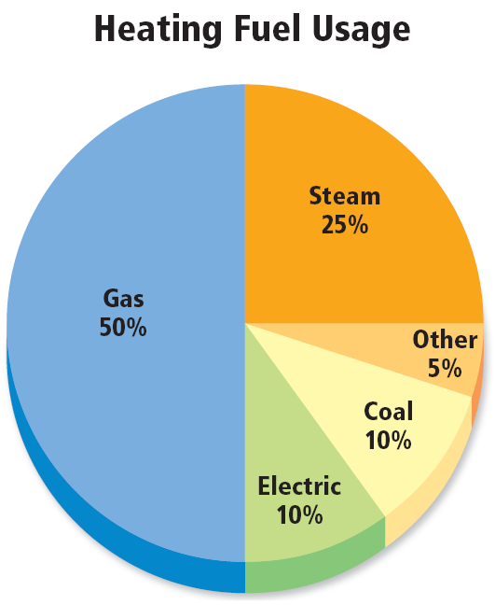
Circle Graphs
A circle graph, or pie graph, is used to show how some fixed quantity is broken down into parts.
The circular pie represents the total.
The slices represent the parts and usually are represented as percentages of the total.
This figure illustrates how a circle graph could be used to show the percentage of buildings in a neighborhood using each of a variety of heating fuels.
Communicating with Graphs
Copyright © McGraw-Hill Education

Slide 16
Circle Graphs
To create a circle graph, you start with the total of what you are analyzing.
This graph starts with 72 buildings in the neighborhood.
For each type of heating fuel, you divide the number of buildings using each type of fuel by the total (72).
Communicating with Graphs
Copyright © McGraw-Hill Education

Slide 17
Circle Graphs
You then multiply that decimal by 360° to determine the angle that the decimal makes in the circle.
Eighteen buildings use steam. Therefore, 18 ÷ 72 x 360° = 90° on the circle graph.
You then would measure 90° on the circle with your protractor to show 25 percent.
Communicating with Graphs
Copyright © McGraw-Hill Education

Slide 18
Review
Essential Questions
What are the three types of graphs, and how are they used?
How are dependent and independent variables expressed in a graph?
How can you analyze data using the various types of graphs?
Vocabulary
graph
Science and Technology
Copyright © McGraw-Hill Education

