Slide 1
Essential Questions
How are force and motion related?
How is the net force on an object determined?
Why is there friction between objects?
What is the difference between mass and weight?
Forces
Copyright © McGraw-Hill Education

Slide 2
Vocabulary
Review
mass
New
force
net force
friction
gravity
field
weight
Forces
Copyright © McGraw-Hill Education

Slide 3
What is force?
A force is a push or pull.
Sometimes it is obvious that a force has been applied (changing motion).
Sometimes it is not as noticeable, such as the force that the floor exerts on your feet.
Forces
Copyright © McGraw-Hill Education

Slide 4
Changing Motion
A force can cause the motion of an object to change.
If you have played billiards, you know that you can force a ball at rest to roll into a pocket by striking it with another ball.
The force of the moving ball causes the ball at rest to move in the direction of the force.
Forces
Copyright © McGraw-Hill Education

Slide 5
Net Force
Suppose two students standing side-by-side push on a box with the same force in the same direction.
These forces are unbalanced.
The net force that acts on this box is found by adding the two forces together.
The box will move.
Forces
Copyright © McGraw-Hill Education

Slide 6
Net Force
Suppose two students are standing on opposite sides of a box and push on it with the same force.
Forces on an object that are equal in size and opposite in direction are called balanced forces.
The net force on the box is zero because the two forces cancel each other.
The box will not move.
Describe the net force when two students stand on opposite sides of the box and push on it with unequal forces. Are the forces balanced or unbalanced?
Forces
Copyright © McGraw-Hill Education

Slide 7
Friction
Suppose you give a skateboard a push with your hand.
Does the skateboard keep moving with constant speed after it leaves your hand?
Forces
Copyright © McGraw-Hill Education

Slide 8
Friction
Friction is the force that opposes the sliding motion of two surfaces that are touching each other.
The force that slows the skateboard and brings it to a stop is friction.
The amount of friction between two surfaces depends on two factors—the kinds of surfaces and the force pressing the surfaces together.
Forces
Copyright © McGraw-Hill Education

Slide 9
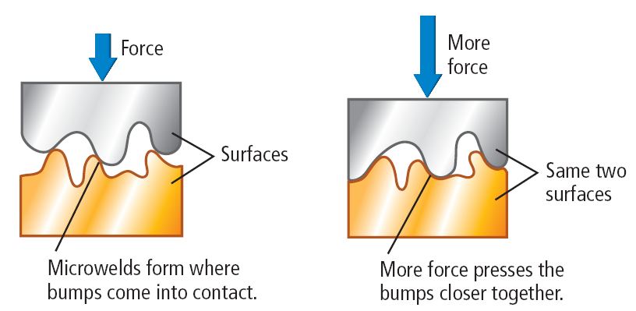
What causes friction?
If two surfaces are in contact, welding or sticking occurs where the bumps touch each other. These micro-welds are the source of friction.
The larger the force pushing the two surfaces together is, the stronger these micro-welds will be, because more of the surface bumps will come into contact.
To move one surface over the other, a force must be applied to break the micro-welds.
Forces
Copyright © McGraw-Hill Education

Slide 10
Static Friction
Suppose you have filled a cardboard box with books and want to move it. It’s too heavy to lift, so you start pushing on it, but it doesn’t budge.
If the box doesn’t move, so the net force on the box is zero. Another force that cancels your push must be acting on the box.
That force is the friction due to the micro-welds that have formed between the bottom of the box and the floor.
Static friction is the frictional force that prevents two surfaces from sliding past each other.
Forces
Copyright © McGraw-Hill Education

Slide 11
Sliding Friction
You ask a friend to help you move the box. Pushing together, the box moves. Together you and your friend have exerted enough force to break the microwelds between the floor and the bottom of the box.
If you stop pushing, the box quickly comes to a stop.
This is because as the box slides across the floor, another force—sliding friction—opposes the motion of the box.
Sliding friction is the force that opposes the motion of two surfaces sliding past each other.
Forces
Copyright © McGraw-Hill Education

Slide 12
Rolling Friction
As a wheel rolls over a surface, static friction acts over the area where they wheel and the surface touch.
This special case of static friction is sometimes called rolling fiction.
Rolling friction prevents wheels from slipping.
When referring to tires on vehicles, the term traction is often used instead of friction.
Forces
Copyright © McGraw-Hill Education

Slide 13
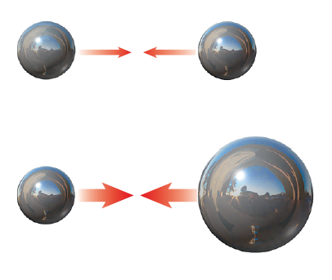
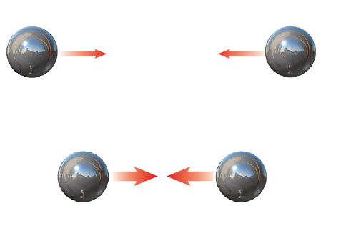
What is gravity?
Gravity is an attractive force between any two objects that depends on the masses of the objects and the distance between them.
If the mass of either of the objects increases, the gravitational force between them increases.
If the objects are closer together, the gravitational force between them increases.
Forces
Copyright © McGraw-Hill Education

Slide 14
The Gravitational Field
A field is a region of space that has a physical quantity (such as force) at every point.
Because objects do not have to be in contact, gravity is sometimes discussed as a field.
The strength of the gravitational field is 9.8 N/kg near Earth’s surface and gets smaller as you move away from Earth.
Forces
Copyright © McGraw-Hill Education

Slide 15
Weight
The gravitational force exerted on an object is called the object’s weight.
Because the weight of an object on Earth is equal to the force of Earth’s gravity on the object, weight can be calculated from this equation:
Forces
Copyright © McGraw-Hill Education

Slide 16
Weight and Mass
The weight of an object usually is the gravitational force between the object and Earth.
Weight and mass are not the same.
Weight and mass are related. Weight increases as mass increases.
The weight of an object can change, depending on the gravitational force on the object.
Mass is a measure of the amount of matter an object contains.
Forces
Copyright © McGraw-Hill Education

Slide 17
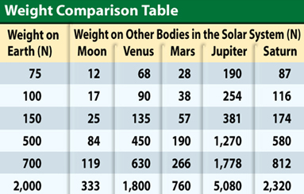
Weight and Mass
The table shows how various weights on Earth would be different on the Moon and some of the planets. 1lb = 4.45N
Forces
Copyright © McGraw-Hill Education

Slide 18
SOLVE FOR WEIGHT
Use with Example Problem 1.
Problem
An elephant has a mass of 5,000 kg. What is the elephant’s weight?
SOLVE FOR THE UNKNOWN
Set Up the Problem
F_{g} = mg
Solve the Problem
F_{g} = (5,000 kg)(9.8 N/kg)
= 49,000 N
Response
ANALYZE THE PROBLEM
KNOWN
mass: m = 5,000 kg
gravitational strength: g = 9.8 N/kg
UNKNOWN
weight: F_{g}
EVALUATE THE ANSWER
The gravitational strength is about 10 N/kg, so we would expect the elephant’s weight to be about 50,000 kg. Our answer (F_{g} = 49,000 N) makes sense.
Forces
Copyright © McGraw-Hill Education

Slide 19
Review
Essential Questions
How are force and motion related?
How is the net force on an object determined?
Why is there friction between objects?
What is the difference between mass and weight?
Vocabulary
force
net force
friction
gravity
field
weight
Forces
Copyright © McGraw-Hill Education

