Slide 1
Essential Questions
How do substances dissolve in a liquid?
How do solid solutions and gas solutions form?
What factors affect the rates at which solids dissolve in liquids?
How Solutions Form
Copyright © McGraw-Hill Education

Slide 2
Vocabulary
Review
polar molecule
New
solute
solvent
alloy
How Solutions Form
Copyright © McGraw-Hill Education

Slide 3
What is a solution?
A solution is a homogeneous mixture, meaning it has the same composition through the mixture.
Solutes and Solvents
A solution contains one substance dissolved in another.
The substance being dissolved is the solute, the substance in which a solute is dissolved is the solvent.
How Solutions Form
Copyright © McGraw-Hill Education

Slide 4
Solutes and Solvents
Non-liquid solutions
Solutions can be liquid, but they can also be gaseous or solid.
All mixtures of gases are solutions.
Solid solutions are also called alloys – mixtures of elements that have metallic properties.
How Solutions Form
Copyright © McGraw-Hill Education

Slide 5
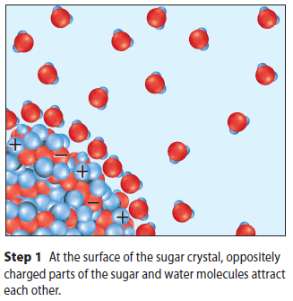
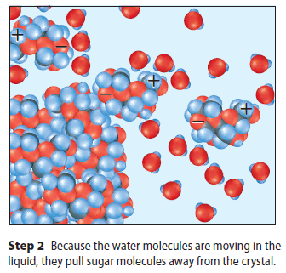
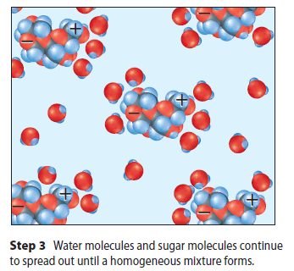
How Substances Dissolve
How it happens
The dissolving of a solid in a liquid occurs at the surface of the solid.
Water makes a good solvent because of its polarity.
How Solutions Form
Copyright © McGraw-Hill Education

Slide 6
How Substances Dissolve
Dissolving liquids and gases
Gases dissolve into liquid similarly to solids
Liquid and gas particles move more freely than solids.
The movement spreads solutes evenly throughout the solvent, resulting in a homogenous solution.
How Solutions Form
Copyright © McGraw-Hill Education

Slide 7
How Substances Dissolve
Dissolving solids in solids
Solid particles move very little, and the motion is not enough to spread particles evenly throughout a mixture.
Solid metals are first melted and then mixed together.
How Solutions Form
Copyright © McGraw-Hill Education

Slide 8
Rate of Dissolving
The three of the most effective techniques for increasing the rate of dissolving are:
Stirring (Agitation , Kinetic Theory)
Increasing surface area ( Solute surface available to the Solvent)
Increasing temperature (Kinetic Theory , More Collisions)
Increasing Pressure ( Gases dissolved into Liquids)
How Solutions Form
Copyright © McGraw-Hill Education

Slide 9
Rate of Dissolving
Stirring
Stirring moves solvent around, bringing more solvent into contact with the solute.
Surface Area
Breaking a solid into pieces provides more surface area.
More surface area allows for more solvent to come into contact with more solute.
How Solutions Form
Copyright © McGraw-Hill Education

Slide 10
Rate of Dissolving
Temperature
Increasing the temperature of a solvent speeds up the movement of its particles.
This increase causes more solvent particles to bump into the solute. As a result, solute particles break loose and dissolve faster
How Solutions Form
Copyright © McGraw-Hill Education

Slide 11
Rate of Dissolving
Controlling the process
Each technique, stirring, increasing surface area, and heating, is known to speed up the rate of dissolving by itself.
When two or more techniques are combined, the rate of dissolving is even faster. (Summation)
Knowing how much each technique affects the rate allows for precise control of dissolving solutes.
How Solutions Form
Copyright © McGraw-Hill Education

Slide 12
Review
Essential Questions
How do substances dissolve in a liquid?
How do solid solutions and gas solutions form?
What factors affect the rates at which solids dissolve in liquids?
Vocabulary
solute
solvent
alloy
How Solutions Form
Copyright © McGraw-Hill Education

