Slide 1
Essential Questions
What is electromagnetic induction?
How does a generator produce an electric current?
What is the difference between alternating current and direct current?
How does a transformer change the voltage of an alternating current?
Producing Electric Current
Copyright © McGraw-Hill Education

Slide 2
Electromagnetic Induction
The generation of a current by a changing magnetic field is electromagnetic induction.
Working independently in 1831, Michael Faraday in Britain and Joseph Henry in the United States both found that moving a loop of wire through a magnetic field caused an electric current to flow in the wire.
They also found that moving a magnet through a loop of wire produces a current.
The magnet and wire loop must be moving relative to each other for an electric current to be produced.
This causes the magnetic field inside the loop to change with time.
Producing Electric Current
Copyright © McGraw-Hill Education

Slide 3
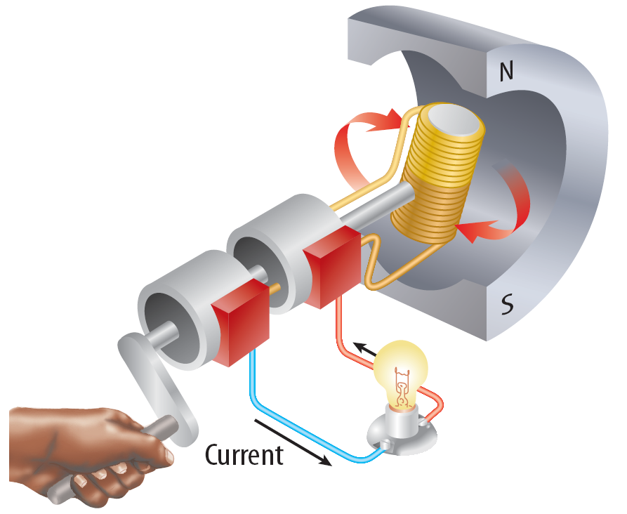
Generators
A generator uses electromagnetic induction to transform mechanical energy into electrical energy.
An example of a simple generator is shown. In this type of generator, a current is produced in the coil as the coil rotates between the poles of a permanent magnet.
Producing Electric Current
Copyright © McGraw-Hill Education

Slide 4
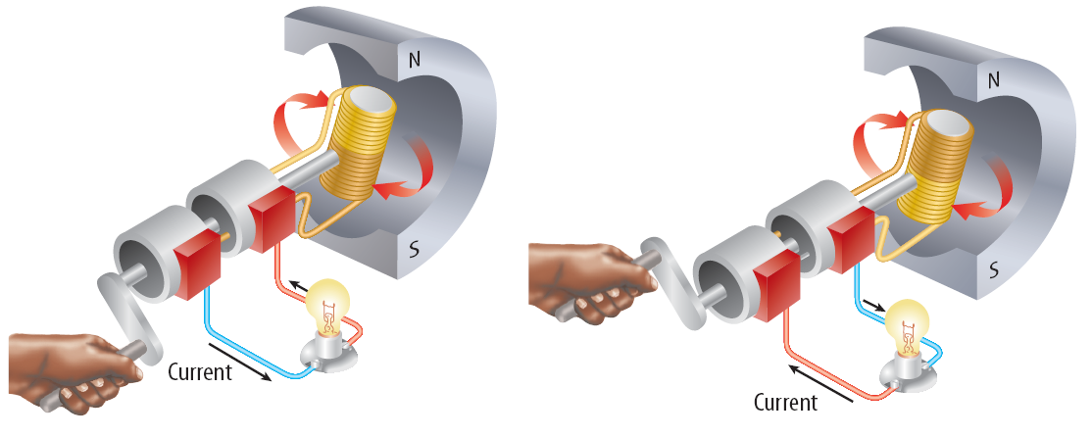
Switching Direction
In a generator, as the coil keeps rotating, the current that is produced periodically changes direction.
The direction of the current in the coil changes twice with each revolution.
The frequency with which the current changes direction can be controlled by regulating the rotation rate of the generator.
Producing Electric Current
Copyright © McGraw-Hill Education

Slide 5
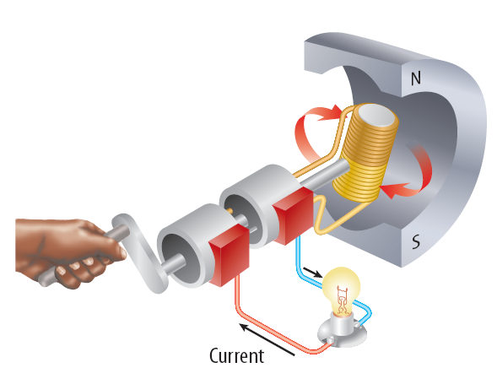
Using Electric Generators
The type of generator shown is used in a car, where it is called an alternator.
The alternator provides electrical energy to operate lights and other accessories.
Producing Electric Current
Copyright © McGraw-Hill Education

Slide 6
Generating Electricity for Your Home
Some power plants first produce thermal energy by burning fossil fuels or using the heat produced by nuclear reactions.
This thermal energy is used to heat water and produce steam.
Thermal energy is then converted to mechanical energy as the steam pushes the turbine blades.
The generator then changes the mechanical energy of the rotating turbine into the electrical energy you use.
Producing Electric Current
Copyright © McGraw-Hill Education

Slide 7
Generating Electricity for Your Home
Both generators and electric motors use magnets to produce energy conversions between electrical and mechanical energy.
In some areas, fields of windmills can be used to capture the mechanical energy in wind to turn generators.
Other power plants use the mechanical energy in falling water to drive the turbine.
Producing Electric Current
Copyright © McGraw-Hill Education

Slide 8
Direct and Alternating Currents
Direct current (DC) is electric current that is always flows in one direction. A battery produces a direct current.
Alternating current (AC) is electric current that reverses direction in a regular pattern. When you plug you plug an appliance into a wall outlet, you are using alternating current.
Producing Electric Current
Copyright © McGraw-Hill Education

Slide 9
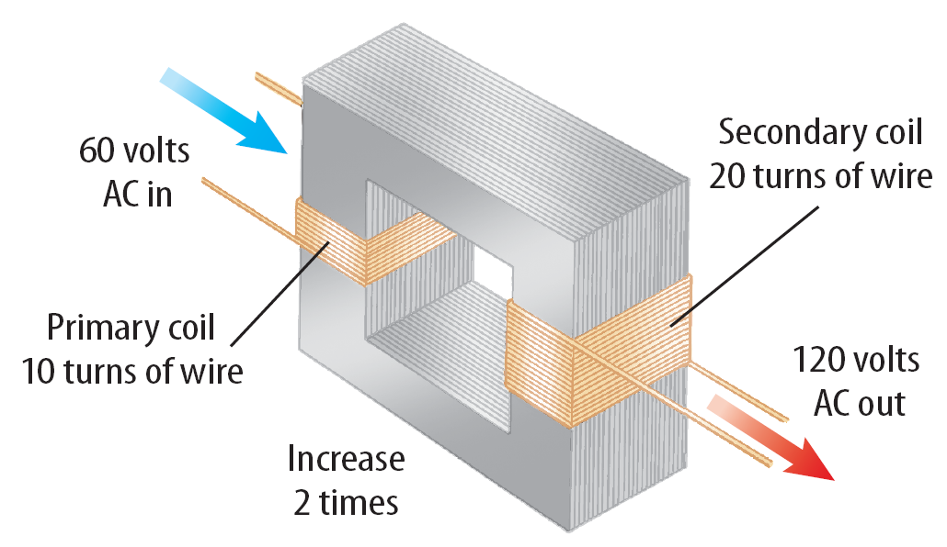
Transformers
A transformer is a device that increases or decreases the voltage of an alternating current.
A transformer is made of a primary coil and a secondary coil.
These wire coils are wrapped around the same iron core.
Producing Electric Current
Copyright © McGraw-Hill Education

Slide 10
Transformers
As an alternating current passes through the primary coil, the coil’s magnetic field magnetizes the iron core.
The magnetic field in the primary coil changes direction as the current in the primary coil changes direction.
This produces a magnetic field in the iron core that changes direction at the same frequency.
The changing magnetic field in the iron core then induces an alternating current with the same frequency in the secondary coil.
Producing Electric Current
Copyright © McGraw-Hill Education

Slide 11
Transformers
The voltage in the primary coil is the input voltage and the voltage in the secondary coil is the output voltage.
The output voltage divided by the input voltage equals the number of turns in the secondary coil divided by the number of turns in the primary coil.
Producing Electric Current
Copyright © McGraw-Hill Education

Slide 12
Step-Up Transformer
A transformer that increases the voltage so that the output voltage is greater than the input voltage is a step-up transformer.
In a step-up transformer the number of wire turns on the secondary coil is greater than the number of turns on the primary coil.
Producing Electric Current
Copyright © McGraw-Hill Education

Slide 13
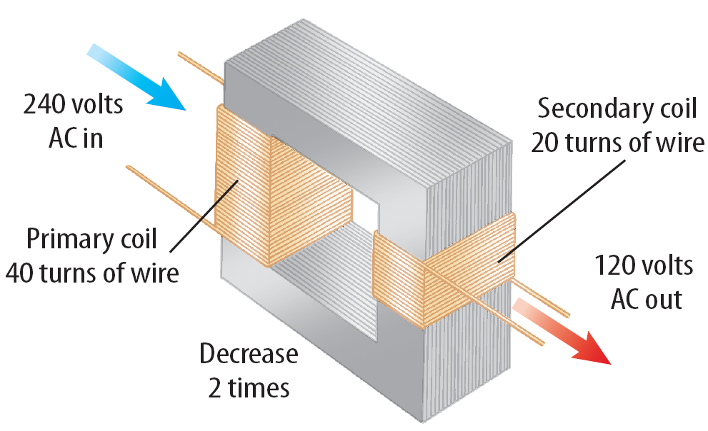
Step-Down Transformer
A transformer that decreases the voltage so that the output voltage is less than the input voltage is a step-down transformer.
In a step-down transformer the number of wire turns on the secondary coil is less than the number of turns on the primary coil.
Producing Electric Current
Copyright © McGraw-Hill Education

Slide 14
SOLVE FOR OUTPUT VOLTAGE
SOLVE FOR THE UNKNOWN
Set Up the Problem
Use the equation: $\frac{\text{V}\text{out}}{\text{V}\text{in}}$ = $\frac{\text{N}\text{2}}{\text{N}\text{1}}$
Solve for $\text{V}\text{ou}\text{t}$= $\frac{\text{V}\text{in}\text{N}\text{2}}{\text{N}\text{1}}$
Solve the Problem
$\text{V}\text{out}$= $\frac{\text{12 }\text{V} \text{×} \text{50}}{\text{150}}$= 4 V
Use with Example Problem 1.
Problem
A transformer has 150 turns in its primary coil and 50 turns in its secondary coil. If the input voltage is 12 V, what is the output voltage?
Response
ANALYZE THE PROBLEM
EVALUATE THE ANSWER
The number of turns in the secondary coil is one-third the number of turns in the primary coil. An output voltage (4 V) that is one-third the input voltage (12 V) makes sense.
KNOWN
input voltage: V_{in} = 12 V
turns in the primary coil: N₁ = 150
turns in the secondary coil: N₂ = 50
UNKNOWN
output voltage: V_{out}
Producing Electric Current
Copyright © McGraw-Hill Education

Slide 15
Transmitting Electrical Energy
When the electric energy is transmitted along power lines, some of the electrical energy is converted into heat due to the electrical resistance of the wires.
The electrical resistance and heat production increases as the wires get longer.
One way to reduce the heat produced in a power line is to transmit the electrical energy at high voltages, typically around 150,000 V.
Electrical energy at such high voltage cannot enter your home safely, nor can it be used in home appliances. A transformer is used to decrease the voltage.
Producing Electric Current
Copyright © McGraw-Hill Education

Slide 16
Transmitting Alternating Current
Although step-up transformers and step-down transformers change the voltage at which electrical energy is transmitted, they do not change the amount of electrical energy transmitted.
This figure shows how step-up and step-down transformers are used in transmitting electrical energy from power plants to your home.
Producing Electric Current
Copyright © McGraw-Hill Education

Slide 17
Review
Essential Questions
What is electromagnetic induction?
How does a generator produce an electric current?
What is the difference between alternating current and direct current?
How does a transformer change the voltage of an alternating current?
Vocabulary
electromagnetic induction
generator
turbine
direct current (DC)
alternating current (AC)
transformer
Producing Electric Current
Copyright © McGraw-Hill Education

