Slide 1
Essential Questions
How do series circuits differ from parallel circuits?
What is the function of a circuit breaker?
How can you calculate electrical power?
How can you calculate the cost of using an electrical appliance?
More Complex Circuits
Copyright © McGraw-Hill Education

Slide 2
Vocabulary
Review
power
New
series circuit
parallel circuit
electrical power
More Complex Circuits
Copyright © McGraw-Hill Education

Slide 3
Series and Parallel Circuits
Circuits usually include three components:
One is a source of voltage difference that can be provided by a battery or an electrical outlet.
Another is one or more devices that use electrical energy.
Circuits also include conductors such as wires that connect the devices to the source of voltage difference to form a closed path.
More Complex Circuits
Copyright © McGraw-Hill Education

Slide 4
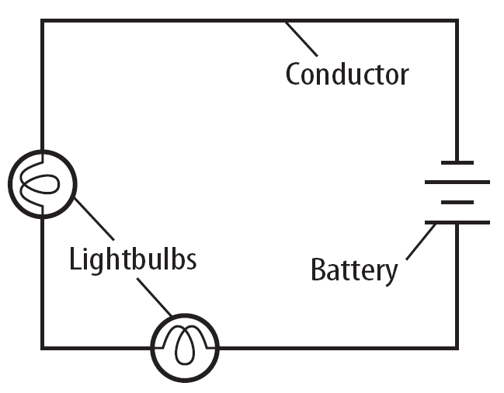
Series Circuits
In a series circuit, the current has only one loop to flow through.
Series circuits are used in flashlights and some holiday lights.
More Complex Circuits
Copyright © McGraw-Hill Education

Slide 5
Open Circuit
How can one faulty bulb cause a whole string of lights to go out?
When any part of a series circuit is disconnected, no current flows through the circuit.
This is called an open circuit. The burned-out bulb causes an open circuit in the string of lights.
More Complex Circuits
Copyright © McGraw-Hill Education

Slide 6
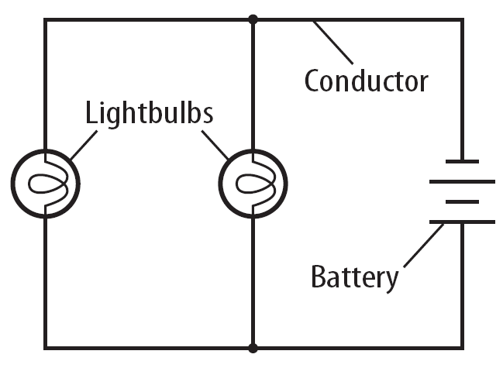
Parallel Circuits
Parallel circuits contain two or more branches for current to move through.
Houses are wired with parallel circuits. .
The current can flow through both or either of the branches.
When one branch of the circuit is opened, such as when you turn a light off, the current continues to flow through the other branches.
More Complex Circuits
Copyright © McGraw-Hill Education

Slide 7
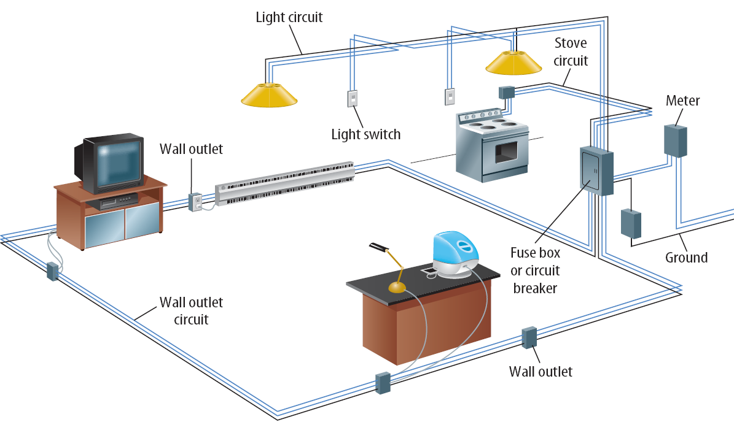
Household Circuits
This wiring is mostly a combination of parallel circuits connected in an organized and logical network.
The wiring in a house must allow for the individual use of various appliances and fixtures.
The main switch and circuit breaker or fuse box serve as an electrical headquarters for your home.
More Complex Circuits
Copyright © McGraw-Hill Education

Slide 8
Household Circuits
Parallel circuits branch out from the breaker or fuse box to wall sockets, major appliances, and lights.
To protect against overheating of the wires, all household circuits contain either a fuse or a circuit breaker.
More Complex Circuits
Copyright © McGraw-Hill Education

Slide 9
Fuses
An electrical fuse contains a small piece of metal that melts if the current becomes too high.
When it melts, it causes a break in the circuit, stopping the flow of current through the overloaded circuit.
To enable current to flow again in the circuit, you must replace the blown fuse with a new one.
Too many appliances in use at the same time is the most likely cause for the overheating of the circuit.
More Complex Circuits
Copyright © McGraw-Hill Education

Slide 10
Circuit Breaker
A circuit breaker contains a piece of metal that bends when the current in it is so large that it gets hot.
The bending causes a switch to flip and open the circuit, stopping the flow of current.
Circuit breakers usually can be reset by pushing the switch to its "on" position.
More Complex Circuits
Copyright © McGraw-Hill Education

Slide 11
Electrical Power and Energy
The rate at which electrical energy is converted to another form of energy is the electric power.
The reason that electricity is so useful is that electrical energy is converted easily to other types of energy.
More Complex Circuits
Copyright © McGraw-Hill Education

Slide 12
Calculate Electric Power
Electric power can be calculated from the following equation:
The unit for power is the watt (W). Because the watt is a small unit of power, electric power is often expressed in kilowatts (kW).
One kilowatt equals 1,000 watts.
More Complex Circuits
Copyright © McGraw-Hill Education

Slide 13
SOLVE FOR ELECTRICAL POWER
SOLVE FOR THE UNKNOWN
Set Up the Problem
P = IV
Solve the Problem
P =(15 A) (240 V) = 3,600 W
The clothes dryer has a power of 3,600 W.
Use with Example Problem 2.
Problem
The current in a clothes dryer is 15 A when it is plugged into a 240-volt outlet. What is the power of the clothes dryer?
Response
ANALYZE THE PROBLEM
EVALUATE THE ANSWER
You can find the power rating for a clothes dryer by looking at the instruction manual, the manufacturer’s web site, or the clothes dryer itself. The power rating on a typical clothes dryer is about 4,000 W. Therefore, an answer of 3,600 W seems reasonable.
KNOWN
current: I = 15 A
voltage difference: V = 240 V
UNKNOWN
power: P
More Complex Circuits
Copyright © McGraw-Hill Education

Slide 14
Calculate Electrical Energy
Electric companies charge by the amount of electrical energy used, rather than by the electric power used.
Electrical energy usually is measured in units of kilowatt hours (kWh) and can be calculated from this equation:
More Complex Circuits
Copyright © McGraw-Hill Education

Slide 15
SOLVE FOR ELECTRICAL ENERGY
SOLVE FOR THE UNKNOWN
Set Up the Problem
E= Pt
Solve the Problem
E = (1.2 kW) (0.25 h) = 0.30 kWh
The power company provided 0.30 kWh of electrical energy for the microwave.
Use with Example Problem 3.
Problem
A microwave oven with a power rating of 1,200 W is used for 0.25 h. How much electrical energy did the power company provide for the microwave?
Response
ANALYZE THE PROBLEM
EVALUATE THE ANSWER
Use rounding to estimate the answer. The microwave oven’s power is very close to 1,000 W, which is the same as 1 kW.
Therefore, using the microwave for 0.25 h should require approximately 0.25 kWh of energy. Our answer, 0.30 kWh, is very close to 0.25 kWh. Therefore, our answer is reasonable.
KNOWN
electrical power used: P = 1,200 W = 1.2 kW
time: t = 0.25 h
UNKNOWN
electrical energy provided: E
More Complex Circuits
Copyright © McGraw-Hill Education

Slide 16
The Cost of Using Electrical Energy
The cost of using the appliance can be computed by multiplying the electrical energy used by the amount the power company charges for each kWh.
For example, if a 100-W lightbulb is left on for 5 h, the amount of electrical energy used is:
More Complex Circuits
Copyright © McGraw-Hill Education

Slide 17
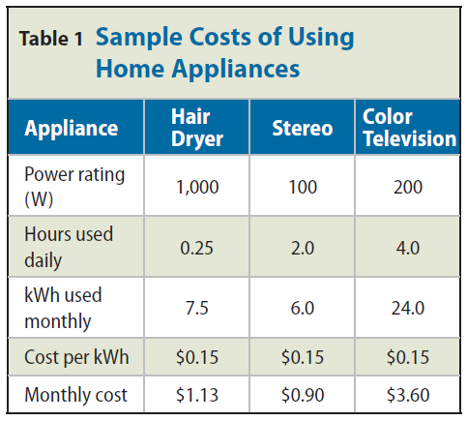
The Cost of Using Electrical Energy
The cost of using some household appliances is given in this table, where the cost per kWh is assumed to be $0.09/kWh.
More Complex Circuits
Copyright © McGraw-Hill Education

Slide 18
Review
Essential Questions
How do series circuits differ from parallel circuits?
What is the function of a circuit breaker?
How can you calculate electrical power?
How can you calculate the cost of using an electrical appliance?
Vocabulary
series circuit
parallel circuit
electrical power
More Complex Circuits
Copyright © McGraw-Hill Education

