Slide 1
Essential Questions
What is the law of conservation of energy?
What is mechanical energy?
Why is mechanical energy not always conserved?
How are power and energy related?
Conservation of Energy
Copyright © McGraw-Hill Education

Slide 2
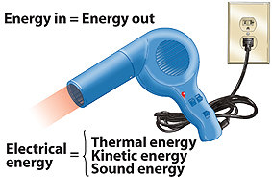
The Law of Conservation of Energy
The law of conservation of energy states that energy cannot be created or destroyed.
Energy can change from one form to another, but the total amount of energy never changes.
Even when energy changes form, energy is never destroyed.
Conservation of Energy
Copyright © McGraw-Hill Education

Slide 3
Mechanical Energy Transformations
Mechanical energy is the sum of the kinetic energy and potential energy of the objects in a system.
Often, the mechanical energy of a system remains constant or nearly constant.
In these cases, energy is only converted between different forms of mechanical energy.
Conservation of Energy
Copyright © McGraw-Hill Education

Slide 4
Falling Objects
An apple on a tree-Earth system has gravitational potential energy due to the gravitational force between apple and Earth.
The instant the apple comes loose from the tree, it accelerates due to gravity.
As the apple falls, it loses height so the gravitational potential energy decreases.
This potential energy is transformed into kinetic energy as the speed of the apple increases.
If the gravitational potential energy is being converted completely into the kinetic energy of the apple falling, then the mechanical energy of the system does not change as the apple falls.
The potential energy that the apple loses is gained back as kinetic energy.
Conservation of Energy
Copyright © McGraw-Hill Education

Slide 5
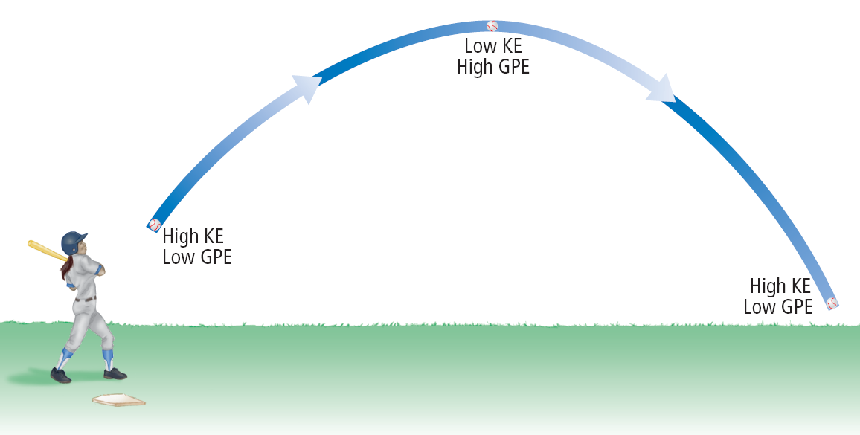
Projectile Motion
Energy transformations also occur during projectile motion when an object moves in a curved path.
However, the mechanical energy of the ball-Earth system remains constant as it rises and falls.
Conservation of Energy
Copyright © McGraw-Hill Education

Slide 6
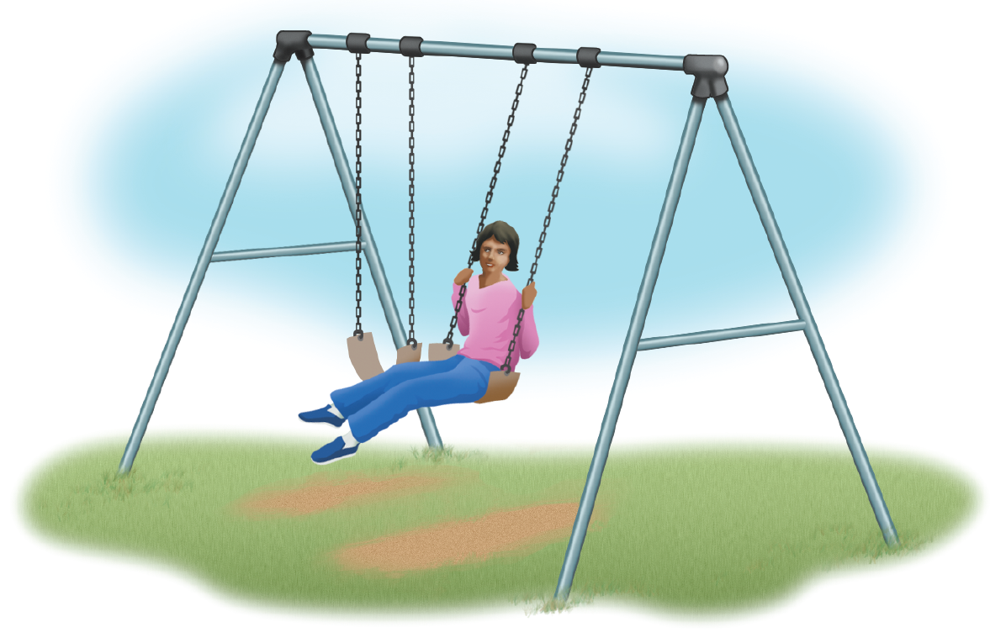
Energy Transformations in a Swing
When you ride on a swing part of the fun is the feeling of almost falling as you drop from the highest point to the lowest point of the swing’s path.
The ride starts with a push that gets you moving, giving you kinetic energy. As the swing rises, you lose speed but gain height.
In energy terms, kinetic energy changes to gravitational potential energy.
At the top of your path, potential energy is at its greatest.
Then, as the swing accelerates downward, potential energy changes to kinetic energy.
Conservation of Energy
Copyright © McGraw-Hill Education

Slide 7
The Effect of Friction
You know from experience that if you don’t continue to pump a swing or get a push from somebody else, your arcs will become lower and you eventually will stop swinging.
In other words, the mechanical (kinetic and potential) energy of the swing decreases, as if the energy were being destroyed. Is this a violation of the law of conservation of energy?
Conservation of Energy
Copyright © McGraw-Hill Education

Slide 8
The Effect of Friction
With every movement, the swing’s ropes or chains rub on their hooks and air pushes on the rider.
Friction and air resistance cause some of the mechanical energy of the swing to change to thermal energy.
With every pass of the swing, the temperature of the hooks and the air increases a little, so the mechanical energy of the swing is not destroyed.
Rather, it is transformed into thermal energy.
Conservation of Energy
Copyright © McGraw-Hill Education

Slide 9
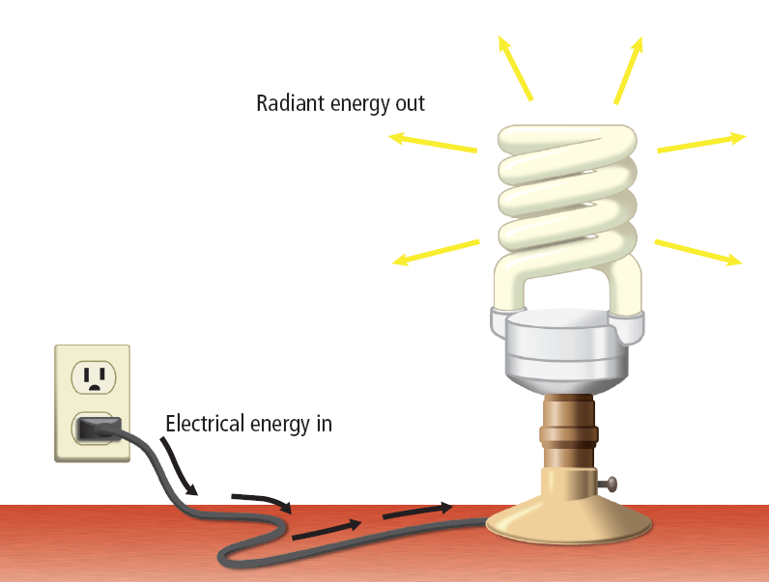
Transforming Electrical Energy
Lightbulbs transform electrical energy into light so you can see.
The warmth you feel around the bulb is evidence that some of that electrical energy is transformed into thermal energy.
Conservation of Energy
Copyright © McGraw-Hill Education

Slide 10
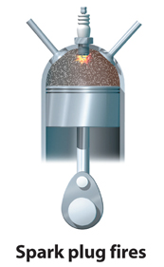
Transforming Chemical Potential Energy
Fuel stores chemical potential energy.
The engine transforms the chemical potential energy of gasoline molecules into the kinetic energy of a moving car or bus.
Several energy conversions occur in this process.
Conservation of Energy
Copyright © McGraw-Hill Education

Slide 11
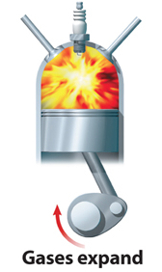
Transforming Chemical Potential Energy
In a car, a spark plug fires, initiating the conversion of chemical potential energy into thermal energy.
As the hot gases expand, thermal energy is converted into kinetic energy.
Conservation of Energy
Copyright © McGraw-Hill Education

Slide 12
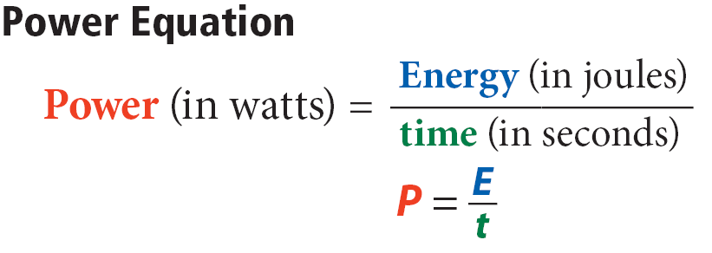
Power—how fast energy changes
The rate at which energy is converted is the object’s power.
Power is measured in watts with 1 watt equaling 1 joule per second.
Conservation of Energy
Copyright © McGraw-Hill Education

Slide 13
SOLVE FOR POWER
Use with Example Problem 6.
Problem
You transform 950 J of chemical energy into mechanical energy to push a sofa. If it took you 5.0 s to move the sofa, what was your power?
SOLVE FOR THE UNKNOWN
Set Up the Problem
P = $\frac{\text{E}}{\text{t}}$
Solve the Problem
P = $\frac{\text{950 }\text{J}}{\text{5.0}\text{s} }$ = 190 W
Response
ANALYZE THE PROBLEM
KNOWN
Energy transformed: E = 950 J
time: t = 5.0 s
UNKNOWN
power: P
EVALUATE THE ANSWER
A typical human can develop a power of 400 W to 1,000 W for short periods of time. Developing a power of 190 W would require some exertion but would not be too difficult. The answer is reasonable.
Conservation of Energy
Copyright © McGraw-Hill Education

Slide 14
Energy Conversions in Your Body
What forms of energy can you find in the human body?
With your right hand, reach up and feel your left shoulder. With that simple action, potential energy from your body was converted to the kinetic energy of your moving arm.
Some of your body’s the chemical potential energy is used to maintain a nearly constant internal temperature.
A portion of this energy also is converted to the excess thermal energy that your body gives off to its surroundings.
Fat and other chemical compounds store energy for your body.
This chemical potential energy is used to fuel the processes that keep you alive, such as making your heart beat and digesting the food you eat.
Conservation of Energy
Copyright © McGraw-Hill Education

Slide 15
Energy Conversions in Your Body
The food Calorie (C) is a unit used by nutritionists to measure how much energy you get from various foods—1 C is equivalent to about 4,000 J.
Every gram of fat a person consumes can supply about 10 C of energy.
Carbohydrates and proteins each supply about 5 C of energy per gram.
Conservation of Energy
Copyright © McGraw-Hill Education

Slide 16
Review
Essential Questions
What is the law of conservation of energy?
What is mechanical energy?
Why is mechanical energy not always conserved?
How are power and energy related?
Vocabulary
law of conservation of energy
mechanical energy
power
Conservation of Energy
Copyright © McGraw-Hill Education

