Slide 1
Essential Questions
What is the difference between kinetic energy and potential energy?
How can you calculate kinetic energy?
What are some different forms of potential energy?
How can you calculate gravitational potential energy?
Describing Energy
Copyright © McGraw-Hill Education

Slide 2
Change Requires Energy
When something is able to change its environment or itself, it has energy. Energy is the ability to cause change.
Anything that causes change must have energy.
Energy has several different forms. Electrical, chemical, radiant, and thermal are examples.
Describing Energy
Copyright © McGraw-Hill Education

Slide 3
Work Transfers Energy
Energy can also be described as the ability to do work.
Therefore, energy can be measured with the same units as work.
Energy, like work, can be measured in joules.
Describing Energy
Copyright © McGraw-Hill Education

Slide 4
Systems
A system is anything that you can imagine a boundary around.
It is useful to think of systems when describing energy.
A system can be a single object, such as a baseball, or a group of objects, such as the solar system.
Describing Energy
Copyright © McGraw-Hill Education

Slide 5
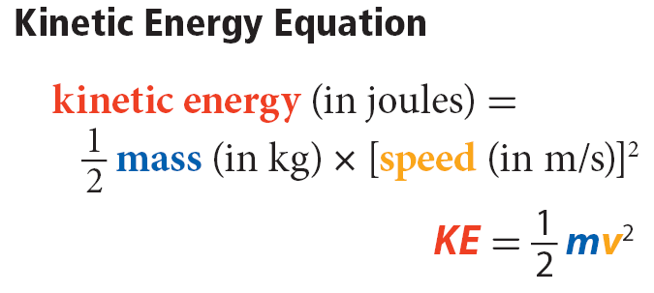
Kinetic Energy
Kinetic energy is the energy a moving object has because of its motion.
The kinetic energy of a moving object depends on the object’s mass and its speed, represented in the equation:
Describing Energy
Copyright © McGraw-Hill Education

Slide 6
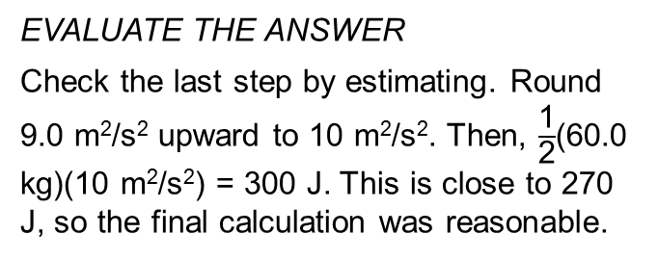
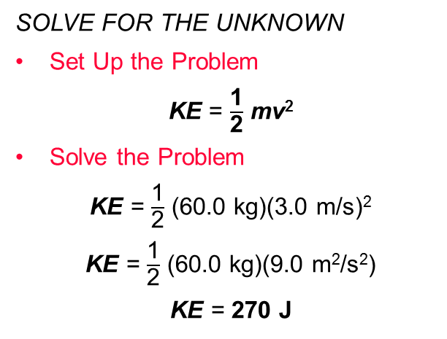
SOLVE FOR KINETIC ENERGY
Use with Example Problem 4.
Problem
A jogger with a mass of 60.0 kg is moving forward at a speed of 3.0 m/s. What is the jogger’s kinetic energy from this forward motion?
SOLVE FOR THE UNKNOWN
Set Up the Problem
KE = $\frac{\text{1}}{\text{2}}$ mv²
Solve the Problem
KE = $\frac{\text{1}}{\text{2}}$ (60.0 kg)(3.0 m/s)²
KE = $\frac{\text{1}}{\text{2}}$ (60.0 kg)(9.0 m²/s²)
KE = 270 J
Response
ANALYZE THE PROBLEM
KNOWN
mass: m = 60.0 kg
speed: v = 3.0 m/s
UNKNOWN
kinetic energy: KE
EVALUATE THE ANSWER
Check the last step by estimating. Round 9.0 m²/s² upward to 10 m²/s². Then, $\frac{\text{1}}{\text{2}}$(60.0 kg)(10 m²/s²) = 300 J. This is close to 270 J, so the final calculation was reasonable.
Describing Energy
Copyright © McGraw-Hill Education

Slide 7
Potential Energy
Stored energy due to the interactions between objects is potential energy.
A hanging apple in a tree has stored energy.
If the apple stays in the tree, the energy will remain stored.
If the apple falls, that stored energy is converted to kinetic energy.
Describing Energy
Copyright © McGraw-Hill Education

Slide 8
Elastic Potential Energy
Elastic potential energy is energy stored by something that can stretch or compress, such as a rubber band or spring.
If you stretch a rubber band and let it go, it sails across the room.
As it flies through the air, it has kinetic energy due to its motion.
Where did this kinetic energy come from?
The stretched rubber band had energy stored as elastic potential energy.
Describing Energy
Copyright © McGraw-Hill Education

Slide 9
Chemical Potential Energy
Energy stored due to chemical bonds is chemical potential energy.
Energy is stored when the bonds that hold the atoms together are formed.
In this chemical reaction, chemical potential energy is released when bonds are broken.
When methane burns, it combines with oxygen to form carbon dioxide and water. In this chemical reaction, chemical potential energy is converted to other forms of energy.
Describing Energy
Copyright © McGraw-Hill Education

Slide 10
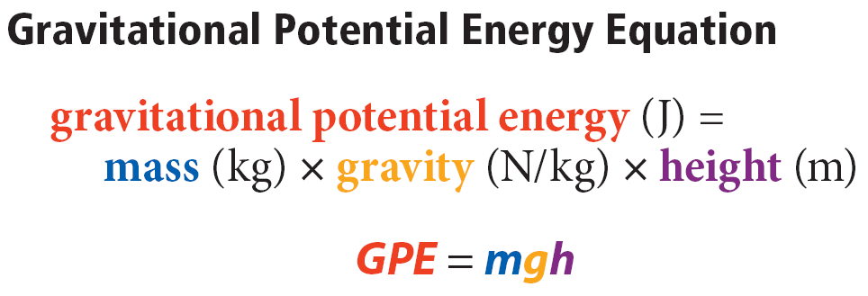
Gravitational Potential Energy
Gravitational potential energy (GPE) is energy due to gravitational forces between objects.
Together, an object near Earth and Earth itself have gravitational potential energy.
Gravitational potential energy can be calculated from the following equation:
Near Earth’s surface, gravity is 9.8 N/kg.
Like all forms of energy, gravitational potential energy can be measured in joules.
Describing Energy
Copyright © McGraw-Hill Education

Slide 11
Changing GPE
According to the equation for gravitational potential energy, the GPE of an Earth system can be increased by increasing the object’s height.
Gravitational potential energy also increases if the mass of the object increases.
Describing Energy
Copyright © McGraw-Hill Education

Slide 12
SOLVE FOR GRAVITATIONAL POTENTIAL ENERGY
Use with Example Problem 5.
Problem
A 4.0-kg ceiling fan is placed 2.5 m above the floor. What is the gravitational potential energy of the Earth-ceiling fan system relative to the floor?
SOLVE FOR THE UNKNOWN
Set Up the Problem
GPE = mgh
Solve the Problem
GPE = (4.0 kg)(9.8 N/kg)(2.5 m) =
98 J • m = 98 J
Response
ANALYZE THE PROBLEM
EVALUATE THE ANSWER
Round 9.8 N/kg to 10 N/kg. Then, GPE = (4.0 kg)(10 N/kg)(2.5 m) = 100 J. This is very close to the answer above. Therefore, that answer is reasonable.
KNOWN
mass: m = 4.0 kg
gravity: g = 9.8 N/kg
height: h = 2.5 m
UNKNOWN
gravitational potential energy: GPE
Describing Energy
Copyright © McGraw-Hill Education

Slide 13
Review
Essential Questions
What is the difference between kinetic energy and potential energy?
How can you calculate kinetic energy?
What are some different forms of potential energy?
How can you calculate gravitational potential energy?
Vocabulary
energy
system
kinetic energy
potential energy
elastic potential energy
chemical potential energy
gravitational potential energy
Describing Energy
Copyright © McGraw-Hill Education

