Slide 1
Essential Questions
What is work?
How can work be calculated when force and motion are parallel to each other?
How do machines make doing work easier?
What are mechanical advantage and efficiency?
Work and Machines
Copyright © McGraw-Hill Education

Slide 2
What is work?
Work is force applied through a distance.
Remember that a force is a push or a pull. Work requires both force and motion.
If you push against the desk and nothing moves, then you haven't done any work.
Suppose you give a book a push and it slides along a table for a distance of 1 m before it comes to a stop.
Even though the book moved 1 m, you do work on the book only while your hand is in contact with it.
Work and Machines
Copyright © McGraw-Hill Education

Slide 3
Doing Work
There are two conditions that have to be satisfied for work to be done on an object.
One is that the applied force must make the object move.
The other is that the movement must be in the same direction as the applied force.
Work and Machines
Copyright © McGraw-Hill Education

Slide 4
Calculating Work
The amount of work done depends on the amount of force exerted and the distance over which the force is applied.
When a force is exerted and an object moves in the direction of the force, the amount of work done can be calculated as follows:
One joule is about the amount of work required to lift a baseball a vertical distance of 0.7 m.
Work and Machines
Copyright © McGraw-Hill Education

Slide 5
SOLVE FOR WORK
Use with Example Problem 1.
Problem
You push a refrigerator with a horizontal force of 100 N. If you move the refrigerator a distance of 5 m while you are pushing, how much work do you do?
SOLVE FOR THE UNKNOWN
Set Up the Problem
W = Fd
Solve the Problem
W = (100 N)(5 m) = 500 J
Response
ANALYZE THE PROBLEM
EVALUATE THE ANSWER
Check to see whether the units match on both sides of the equation.
units of W = (units of F ) × (units of d)
= N × m = J
KNOWN
applied force: F = 100 N
distance: d = 5 m
UNKNOWN
work: W
Work and Machines
Copyright © McGraw-Hill Education

Slide 6
Machines
A machine is a device that changes the force or increases the motion from work.
Some machines, such as knives, scissors, and doorknobs make doing work easier.
Some machines, such as bicycles, increase speed.
Some machines, such as an axe, change the direction of force.
Some machines, such as a car jack, increase force.
Work and Machines
Copyright © McGraw-Hill Education

Slide 7
Types of Simple Machines
A simple machine is a machine that does work with only one movement of the machine.
There are six types of simple machines:
lever
pulley
wheel and axle
inclined plane
screw
wedge
Work and Machines
Copyright © McGraw-Hill Education

Slide 8
Compound Machines
A compound machine is a combination of two or more simple machines.
A pair of scissors is a compound machine that combines two wedges and two levers.
A bicycle is also a compound machine made up of two wheel and axle systems.
Work and Machines
Copyright © McGraw-Hill Education

Slide 9
Calculating Efficiency
Efficiency is a measure of how much of the work put into a machine is changed into useful output work by the machine. Every machine is less than 100% efficient.
Work and Machines
Copyright © McGraw-Hill Education

Slide 10
SOLVE FOR EFFICIENCY
Use with Example Problem 2.
Problem
You do 20 J of work in pushing a crate up a ramp. If the output work from the inclined plane is 11 J, then what is the efficiency of the inclined plane?
SOLVE FOR THE UNKNOWN
Set Up the Problem
e = $\frac{\text{W}\text{out}}{\text{W}\text{in}}$ × 100
Solve the Problem
e = $\frac{\text{11 }\text{J}}{\text{20 }\text{J}}$ × 100
e = 55 percent
Response
ANALYZE THE PROBLEM
KNOWN
work in: W_{in} = 20 J
work out: W_{out} = 11 J
UNKNOWN
efficiency: e
EVALUATE THE ANSWER
The work out is about half of the work in. Therefore, an answer close to 50 percent is reasonable.
Work and Machines
Copyright © McGraw-Hill Education

Slide 11
Mechanical Advantage
The ratio of the output force to the input force is the mechanical advantage of a machine.
Two forces are involved when a machine is used to do work. The force that is applied to the machine is called the input force. F_{in} stands for the effort force.
The force applied by the machine is called the output force, symbolized by F_{out}.
Work and Machines
Copyright © McGraw-Hill Education

Slide 12
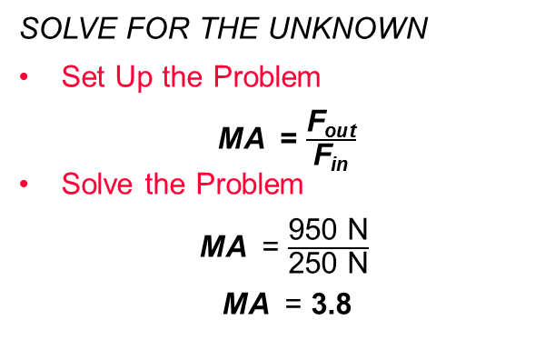
SOLVE FOR MECHANICAL ADVANTAGE
Use with Example Problem 3.
Problem
A crate weighs 950 N. If you can use a pulley system to lift that crate with a force of only 250 N, then what is the mechanical advantage of the pulley system?
SOLVE FOR THE UNKNOWN
Set Up the Problem
MA = $\frac{\text{F}\text{out}}{\text{F}\text{in}}$
Solve the Problem
MA = $\frac{\text{950 }\text{N}}{\text{250 }\text{N}}$
MA = 3.8
Response
ANALYZE THE PROBLEM
EVALUATE THE ANSWER
The weight of the crate is very close to four times the force needed to lift the crate. Therefore, the mechanical advantage of the crate should be close to 4. Our answer is close to 4, so it is reasonable.
KNOWN
output force: F_{out} = 950 N
input force: F_{in} = 250 N
UNKNOWN
mechanical advantage: MA
Describing Energy
Copyright © McGraw-Hill Education

Slide 13
Review
Essential Questions
What is work?
How can work be calculated when force and motion are parallel to each other?
How do machines make doing work easier?
What are mechanical advantage and efficiency?
Vocabulary
work
machine
simple machine
compound machine
efficiency
mechanical advantage
Work and Machines
Copyright © McGraw-Hill Education

