Slide 1
Essential Questions
How does Newton’s first law explain what happens in a car crash?
How does Newton’s second law explain the effects of air resistance?
When is momentum conserved?
Using Newton’s Laws
Copyright © McGraw-Hill Education

Slide 2
What happens in a crash?
Newton’s first law of motion can explain what happens in a car crash.
When the car abruptly stops, the passengers will continue to move unless acted on by an outside force.
Safety belts and air bags counteract the force of inertia to reduce injuries.
Using Newton’s Laws
Copyright © McGraw-Hill Education

Slide 3
Newton’s Second Law and Gravitational Acceleration
When all forces except gravity acting on a falling object can be ignored, the object is said to be in free fall.
Close to Earth’s surface, the acceleration of a falling object in free fall is about 9.8 m/s².
This acceleration is given the symbol g and is called acceleration due to gravity.
If an object is in free fall near Earth’s surface, the net force on it equals the force of gravity (F_{net} = F_{g}).
Using Newton’s Laws
Copyright © McGraw-Hill Education

Slide 4
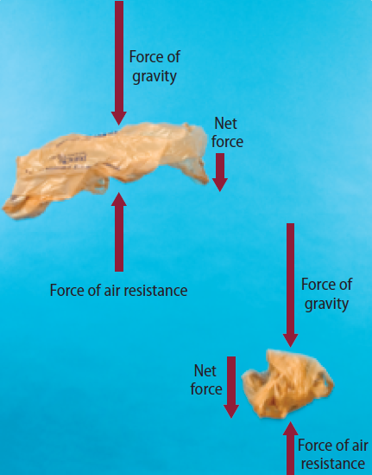
Air Resistance
A friction-like force called air resistance opposes the motion of objects that move through the air.
Using Newton’s Laws
Copyright © McGraw-Hill Education

Slide 5
Air Resistance
The amount of air resistance on an object depends on the speed, size, and shape of the object.
Air resistance, not the object’s mass, is why feathers, leaves, and pieces of paper fall more slowly than pennies, acorns, and apples.
Using Newton’s Laws
Copyright © McGraw-Hill Education

Slide 6
Terminal Velocity
The terminal velocity is the highest speed a falling object will reach. The terminal velocity depends on the size, shape, and mass of a falling object.
As an object falls, the downward force of gravity causes the object to accelerate.
Using Newton’s Laws
Copyright © McGraw-Hill Education

Slide 7
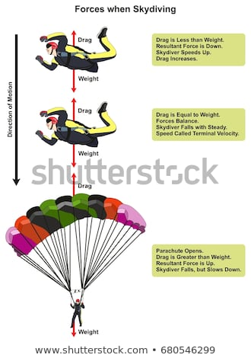
Terminal Velocity
As an object falls faster, the upward force of air resistance increases.
This causes the net force on a sky diver to decrease as the sky diver falls.
Using Newton’s Laws
Copyright © McGraw-Hill Education

Slide 8
Terminal Velocity
Finally, the upward air resistance force becomes large enough to balance the downward force of gravity. This means the net force on the object is zero.
Then the acceleration of the object is also zero, and the object falls with a constant speed called the terminal velocity.
Using Newton’s Laws
Copyright © McGraw-Hill Education

Slide 9
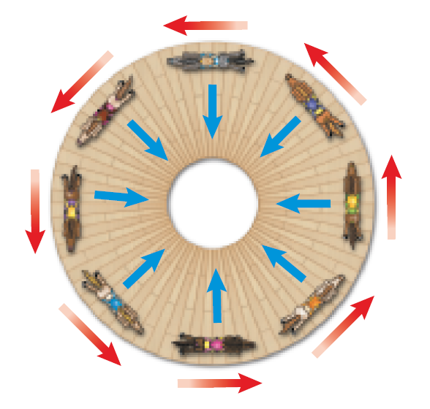
Centripetal Forces
The net force exerted toward the center of a curved path is called a centripetal force.
Anything that moves in a circle is doing so because a centripetal force is accelerating it toward the center.
Using Newton’s Laws
Copyright © McGraw-Hill Education

Slide 10
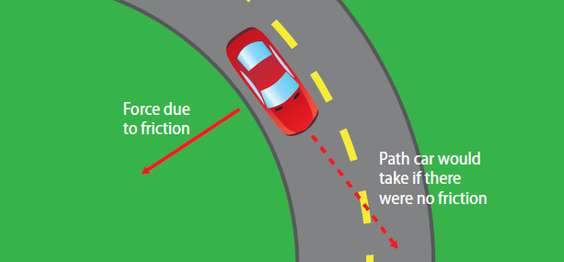
Centripetal Force and Traction
When a car rounds a curve on a highway, a centripetal force must be acting on the car to keep it moving in a curved path.
This centripetal force is the frictional force, or the traction, between the tires and the road surface.
Using Newton’s Laws
Copyright © McGraw-Hill Education

Slide 11
Law of Conservation of Momentum
The law of conservation of momentum states that if no external forces act on a group of objects, their total momentum doesn’t change. That is, momentum is conserved.
The momentum of an object doesn’t change unless its mass, velocity, or both change.
Momentum, however, can be transferred from one object to another.
Using Newton’s Laws
Copyright © McGraw-Hill Education

Slide 12
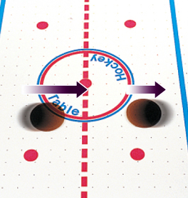
When Objects Collide
The results of a collision depend on the momentum of each object.
When the first puck hits the second puck from behind, it gives the second puck momentum in the same direction.
Using Newton’s Laws
Copyright © McGraw-Hill Education

Slide 13
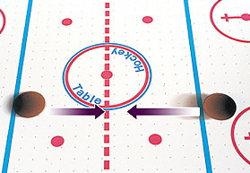
When Objects Collide
If the pucks are speeding toward each other with the same speed, the total momentum is zero.
Using Newton’s Laws
Copyright © McGraw-Hill Education

Slide 14
Rocket Propulsion
In a rocket engine, burning fuel produces hot gases. The rocket engine exerts a force on these gases and causes them to escape out the back of the rocket.
By Newton’s third law, the gases exert a force on the rocket and push it forward.
Using Newton’s Laws
Copyright © McGraw-Hill Education

