Slide 1

Section 3: Particles in Solution
Dissolved particles can both lower the freezing point and raise the boiling point of a solvent.
K What I Know | W What I Want to Find Out | L What I Learned

Slide 2
Essential Questions
Why do some solutions conduct electricity?
What are two ways that some solutes form ions in solution?
How do solutes affect the freezing and boiling points of solvents?
Particles in Solution
Copyright © McGraw-Hill Education

Slide 3
Vocabulary
Review
ion
New
electrolyte
nonelectrolyte
ionization
dissociation
Particles in Solution
Copyright © McGraw-Hill Education

Slide 4
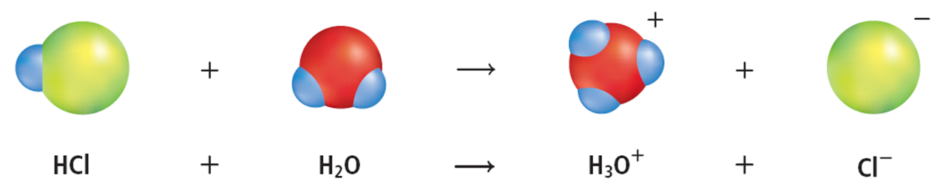
Ion Formation in Solution
Ions are charged particles
Important in many systems, including the human body
Compounds that produce solutions of ions in water are known as electrolytes.
Particles in Solution
Copyright © McGraw-Hill Education

Slide 5
Ion Formation in Solution
Solutions containing electrolytes conduct electricity
  Strong electrolytes produce many ions and conduct a strong current
  Weak electrolytes produce few ions and conduct a weak current.
Nonelectrolytes are substances that form no ions in water and cannot conduct electricity.
Particles in Solution
Copyright © McGraw-Hill Education

Slide 6
Ion Formation in Solution
Ionization
Solutions of electrolytes form two ways, ionization or dissociation
The process in which molecular compounds dissolve in water and form charged particles is called ionization.
Particles in Solution
Copyright © McGraw-Hill Education

Slide 7
Ion Formation in Solution – Ionization
Animation
FPO Add link to concepts in motion animation from page 658 here.
Describing Motion
Copyright © McGraw-Hill Education

Slide 8
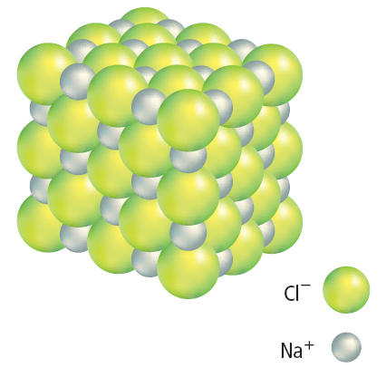
Ion Formation in Solution
Dissociation
The second way electrolyte solutions form is by the separation of ions in ionic compounds.
Dissociation is the process in which positive and negative ions in an ionic solid mix with a solvent to form a solution.
Particles in Solution
Copyright © McGraw-Hill Education

Slide 9
Ion Formation in Solution – Dissociation
Animation
FPO Add link to concepts in motion animation from page 659 here.
Particles in Solution
Copyright © McGraw-Hill Education

Slide 10
Effects of Solute Particles
All solute particles (polar, nonpolar, electrolyte, nonelectrolyte) affect the physical properties of the solvent
The effect the solute has on a solvent depends on the number of solute particles in solution – not on the chemical nature of the particles.
Particles in Solution
Copyright © McGraw-Hill Education

Slide 11
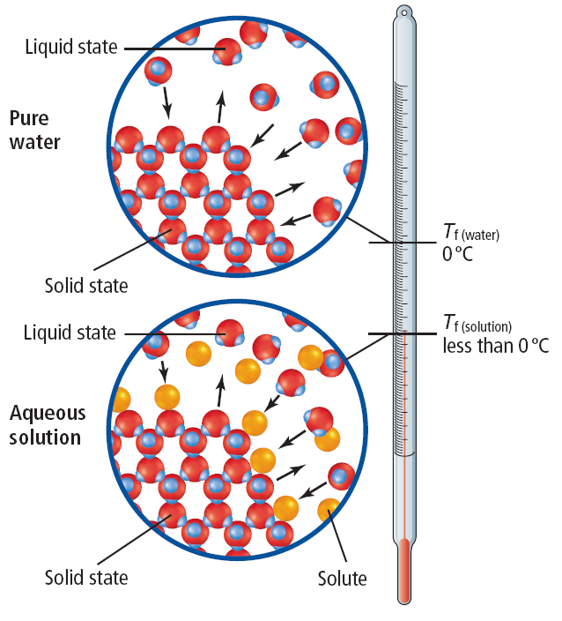
Effects of Solute Particles
Lowering freezing point
Adding a solute to a solvent lowers the freezing point of the solvent.
The amount that the freezing point lowers depends on the concentration of the solute particles.
A solute interferes with the formation of the solid pattern in a solvent, making it harder for the solvent to freeze
This can be seen in nature – some animals increase the concentration of solutes in their tissues to prevent freezing in extreme conditions.
Particles in Solution
Copyright © McGraw-Hill Education

Slide 12
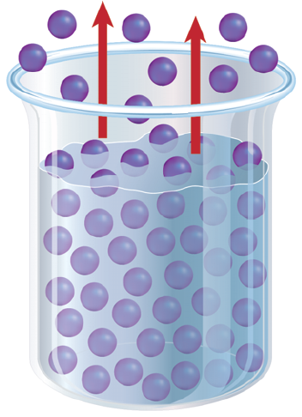
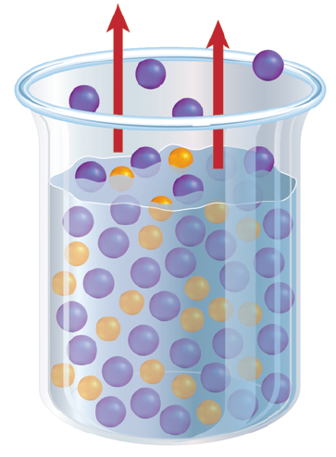
Effects of Solute Particles
Raising boiling point
Similar to the freezing process, solute particles can interfere with the transition of a solvent from liquid to gas, raising the boiling point
Solute particles interfere with the evaporation of solvent particles at the surface of the solution
More energy is needed for the solvent particles to escape from the liquid surface.
Particles in Solution
Copyright © McGraw-Hill Education

Slide 13
Review
Essential Questions
Why do some solutions conduct electricity?
What are two ways that some solutes form ions in solution?
How do solutes affect the freezing and boiling points of solvents?
Vocabulary
electrolyte
nonelectrolyte
ionization
dissociation
Particles in Solution
Copyright © McGraw-Hill Education

