Slide 1
Essential Questions
How are the concentrations of solutions expressed?
What is solubility?
What are saturated, unsaturated, and supersaturated solutions?
How do pressure and temperature affect the solubility of gases?
Concentration and Solubility
Copyright © McGraw-Hill Education

Slide 2
Vocabulary
Review
solution
New
concentration
solubility
saturated solution
unsaturated solution
supersaturated solution
Concentration and Solubility
Copyright © McGraw-Hill Education

Slide 3
Concentration
A solution can be described as concentrated – containing a large amount of solute, or dilute – containing a little amount of solute
The concentration of a solution is the amount of solute actually dissolved in a given amount of solvent.
One way is to state the percentage by volume of the solute.
Examples: 70% Rubbing Alcohol and 3% Hydrogen Peroxide
Concentration and Solubility
Copyright © McGraw-Hill Education

Slide 4
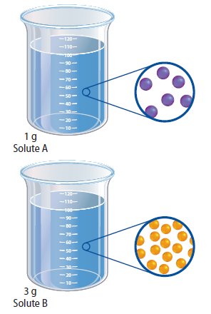
How much can dissolve?
Comparing solubilities
Solubility is the maximum amount of a solute that can be dissolved in a given amount of solvent at a given temperature.
Often expressed as grams of solute per 100g of water (g/100 g water)
Solubility can vary based on temperature, pressure, and other factors
Concentration and Solubility
Copyright © McGraw-Hill Education

Slide 5
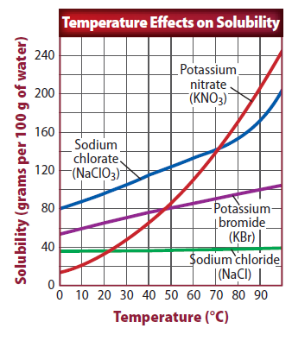
Types of Solutions
Saturated solutions
Saturated solution is a solution that contains all of the solute that it can hold at a given temperture
Generally, as the temperature of a liquid solvent increases, the amount of solid solute it can dissolve also increases.
Solubility curves can be used to determine how much solute will dissolve at any temperature given on the graph
Concentration and Solubility
Copyright © McGraw-Hill Education

Slide 6
Solubility Table

Slide 7
Types of Solutions
Unsaturated solutions
An unsaturated solution is any solution that can dissolve more solute at a given temperature.
Each time a saturated solution is heated to a higher temperature, it becomes unsaturated. (Solid dissolved in a Liquid solvent)
Concentration and Solubility
Copyright © McGraw-Hill Education

Slide 8
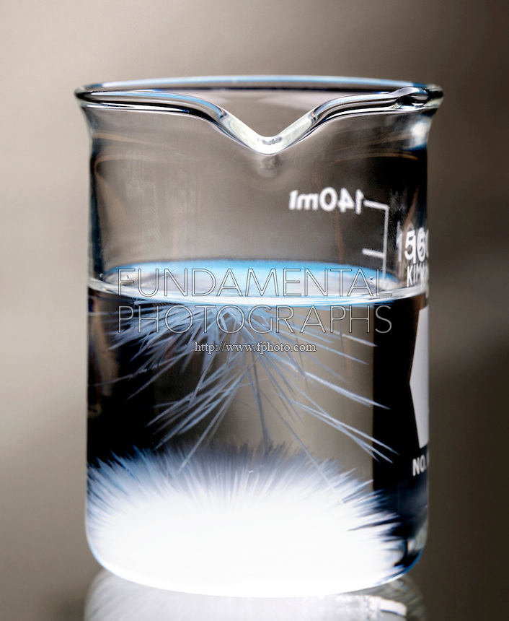
Types of Solutions
Supersaturated solutions
A supersaturated solution is one that contains more solute than a saturated solution at the same temperature.
Supersaturated solutions are unstable. This means that as they cool they will begin to precipitate out or start to form crystals (crystallization).
Concentration and Solubility
Copyright © McGraw-Hill Education

Slide 9
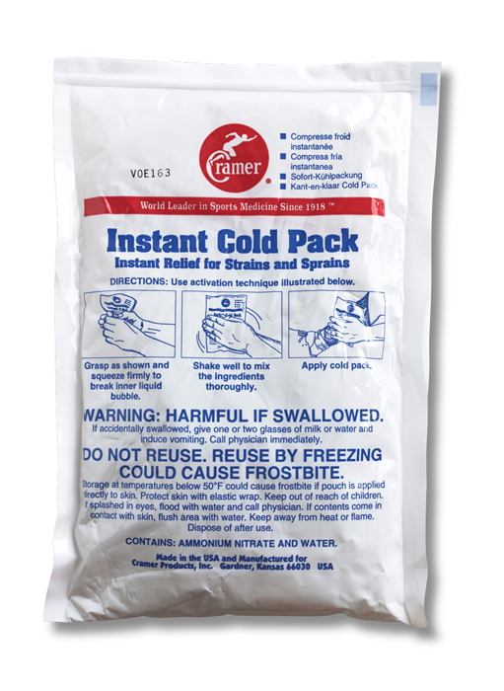
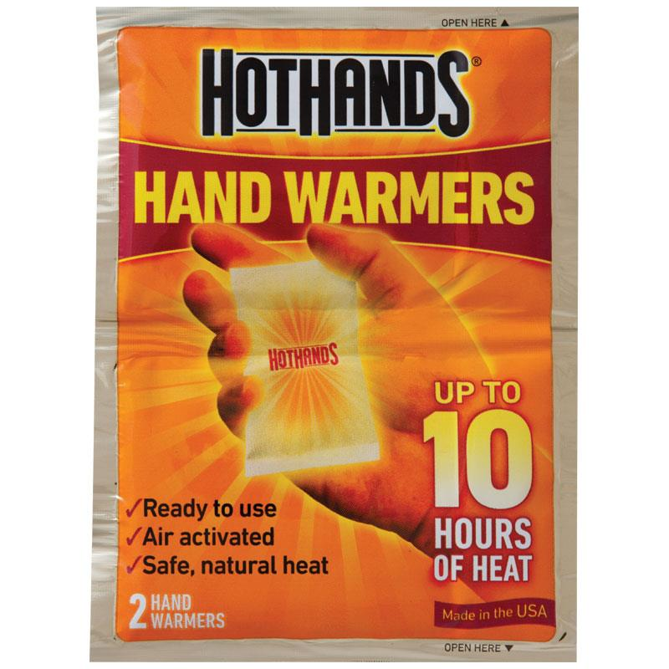
Solution Energy
The formation of some solutions are exothermic – they give off energy
Some substances need outside energy to dissolve, they are endothermic
Reusable hot and cold packs are examples of exothermic and endothermic solutions.
Concentration and Solubility
Copyright © McGraw-Hill Education

Slide 10
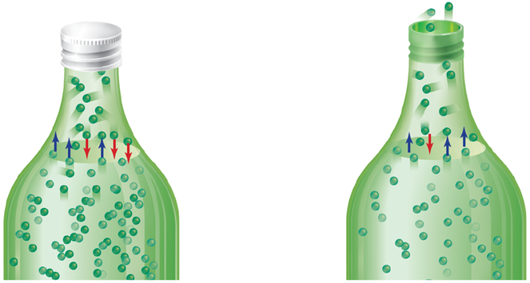
Solubility of Gases
Pressure effects
One way to increase the solubility of gases in liquid is to increase the pressure.
Soft drinks are bottled so that the pressure inside the bottle is higher than the pressure outside – this is why they bubble when opened. They will lose all carbonation if left unsealed. (Loss of high pressure)
Concentration and Solubility
Copyright © McGraw-Hill Education

Slide 11
Solubility of Gases
Temperature effects
Another way to increase the amount of gas that dissolves in a liquid is to cool the liquid.
This is why soft drinks stay bubblier when kept cold
Concentration and Solubility
Copyright © McGraw-Hill Education

