Slide 1
Section 2: Classifying Chemical Reactions
Reactions can be classified based on how atoms are rearranged.
K What I Know | W What I Want to Find Out | L What I Learned

Slide 2
Essential Questions
What are the five general types of chemical reactions?
How can you predict if a metal will replace another in a compound?
What do the terms oxidation and reduction mean?
How are redox reactions identified?
Classifying Chemical Reactions
Copyright © McGraw-Hill Education

Slide 3
Vocabulary
Review
states of matter
New
combustion reaction
synthesis reaction
decomposition reaction
single-displacement reaction
double-displacement reaction
precipitate
oxidation
reduction
Classifying Chemical Reactions
Copyright © McGraw-Hill Education

Slide 4
Types of Reactions
Chemists have defined five main categories of chemical reactions:
combustion
synthesis
decomposition
single displacement
double displacement
Classifying Chemical Reactions
Copyright © McGraw-Hill Education

Slide 5
Types of Reactions
Combustion reactions
A combustion reaction occurs when a substance reacts with oxygen to produce energy in the form of heat and light.
Many combustion reactions also fit into other categories of reactions.
Classifying Chemical Reactions
Copyright © McGraw-Hill Education

Slide 6
Types of Reactions
Synthesis reactions
In a synthesis reaction, two or more substances combine to form another substance.
The generalized formula for this reaction type is as follows:
A + B → AB
Classifying Chemical Reactions
Copyright © McGraw-Hill Education

Slide 7
Types of Reactions
Decomposition reactions
A decomposition reaction occurs when one substance breaks down, or decomposes, into two or more substances.
Reverse of a synthesis reaction
The general formula for this type of reaction type is:
AB → A + B
Most decomposition reactions require the use of heat, light, or electricity.
Classifying Chemical Reactions
Copyright © McGraw-Hill Education

Slide 8
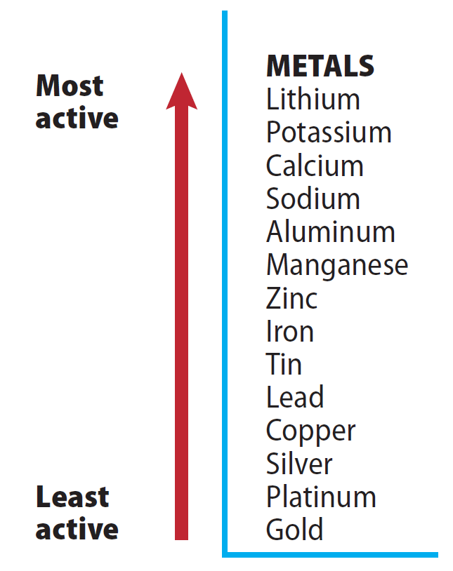
Types of Reactions
Single displacement
When one element replaces another element in a compound, it is called a single-displacement reaction.
Single-displacement reactions are described by the general equation
A + BC → AC + B
We can predict which metal will replace another by comparing how reactive they are.
A metal will replace any less active metal.
Classifying Chemical Reactions
Copyright © McGraw-Hill Education

Slide 9
Types of Reactions
Double displacement
In a double-displacement reaction, the positive ion of one compound replaces the positive ion of the other to form two new compounds.
The generalized formula for this type of reaction is as follows:
AB + CD → AD + CB
A double displacement reaction results in a precipitate, water, or a gas forming when the two ionic compounds are combined.
A precipitate is an insoluble compound that comes out of solution.
Classifying Chemical Reactions
Copyright © McGraw-Hill Education

Slide 10
Oxidation – Reduction Reactions
One characteristic that is common to many chemical reactions is the tendency of the substances to lose or gain electrons.
Oxidation: the loss of electrons
Reduction: the gain of electrons
The substance that loses an electron or electrons then becomes more positive, and we say it is oxidized.
The substance that gains an electron or electrons obviously becomes more negative, so we say it is reduced.
Oxidation and reduction are partners, and often referred to as redox.
Classifying Chemical Reactions
Copyright © McGraw-Hill Education

Slide 11
Oxidation – Reduction Reactions
Animation
FPO Add link to animation from page 593 here.
Classifying Chemical Reactions
Copyright © McGraw-Hill Education

Slide 12
Review
Essential Questions
What are the five general types of chemical reactions?
How can you predict if a metal will replace another in a compound?
What do the terms oxidation and reduction mean?
How are redox reactions identified?
Vocabulary
combustion reaction
synthesis reaction
decomposition reaction
single-displacement reaction
double-displacement reaction
precipitate
oxidation
reduction
Classifying Chemical Reactions
Copyright © McGraw-Hill Education

