Slide 1
Essential Questions
What are the reactants and products in a chemical reaction?
Is mass conserved in a chemical reaction?
Why are chemical reactions important?
How do you balance a chemical equation?
Chemical Changes
Copyright © McGraw-Hill Education

Slide 2
Vocabulary
Review
chemical formula
New
chemical reaction
reactants
products
chemical equation
coefficient
balanced chemical equation
mole
molar mass
Chemical Changes
Copyright © McGraw-Hill Education

Slide 3
Lavoisier and the Conservation of Mass
A chemical reaction is a change in which one or more substances are converted into new substances.
The substances that react are called reactants.
The new substances produced are called products.
This relationship can be written as follows:
Chemical Changes
Copyright © McGraw-Hill Education

Slide 4
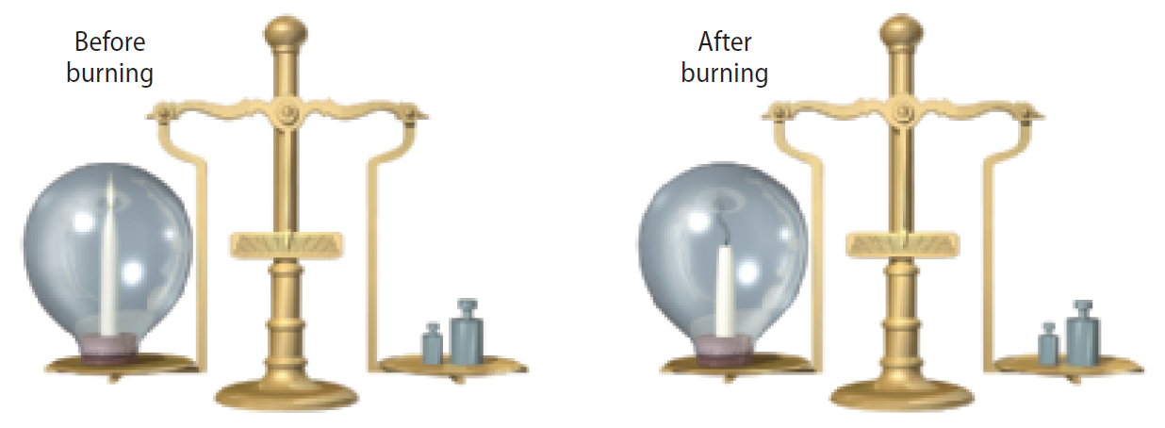
Lavoisier and the Conservation of Mass
The French chemist Antoine Lavoisier established that the total mass of the products always equals the total mass of the reactants.
The mass of the candles and oxygen before burning is exactly equal to the mass of the remaining candle and gaseous products.
Chemical Changes
Copyright © McGraw-Hill Education

Slide 5
Lavoisier and the Conservation of Mass
Lavoisier investigated what happened when substances changed form.
Experiment with mercury: placed a carefully measured mass of solid mercury (II) oxide into a sealed container
When he heated it , the red powder transformed into a silvery liquid, and a gas was produced.
The mass of the liquid mercury and gas was exactly the same as the mass of the red powder he had started with.
Lavoisier also established that the gas produced by heating mercury(II) oxide, which we call oxygen, was a component of air.
Chemical Changes
Copyright © McGraw-Hill Education

Slide 6
Writing Equations
Many words are needed to state all the important information about reactions.
Scientists developed a shorthand method, chemical equations, which describe a chemical reaction using chemical formulas and other symbols.
Chemical equations make it much easier to quickly and clearly identify reactants and products.
Chemical Changes
Copyright © McGraw-Hill Education

Slide 7
Coefficients
Chemical equations list more than just the chemical formulas of the reactants and products – they also convey the amount of each substance involved.
Coefficients represent the number of units of each substance taking part in a reaction. These numbers are used to balance the number of atoms on both sides of the chemical equation. ***Do not confuse coefficients with subscripts. Subscripts are for chemical formulas***
2Mg(s) + O2(g) → 2MgO(s)
2H2 + O2 --→ 2H2O
Chemical Changes
Copyright © McGraw-Hill Education

Slide 8
Balancing Equations
Lavoisier's mercury(II) oxide reaction can be written as:
Notice that the number of mercury atoms is the same on both sides of the equation but that the number of oxygen atoms is not the same.
According to the law of conservation of mass, one oxygen atom cannot just become two.
Chemical Changes
Copyright © McGraw-Hill Education

Slide 9
Balancing Equations
Choosing coefficients
The balancing process involves changing coefficients in a reaction to achieve a balanced chemical equation, which has the same number of atoms of each element on both sides of the arrow.
Chemical Changes
Copyright © McGraw-Hill Education

Slide 10
Balancing Equations
Try Your Balancing Act
To write a balanced chemical equation for this and most other reactions, follow these four steps:
Step 1
Write a chemical equation for the reaction using formulas and symbols.
Chemical Changes
Copyright © McGraw-Hill Education

Slide 11
Balancing Equations
Try Your Balancing Act
Step 1
Write a chemical equation for the reaction using formulas and symbols.
Step 2
Count the atoms in reactants and products.
Chemical Changes
Copyright © McGraw-Hill Education

Slide 12
Balancing Equations
Try Your Balancing Act
Step 1
Write a chemical equation for the reaction using formulas and symbols.
Step 2
Count the atoms in reactants and products.
Step 3
Choose coefficients that balance the equation.
Chemical Changes
Copyright © McGraw-Hill Education

Slide 13
Balancing Equations
Try Your Balancing Act
Step 1
Write a chemical equation for the reaction using formulas and symbols.
Step 2
Count the atoms in reactants and products.
Step 3
Choose coefficients that balance the equation.
Step 4
Recheck the numbers of each atom on each side of the equation and adjust the coefficients if necessary.
Chemical Changes
Copyright © McGraw-Hill Education

